Slide 1
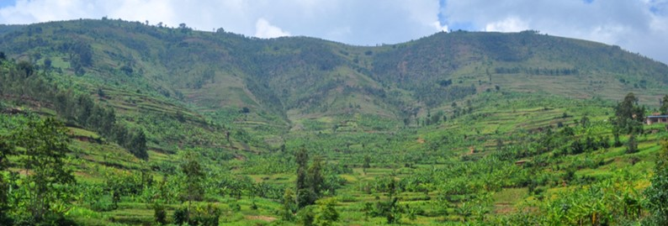
Decision Support for Mainstreaming and Scaling up of Sustainable Land Management
Country Presentation
Country: Thailand
Presentation made by: Dr.Bunjirtluk Jintaridth, Somsot Dumneonngam, Somsak Sukchan, Chettaruj Janplang, Prapa Taranet, and Apisit Boupai
Global Meeting of the DS-SLM Project
24 - 27 April 2018
FAO, Rome, Italy

Slide 2
Objectives of the project
01
Addressing Thailand’s challenges “ to combat desertification, land degradation and drought” (DLDD) by increasing national capacity of policy makers and field officers to demonstrate the potential of existing SLM technologies using FAO & WOCAT-LADA methodologies for national and local decision-support on combating DLDD
02
Promote scaling up of SLM best practices through DLDD and SLM knowledge management and decision-support platform at national, regional and global levels
03
Monitoring and evaluation and dissemination of project results
Colored infographic template

Slide 3
Ministry of Agriculture and Cooperatives Prime Minister’s Office Ministry of Foreign Affaires Ministry of Natural Resources and Environment Ministry of Interior Ministry of Digital Economy and Society Ministry of Science and Technology Ministry of Education CSO Private Sector
Institutional arrangements
National Steering Committee establishment
Land Development Department
The Government Public Relation Department
Bureau of the Budget
Office of the National Economic and Social Development Board
Department of Treaties and Legal Affairs
Department of International Organizations
Rice Department
Royal Irrigation Department
Department of Fisheries
Department of Livestock
Department of Royal Rainmaking and Agricultural Aviation
Department of Agriculture
Department of Agriculture Extension
Agricultural Land Reform Office
Office of Agriculture Economics
Foreign Agricultural Relation – Office of the Permanent Secretary
Department of Water Resources
Royal Forest Department
Department of Natural Park, Wildlife. And Plant Conservation
Office of Natural Resources and Environmental Policy and Planning
Office of International Cooperation on Natural Resources, and Environment
Thai Meteorological Department
Department of Disaster Prevention and Mitigation
Department of Local Administration
National Science and Technology Development Agency
Office of the Higher Education Commission
National Farmers Council
The Thai Chamber of Commerce
Agricultural Technology and Sustainable Agriculture Policy Division – Office of the Permanent Secretary

Slide 4
Integrating other projects to DS-SLM
LADA
(Land Degradation Assessment in Drylands)
WOCAT
(World Overview of Conservation Approaches and Technologies)
UNCCD & LDN
(United Nations Convention to Combat Desertification) & (Land Degradation Neutrality)
DS-SLM
FAO/MoAC/LDD
ASP/GSP
GIAHS (Globally Important Agricultural Heritage System)
Other GEF Thailand

Slide 5
Integrating practices
from
LADA
(Land Degradation Assessment in Drylands)
Soil information of Thailand

Slide 6
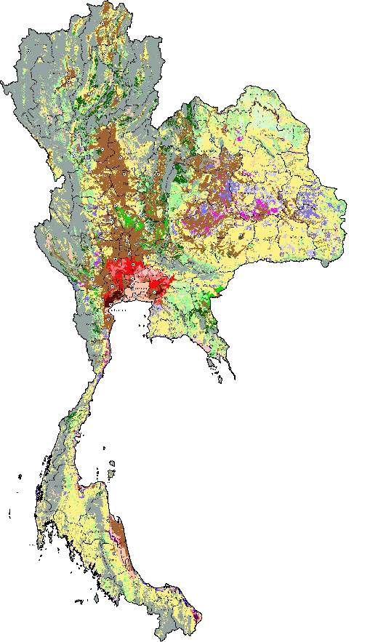
LADA
Land resources of Thailand
Total area = 513,120 sq km
Farming area = 278,400 sq km (54%)
Arable land = 120,000 sq km
Infertile land = 158,400 sq km
Causes of soil degradation in Thailand
Water erosion = 65.5%
Physical degradation = 24.3%
Chemical degradation = 7.3%
Biological degradation = 2.9%

Slide 7
LADA
Soil degradation
Problem soils
“Mainly human-induced with original soil characteristics having been adversely changed, resulting in lowering soil productivity”
“Major problems derive from inherent properties and inappropriate uses may worsen soil power environmentally and productively”
Infertile land
In Thailand

Slide 8
LADA
Problem soils in Thailand
Acid sulfate soils = 1.66%
Peat soils = 0.16%
Salt-affected soils = 6.77%
Coastal saline soils = 1.13%
Non-Coastal saline soils = 5.65%
Sandy soils = 2.22%
Sandy soils with hardpan = 0.16%
Sandy soils without hardpan = 2.06%
Shallow soils = 15.99%
Shallow soils with gravel mixed = 9.91%
Shallow soils with rubble mixed = 5.4%
Shallow soils with marl lime stone = 0.68%
Slope complex = 29.98%
Total area = 100%

Slide 9
Integrating practices
from
LDD
(Land Development Department)
“Volunteer Soil Doctor”

Slide 10
LDD
Soil doctors:
A capacity development and participatory approach for Sustainable Land Management (SLM) in Thailand
“Only 2,000 staffs of Land Development Department in which responsible for soil problems and management in Thailand, therefore it is not enough for implementing soil management and improvement.”
2,000 LDD staffs
VS
25 mil of farmers
Land Development Department (LDD), Ministry of Agriculture and Cooperatives is the core organization to conserve and improve soil resources for agricultural productivity, food security, and sustainable land use.

Slide 11
LDD
Volunteer soil doctors
At least 20 years of age, willing to work
Keen on land development activities and reside in concerning areas
General training, basic practices, observation, study tour, workshop and others
“How many?
83,243 of them in every village/sub-district/district/province of Thailand”
Young volunteer soil doctors
“How many?
5,460 students and 775 schools across Thailand
Students at age 10-12 (grade 5-7)
2 students and a teacher in each school
Be Trained in basic soil science (problem soils, organic fertilizer, green manure, bioextracts, vertiver grass)

Slide 12
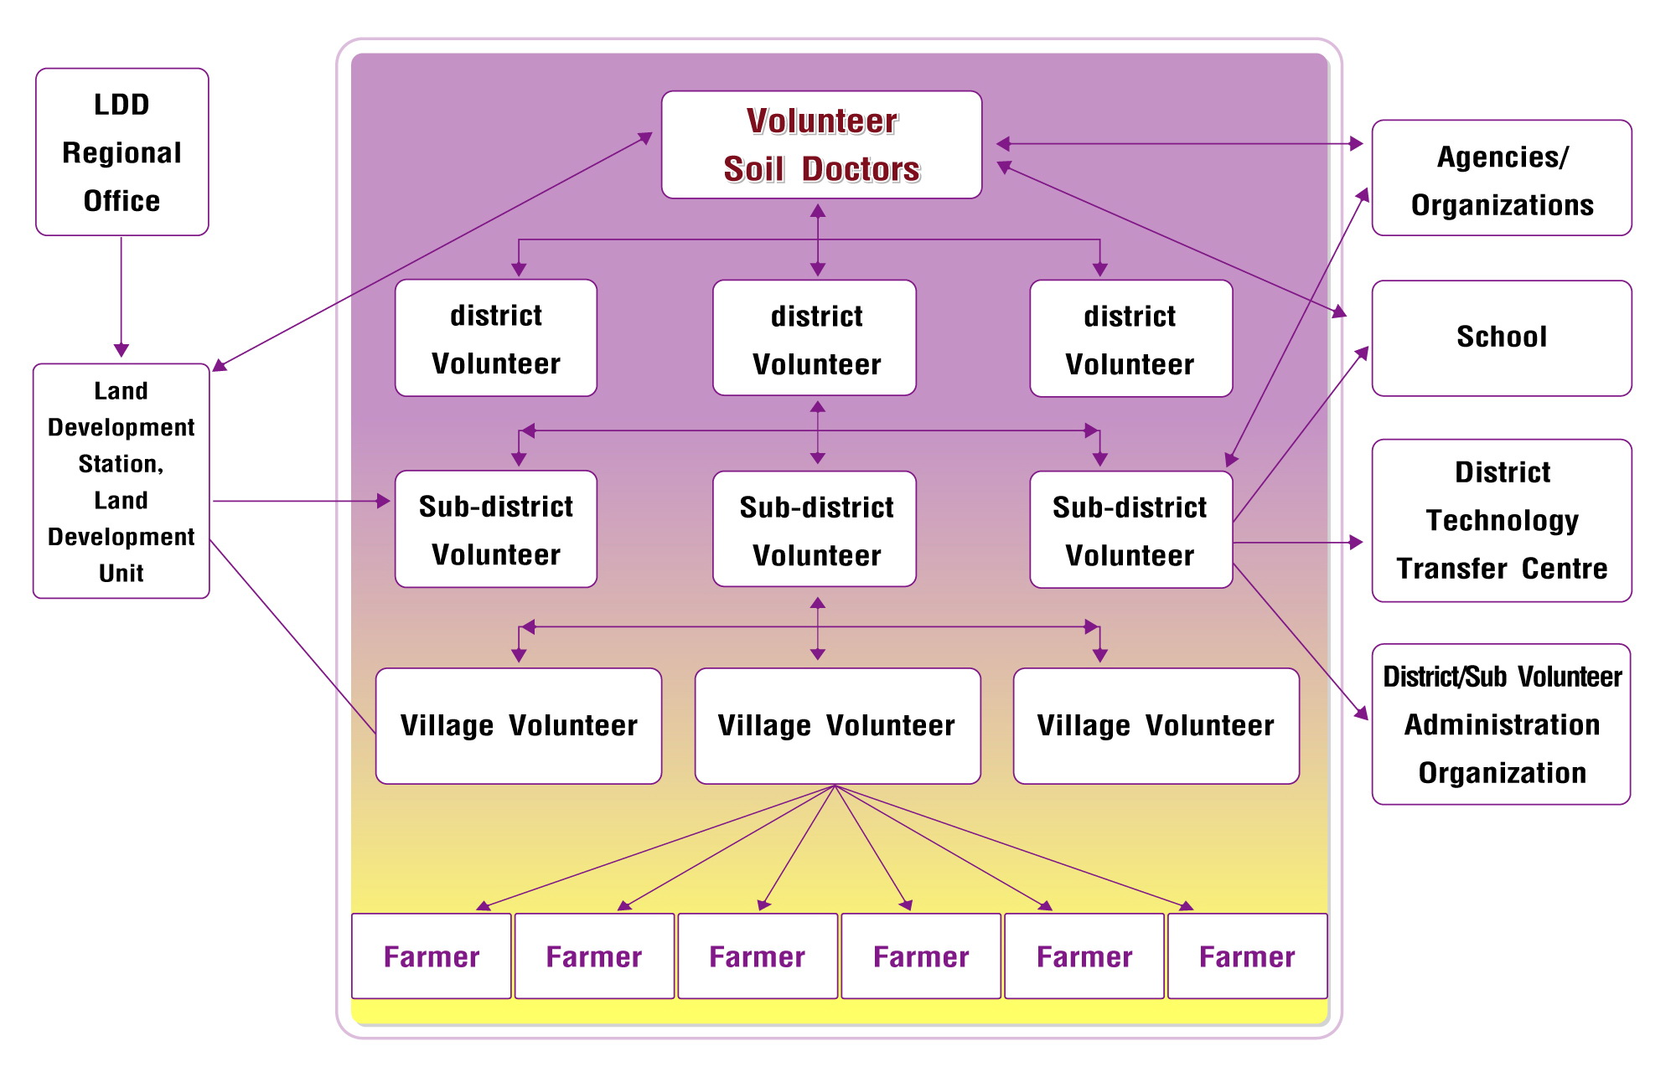
LDD
How’s soil doctors work

Slide 13
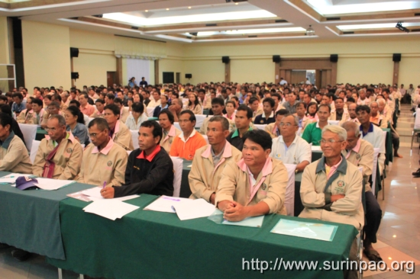
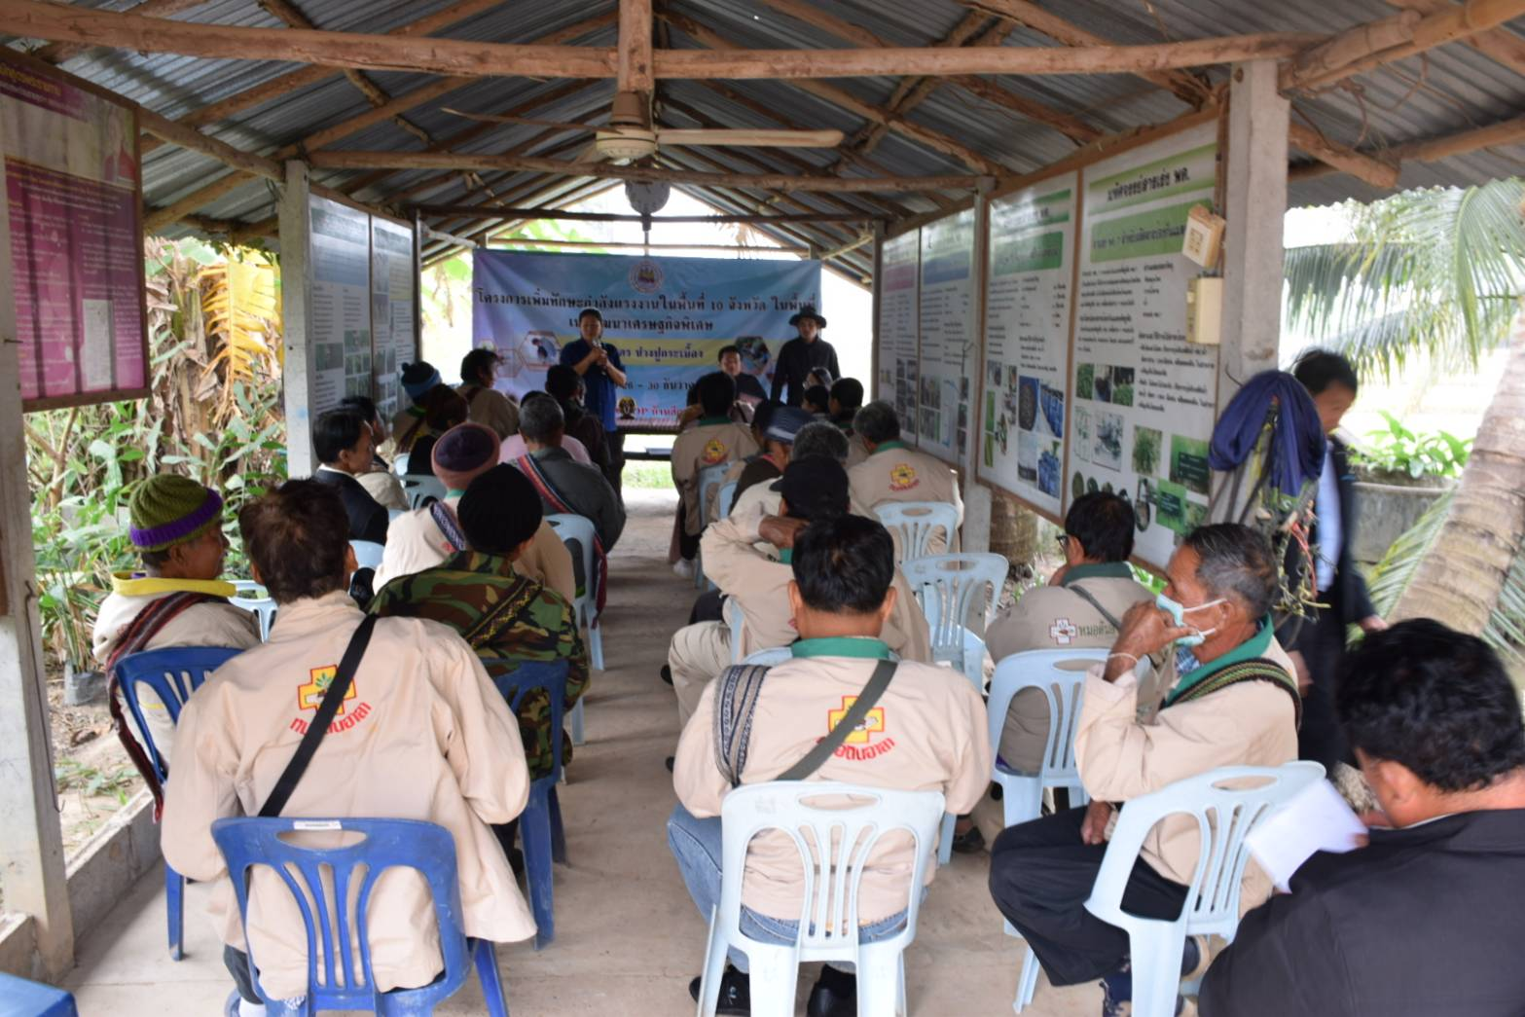
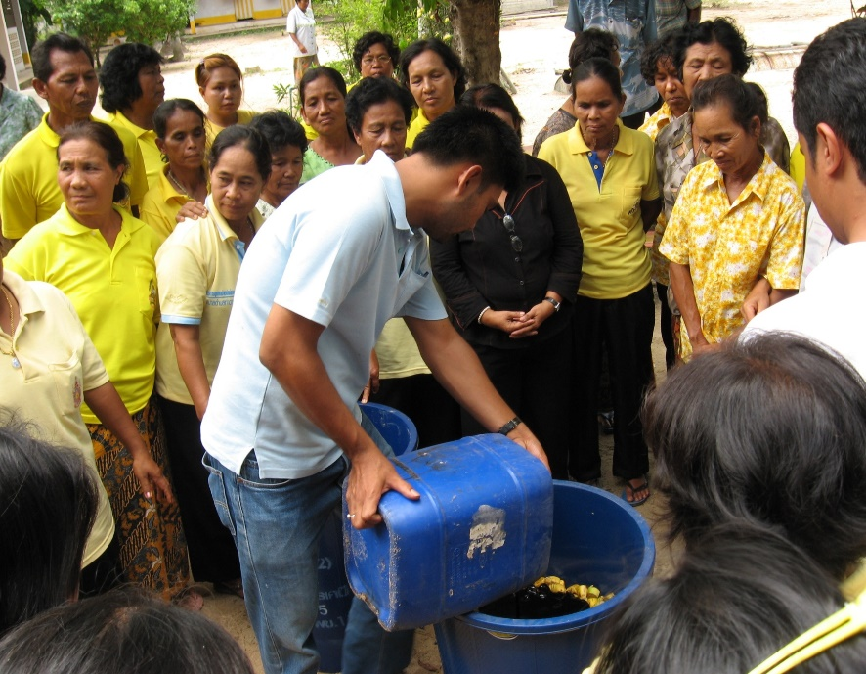
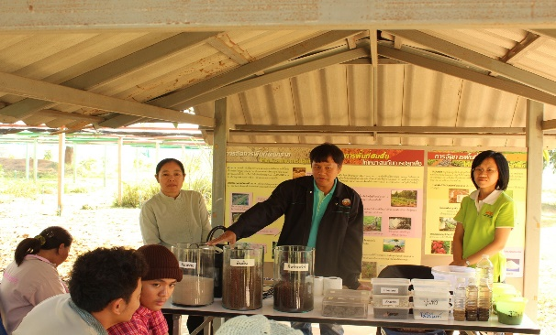
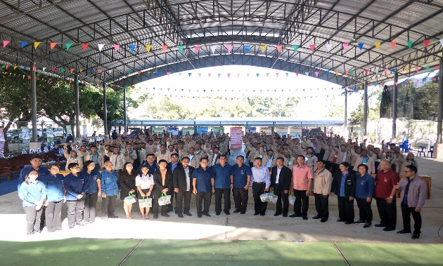
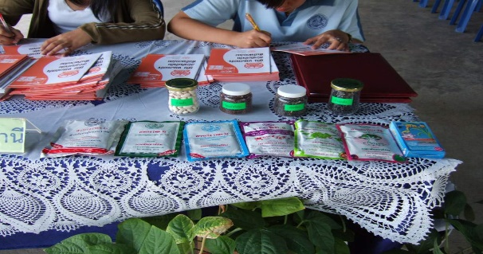
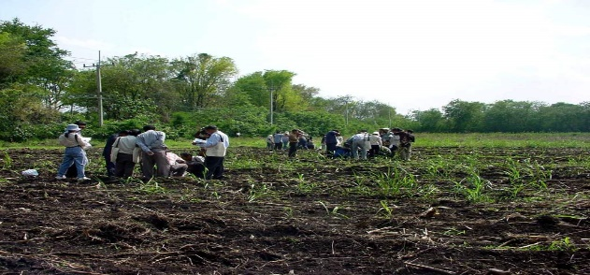
LDD
soil doctors’ activities

Slide 14
Integrating practices
from
LDN
(Land Degradation Neutrality)

Slide 15
LDN
“Amount and quality of land resources necessary to support ecosystem functions and services and enhance food security remain stable or increase within specified temporal and spatial scales”.
Tier 1-1: Land Productivity Dynamics (LPD)
Global/regional earth observation, geospatial information and modelling
Tier 1-2: Soil Organic Carbon (SOC)
National statistics based on data acquired for administrative or natural reference units
(e.g. watersheds) and national earth observation
Tier 2: Land use/cover change (LUC)
Field surveys, assessments and ground measurements
This approach enables national authorities to use methods consistent with their capabilities, resources and data availability and facilitates comparability at global level

Slide 16
LDN
Tier 1-1: Land Productivity Dynamics (LPD)
Forest → Cropland (ha)
Declining | Early signs of decline | Stable but stressed | Stable not stressed | Increasing | Total
522 | 2,763 | 16,326 | 18,468 | 19,863 | 57,942
Forest → Shrubs, grasslands and sparsely vegetated areas (ha)
Declining | Early signs of decline | Stable but stressed | Stable not stressed | Increasing | Total
513 | 1,557 | 12,249 | 23,958 | 86,494 | 46,971
* LPD derived from NDVI from 1999 to 2013 totally 15 years (10-day interval) (JRC,ESA)

Slide 17
LDN
Tier 1-2: Soil Organic Carbon (SOC)
Forest → Cropland
Sq km | In 2000 (ton/ha) | In 2010 (ton/ha) | In 2000 total (ton) | In 2010 total (ton) | 2000-2010 Total loss
588 | 84.0 | 62.8 | 4,938,993 | 3,692,601 | -1,246,392
Forest → Shrubs, grasslands and sparsely vegetated areas
Sq km | In 2000 (ton/ha) | In 2010 (ton/ha) | In 2000 total (ton) | In 2010 total (ton) | 2000-2010 Total loss
471 | 85.7 | 85.7 | 4,040,154 | 4,040,154 | 0
SoilGrids250m (ISRI – SOC%) : bulk density, gravel fraction 0 – 30 cm.
Soil profile + MODIS land products, SRTM DEM, climatic images, global landforms and lithology maps.

Slide 18
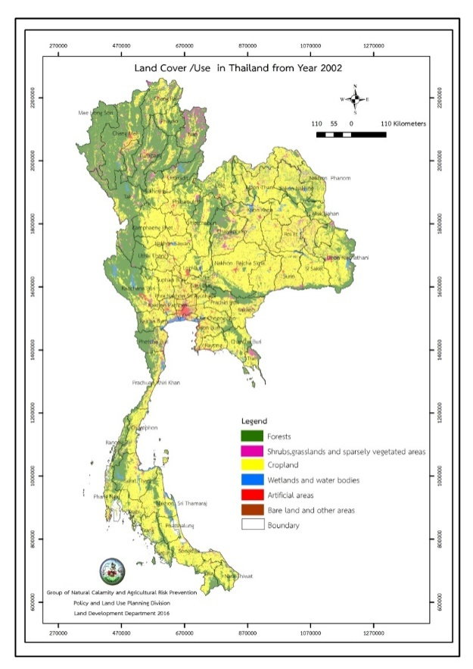
LDN
Tier 2: Land use/cover change (LUC)
Percentage changes
Forest [-4.88%]
Shrubs, Grasslands and sparsely vegetated areas [+12.25%]
Cropland [-4.07%]
Wetland and water bodies [+67.75%]
Artificial areas [+47.3%]
Bare land and other areas [+74.46%]
2002
2013

Slide 19
Integrated practice
from
UNCCD
(United Nations Convention to Combat Desertification)

Slide 20
UNCCD
Integrate the work of relevant agencies on soil, water, forest, drought, and community
Target 1: Increase the proportion of national forest cover through reforestation and rehabilitation degraded forest including headwater and mangrove forests by participation of local community.
Target 2: Restore and rehabilitate degraded land to be productive land, emphasized on sustainable agriculture.
Target 3: Reduce soil carbon loss and increase soil carbon sequestration by soil and water conservation and promote awareness raising and community participation in land management

Slide 21
UNCCD
Target 1: Increase the proportion of national forest cover through reforestation and rehabilitation degraded forest including headwater and mangrove forests by participation of local community.
- Review and conduct agricultural land use planning in consistent with national directions and development targets indicated in national strategy
Promote reforestation and fast growing trees especially at the household and community level under the appropriate concept and mechanisms such as tree banks in order to increase biodiversity and soil carbon stocks.
- Promote the development of community rules that relate to the forest conservation, reforestation in the area of forest complex that connects to the corridor of land owned by the state by participatory of all sectors

Slide 22
UNCCD
Target 2: Restore and rehabilitate degraded land to be productive land, emphasized on sustainable agriculture.
- Apply principle of sufficiency economy in agriculture, sustainable land development, good agriculture practices, organic farming, integrated farming and agricultural system enhance resilient to climate change in corporation with local wisdom
- Support and promote learning and land management for land degradation neutrality
- Formulate strategy and action plan to halt land degradation
- Increase efficiency of water management for agricultural areas

Slide 23
UNCCD
Target 3: Reduce soil carbon loss and increase soil carbon sequestration by soil and water conservation and promote awareness raising and community participation in land management
- Promote soil and water conservation measures by both mechanical and vegetative measures, appropriate soil improvement in agricultural areas in highland and lowland
- Promote campaigns to reduce stubble burning plant, control the forests burning and agricultural residues management
- Develop land productivity and soil organic carbon database in national level by 2022

Slide 24
DS-SLM
(Decision Support for Sustainable Land Management)

Slide 25
DS-SLM
Structure of the projects
Working I
Working II
Working III
Working IV
Working I – Secretariat & Administrative
Working II – Land Use Planning/LADA
Working III – SLM Field and Secretariat function Extension
Working IV – Policies, mainstreaming and Scaling-UP

Slide 26
DS-SLM
Working I – Secretariat & Administrative
Operate Strategy and Workplan
Establish project NPCU and Working Groups and Secretariat function
Staff, experts and consultants recruitment
Organize meetings, workshops and consultations at national and regional levels (4 regions)
Report project monitoring and progress
Establish manual on Operational Strategy
Develop Communication Strategy and Secretariat function
Organize awareness raising initiatives, and develop materials
Develop web portal, website, and webpage

Slide 27
DS-SLM
Working II – Land Use Planning/LADA
Activities
Collect datasets and information from LDD
Collect data from relevant departments and ministries
Translated data sets into English
Organize training of trainers on LADA/LUS
Organize Participatory Assessment Workshops and Stakeholders workshops in 4 regions
Translate Training modules in Thai
Invite other partners from Asia
Develop Land Use System
Output
List of participants from Training (70% men and 30%women)
Database and inventory of existing data and tools
Trained Technician and stakeholders (70% men and 30%women)

Slide 28
DS-SLM
Working III – SLM Field and Secretariat function Extension
Activities
- Organize Participatory stakeholders workshops in 4 regions (including demonstration and scaling up linkages at landscape level)
- Training modules in English and Thai
- Data collection from relevant departments and ministries
- Translated documents (QA&QT into Thai and English)
- Organize training of trainers on QA&QT by WOCAT
Output
- Database of demonstration sites
- Database & inventory of existing data and tools
- List of participants from Training (60/30 men/women); Invite other partners from Asia
- APP of QA& QT
- Document at least 10 SLM good practices per region

Slide 29
DS-SLM
Working IV – Policies, mainstreaming and Scaling-UP
Activities
- Establish inter-sectoral partnership mechanisms on SLM
Organize local participatory SLM strategic planning, indicators, ecosystem services, incentives, financing, LDN, LUP, scaling out, etc. at landscape level workshops and trainings
Organize national workshop on scaling up SLM
Output
Strategy Paper on Enabling SLM mainstreaming at national and regional levels, SWOT, SLM adoption
Input to CCD Strategy
Consultant’s report and Review of existing policies and institutions
Consultant report on how to integrate SLM within existing policies and institutions

Slide 30
DS-SLM Roadmap
3) Publication Report
- Publications
- Communications
- Reports
4) Event
- National events
- Regional events
- Mainstreaming workshops
Aug-Dec 2018
Jun 2018-Feb 2019
6) Scaling out
- Policy brief
- Stratergy & Action plan
2) Data Collection
- Identify & Monitoring
- Develop Database
- Field support
Dec 2018
1) Training Workshop
- Training for trainer
- Knowledge sharing
- QA/QT
Jun 2018-Mar 2019
5) Technology
- Develop database system
- Develop online platforms
- Land use system GIS
May-Dec 2018
May-Dec 2018

Slide 31
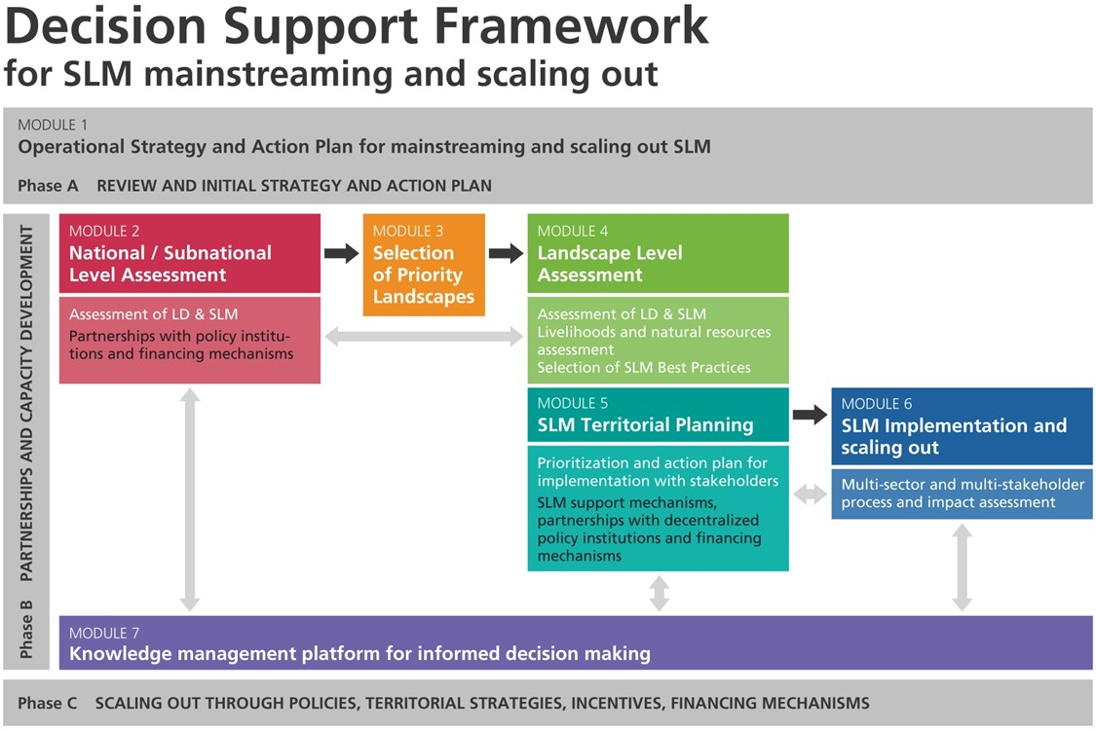
DS-SLM Methodological framework

Slide 32
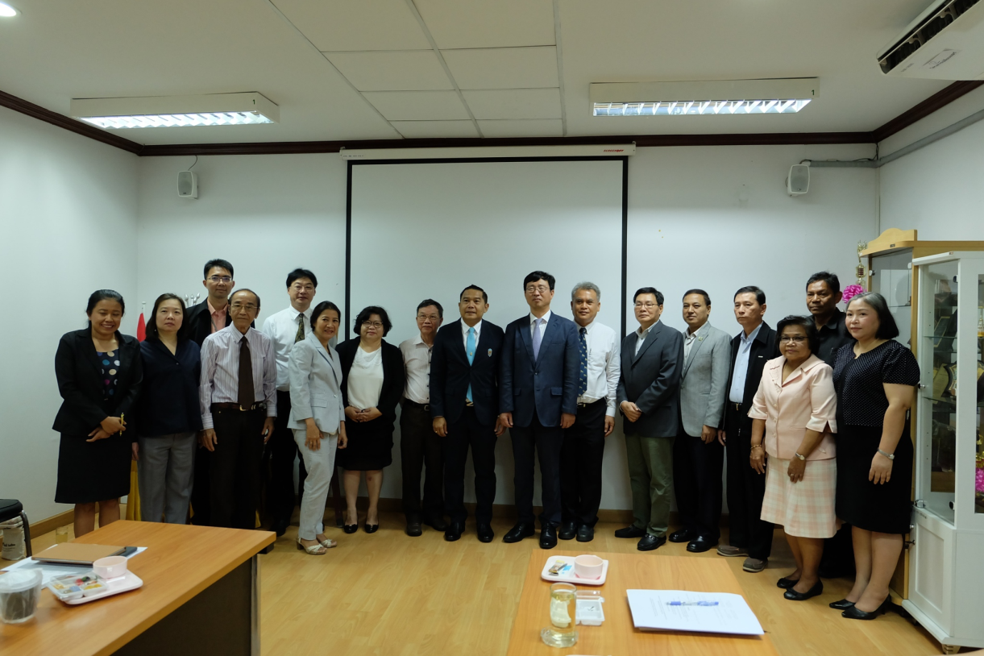
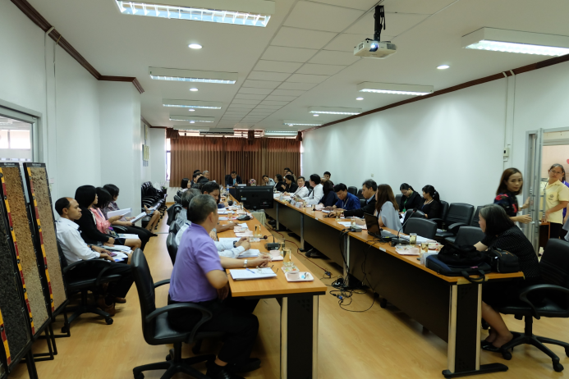
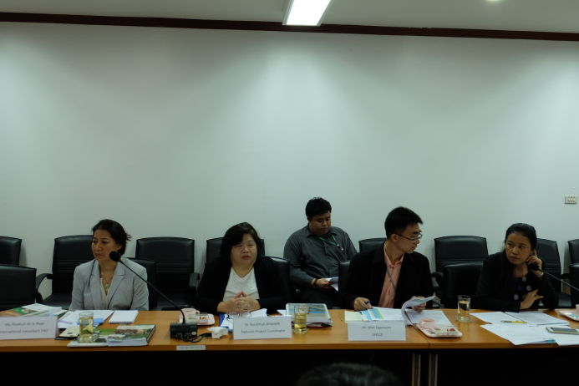
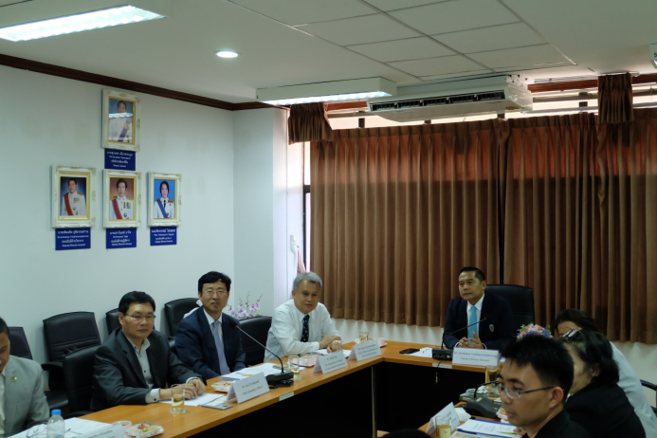
Module 1 Mainstreaming strategy
Inception workshop
8th March 2018
Consultation and Inception Workshop on the Implementation of the Thailand National Project Component
Overview of the Global Project
Thailand Project Workplan
FAO Operational Procedures
Project Roadmap

Slide 33
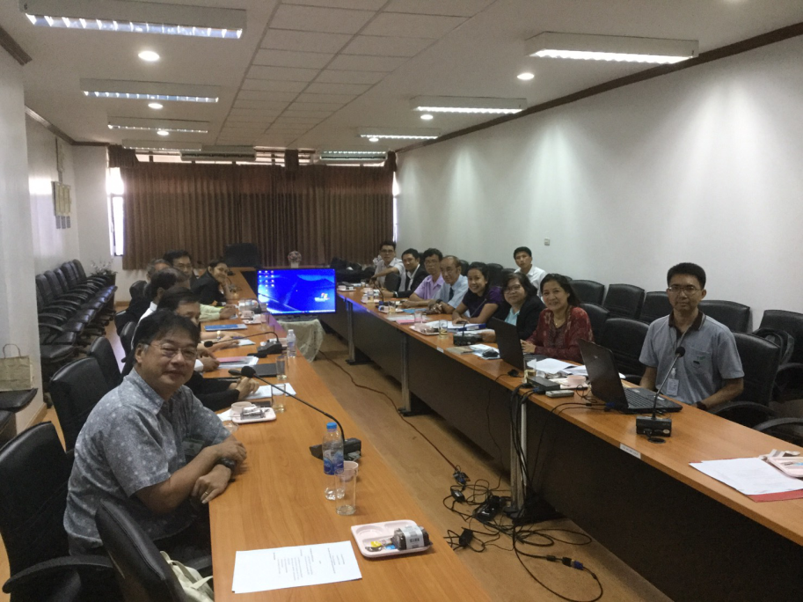
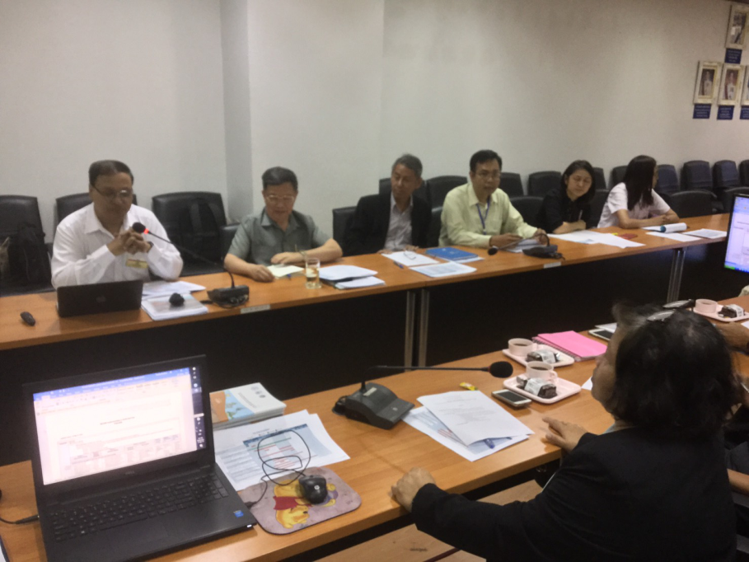
Module 2. National /subnational assessment
11th April 2018
Consultation and Inception Workshop on the National and subnational land use assessment in Thailand
Land use system and GIS workplan
Policy and Land use Planning Division will provide satellite maps including of land use maps, soil series maps, soil fertility maps, regional maps for making a decision and assessing areas
Research and Development for Land Management Division will provide data of soil doctors, organic farming groups, problem soil managements, and good practices for SLM which are appropriate land use assessment

Slide 34
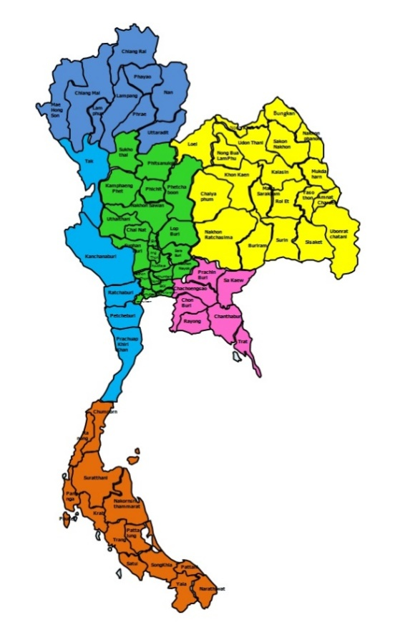
Module 3. Selection of priority landscapes
Team I: Northern Region
Slop complex
Soil conservation
Team II: Northeastern Region
Salt-affected soils
Saline soils
Team III: Central & South Region
Acid sulfate soils
Organic soils
Team IV: Western & Eastern Region
Sandy soils
Shallow soils
Lateritic soils
Each team consists of consultants, central & regional administrative staffs, stakeholders, companies, partners, etc.
Each team will collaborate with Soil doctors, farmer groups, and other teams supporting by FAO, NPCU, and Committees

Slide 35
The project structure
National Steering Committee
(UNCCD Sub-committee, Technical)
Working group # 1
FAO
Thailand
(LDD as NEA)
Working group # 2
Consultants
WOCAT
Working group # 3
Working group # 4
Lead Consultant

Slide 36
QA/QT Procedures
QT contents (short version)
QA contents (short version)
Introduction to the questionnaire
1. General information
2. Description of the SLM Technology
3. Classification of the SLM Technology
4. Technical specifications, implementation activities, inputs, and costs
5. Natural and human environment
6. Impacts and concluding statements
7. References and links
Introduction to the questionnaire
1. General information
2. Description of the SLM Approach
3. Participation and roles of stakeholders involved
4. Technical support, capacity building and knowledge management
5. Financing and external material support
6. Impact analysis and concluding statements
7. References and links

Slide 37
Land Use Systems (LUS) map
LUS is a base map and is basis for assessment of LD & SLM
LUS includes (secondary)data on land management, inputs and socioeconomic conditions
LUS map helps to provide information on drivers and impacts of LD (DPSIR)
Land use/cover
Livestock density, Irrigated area
Slope classes, Soil type, Elevation
Protected areas
Climate (temperature, rainfall),
Population density (provincial level), Rural/urban population, Poverty index
Basis could be AEZ or 4 sub-regions in a country.
Scale to be determined: 250K to 500 K
500-600 mapping units
Validation of LUS map
Data consideration for LUS map
Land cover (Level – I Built-up, agriculture, range/shrubland, forest, plantations, water, wetland, Barrenland or Level II)
Cropping pattern/ crop intensity
Irrigation (area, intensity, planned)
Input use (fertilizers, chemicals, mechanization)
Protected areas types
Livestock population/density
Climate classes or (Climate data: temp., rainfall, LGP)
Soil properties
Terrain (elevation, slope, aspect) or terrain index map
Administrative boundaries
Population density
Poverty
GDP
Land ownership
Others (problem soils, wetland/mining exploitation, specific environmental issue presence)

Slide 38
Potential Technologies for SLM
Cover crop
Vertiver grass
Climate change database
Local organic fertilizer factory
LDD Products
Royal Projects
Soil maps
Soil conservation
MoAC Dtabase

Slide 39
Conclusions- lessons learned
Land Development Department (LDD), Ministry of Agriculture and Cooperatives that is the core organization to conserve and improve soil resources for agricultural productivity, food security, and sustainable land use will be a leader to run the DS-SLM project supporting by National steering committee, stakeholders, companies, farmer groups, and other countries.
Integration from previous projects (LADA, WOCAT, LDN, and UNCCD) will be adopted to DS-SLM by sharing connections, knowledge, data, information, or tools with each others.
Land management in Thailand needs new technology and know-how with existed knowledge to drive policies against poverty and land degradation.

Slide 40
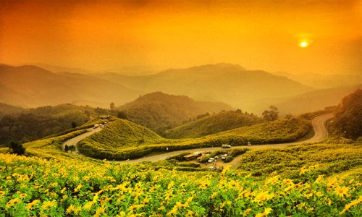
Thank you

