Slide 1



LDN ToolBox Training
Nairobi, 2-6 October 2023
Ingrid Teich
Senior Research Scientist
UniBern, CDE / WOCAT

Slide 2
Many more tools!
In the LDN ToolBox there are many more tools to support achieving LDN
LandPKS
WOCAT SLM database
Open Foris Tools
And many more…

Slide 3
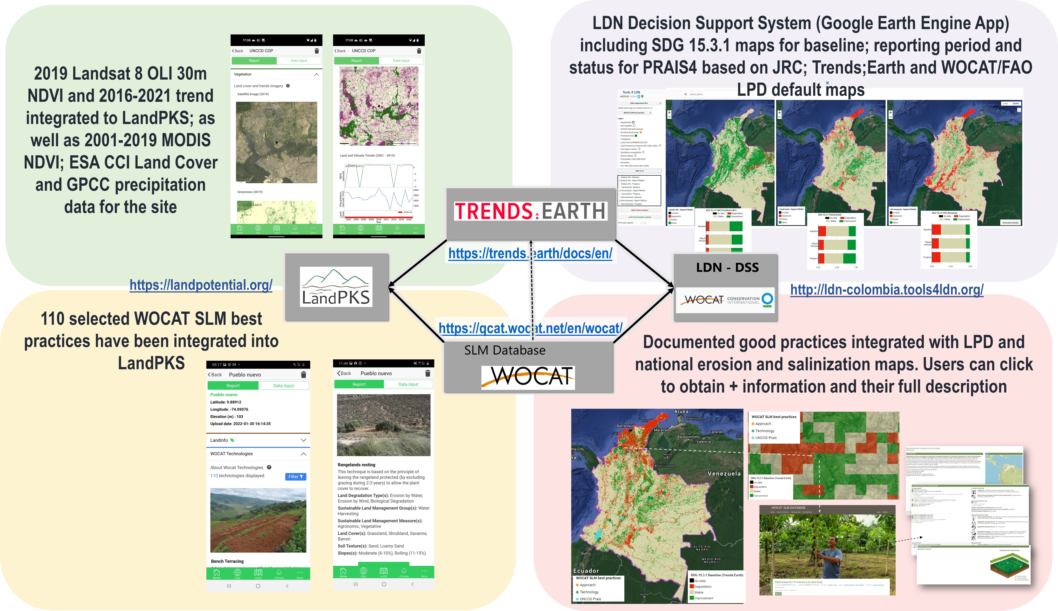
Integration of tools & interoperability: Tools4LDN

Slide 4

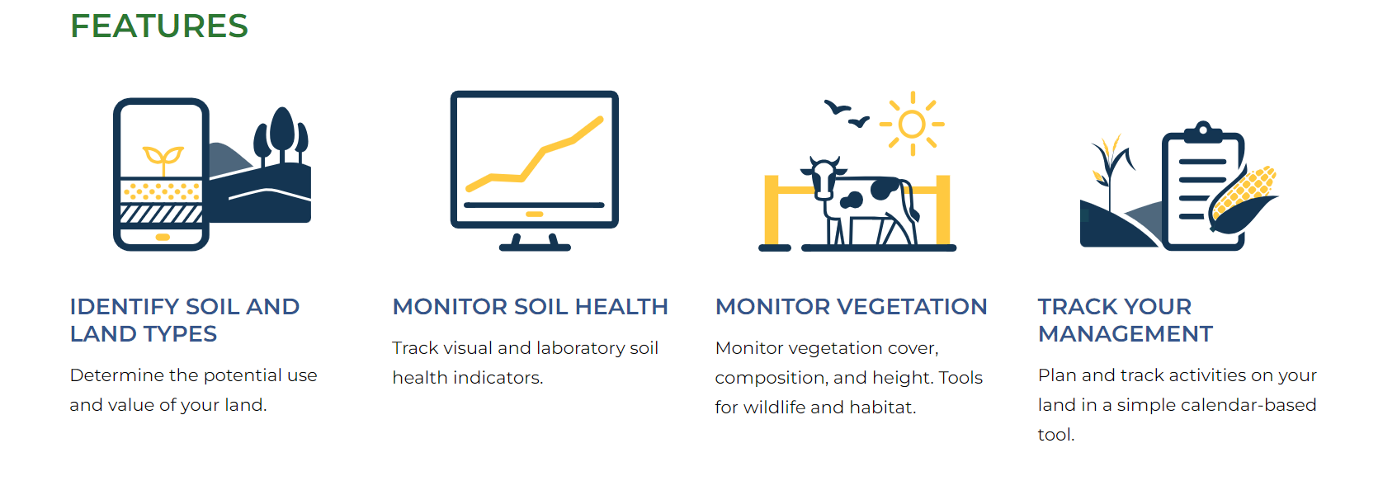
LandPKS
https://landpotential.org/

Slide 5
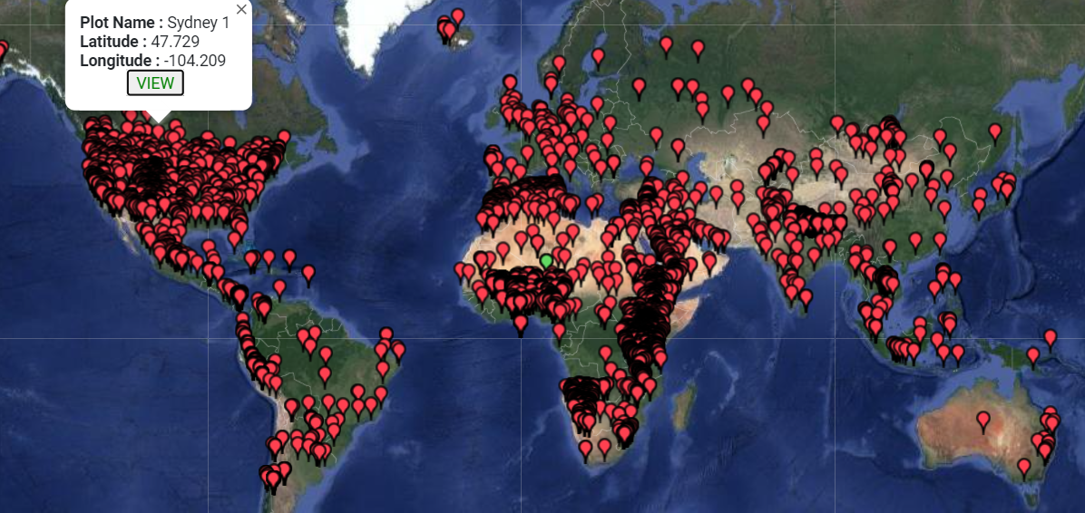

Slide 6
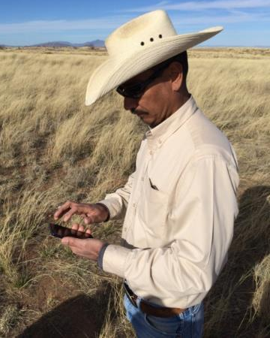
Why use the LandPKS application?
a) To help in determining land potential;
b) To access information from Trends.Earth;
c) To access information from WOCAT;
d) To quantify and monitor land cover and soil health
Emilio Gutierrez on the Santa Rita Ranch, Arizona

Slide 7
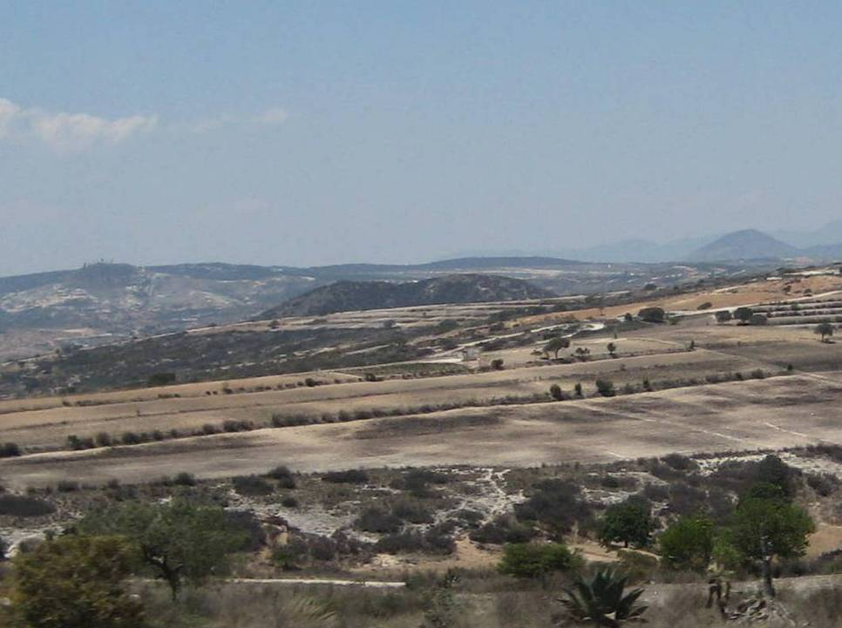
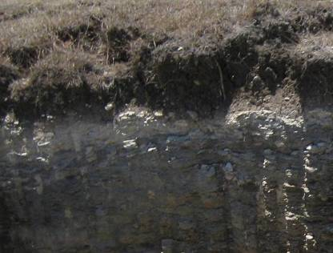
Why is it important to understand land potential?
To determine how to:
avoid degradation
restore and
produce better in each place

Slide 8
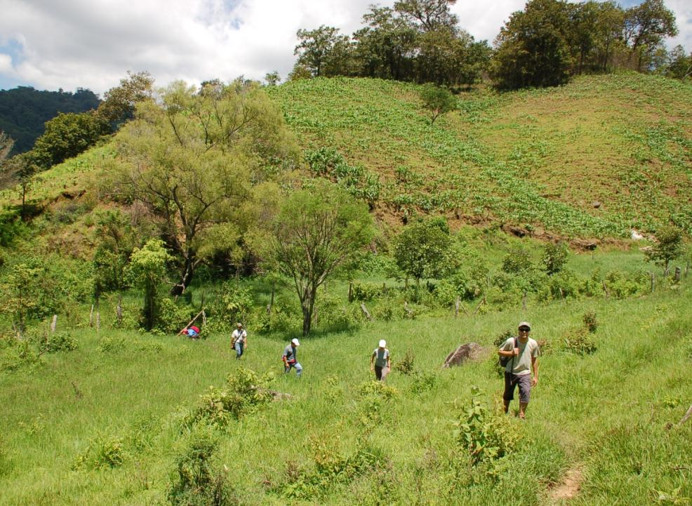


Salud de Pastizales
⬄
Salud de Comunidades
Challenge: sustainable land use → objective land evaluation + planning tools
Options!
Maize
Erosion + low yields
Un Sistema para el Manejo de Pastizales en el Contexto del Paisaje y la Aptitude de Suelos para Actividades Pecuarias
Pasture
Notes:
Even within the existing land use and land tenure system, however, production may be maintained and sustainability increased by limiting production to the more gently sloping, concave, run-in parts of the hillside (which will also have deeper, richer soils), and concentrating fertilizer inputs and management on those areas. ROI = Return on Investment.

Slide 9
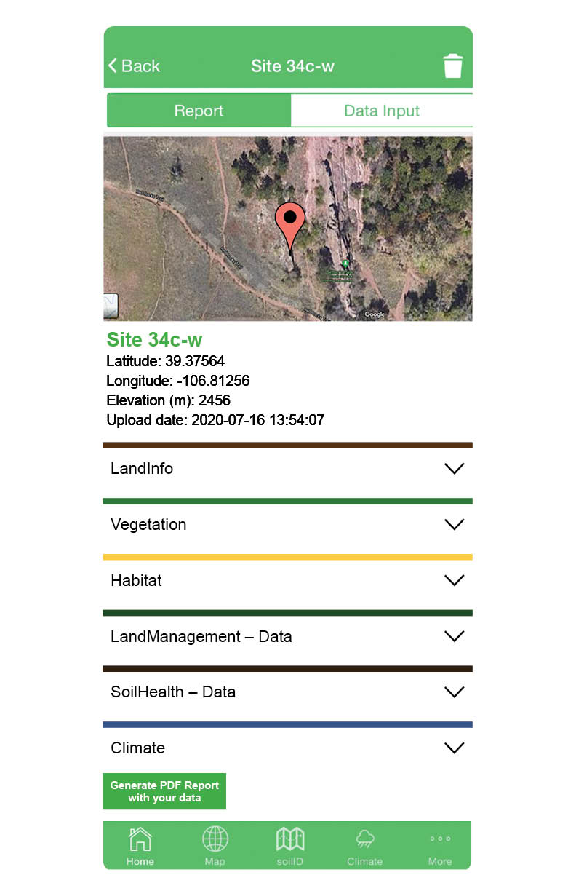

Field Access to Land Information!
WOCAT Technologies
FAO + ISRIC Soil Info
WOCAT Technologies

Slide 10



Access site-specific
data to understand
land
POTENTIAL
+
CURRENT CONDITION
Adopt innovative management
strategies to
AVOID, REDUCE,
RESTORE
Collect monitoring
data to
VERIFY TRENDS
+
IMPROVE
Report to UNCCD
using the new
integration with
PRAIS

Slide 11
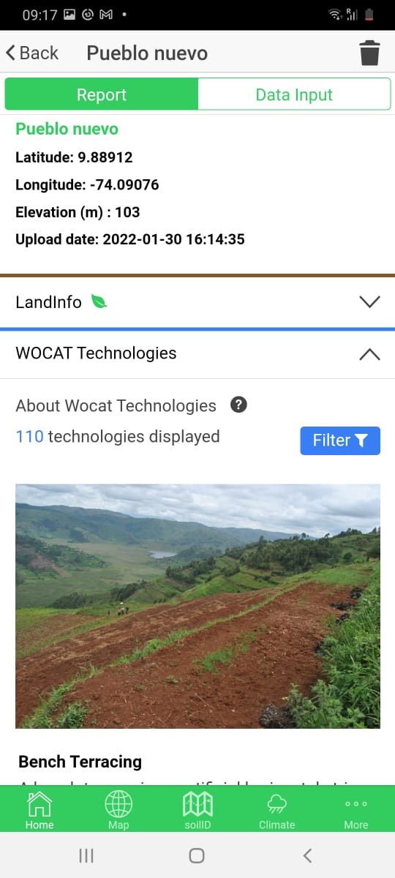
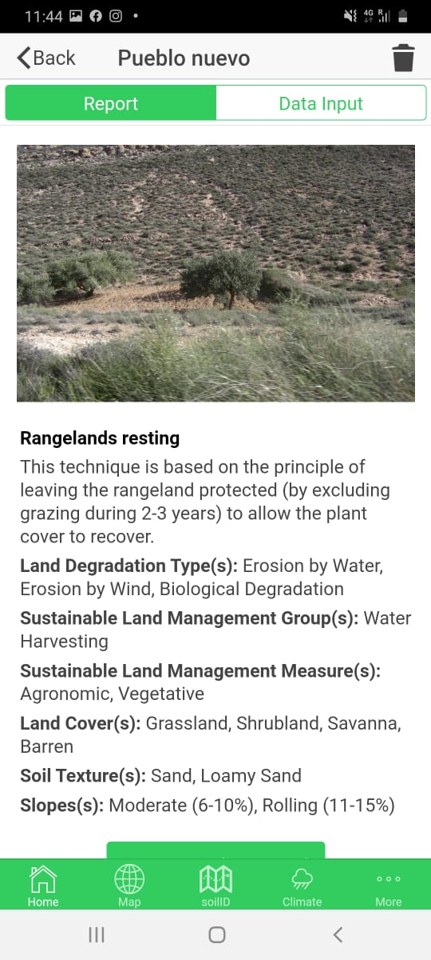
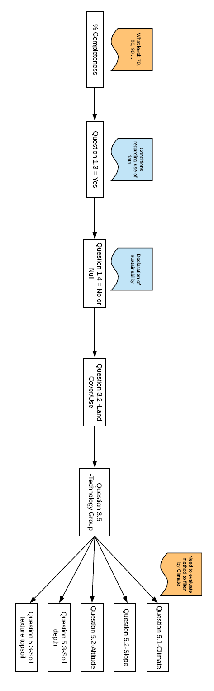
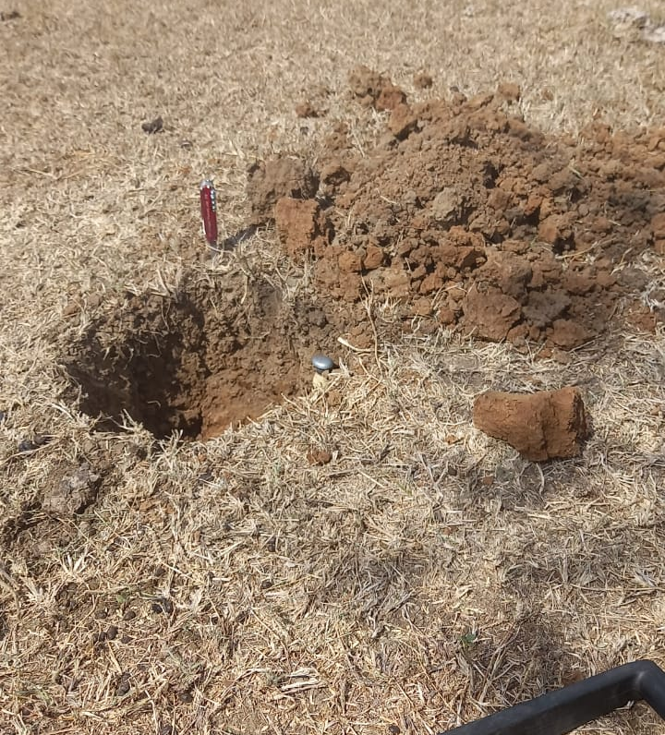
WOCAT and LandPKS
110 selected WOCAT SLM best practices have been integrated into LandPKS
Filtering by:
LandPKS cover typeSLM Group
SLM Measure
Land Degradation
Annual Rainfall
Agroclimatic Zone
Slope
Altitudinal Zone
Soil Depth
Soil Texture (topsoil)
Market Orientation
Scale

Slide 12
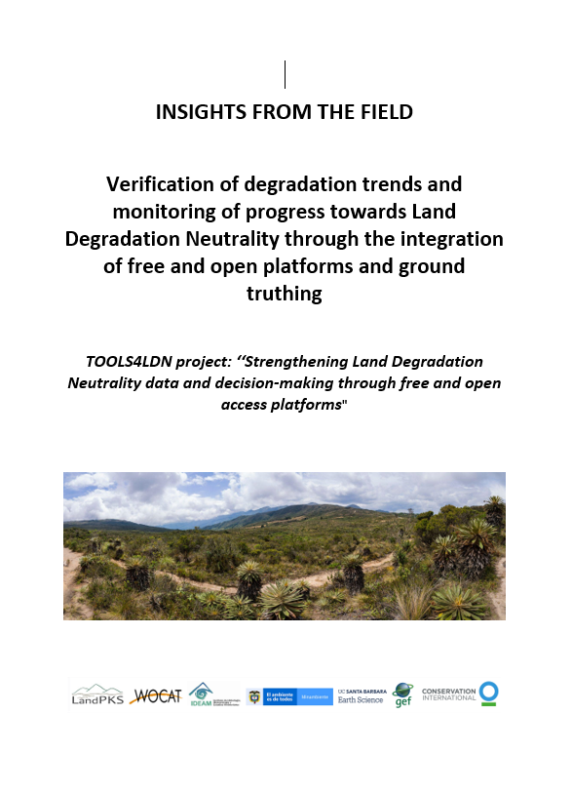
Integration of tools & interoperability: Tools4LDN
Challenges:
Selection of representative locations/sites
Land Use Types / Cover not mapped well
Different results from different methods, verification missing
→ Field reality not properly reflected

Slide 13
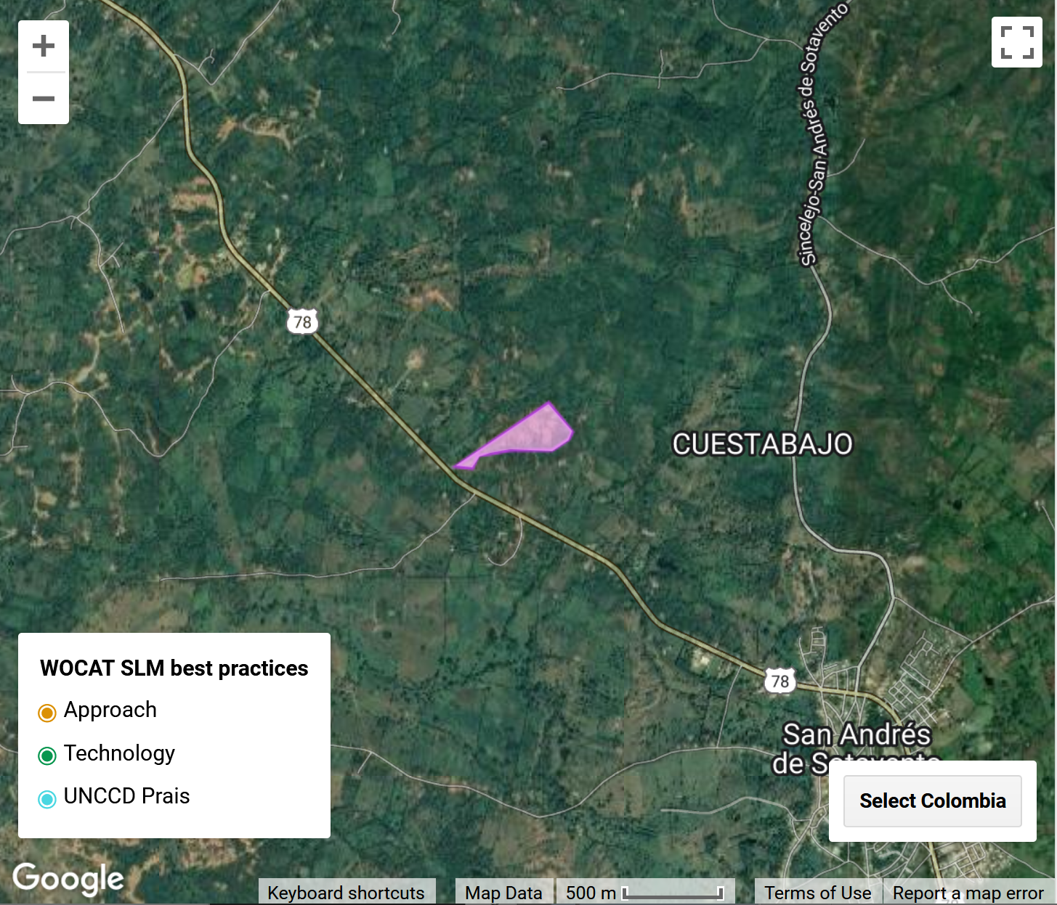
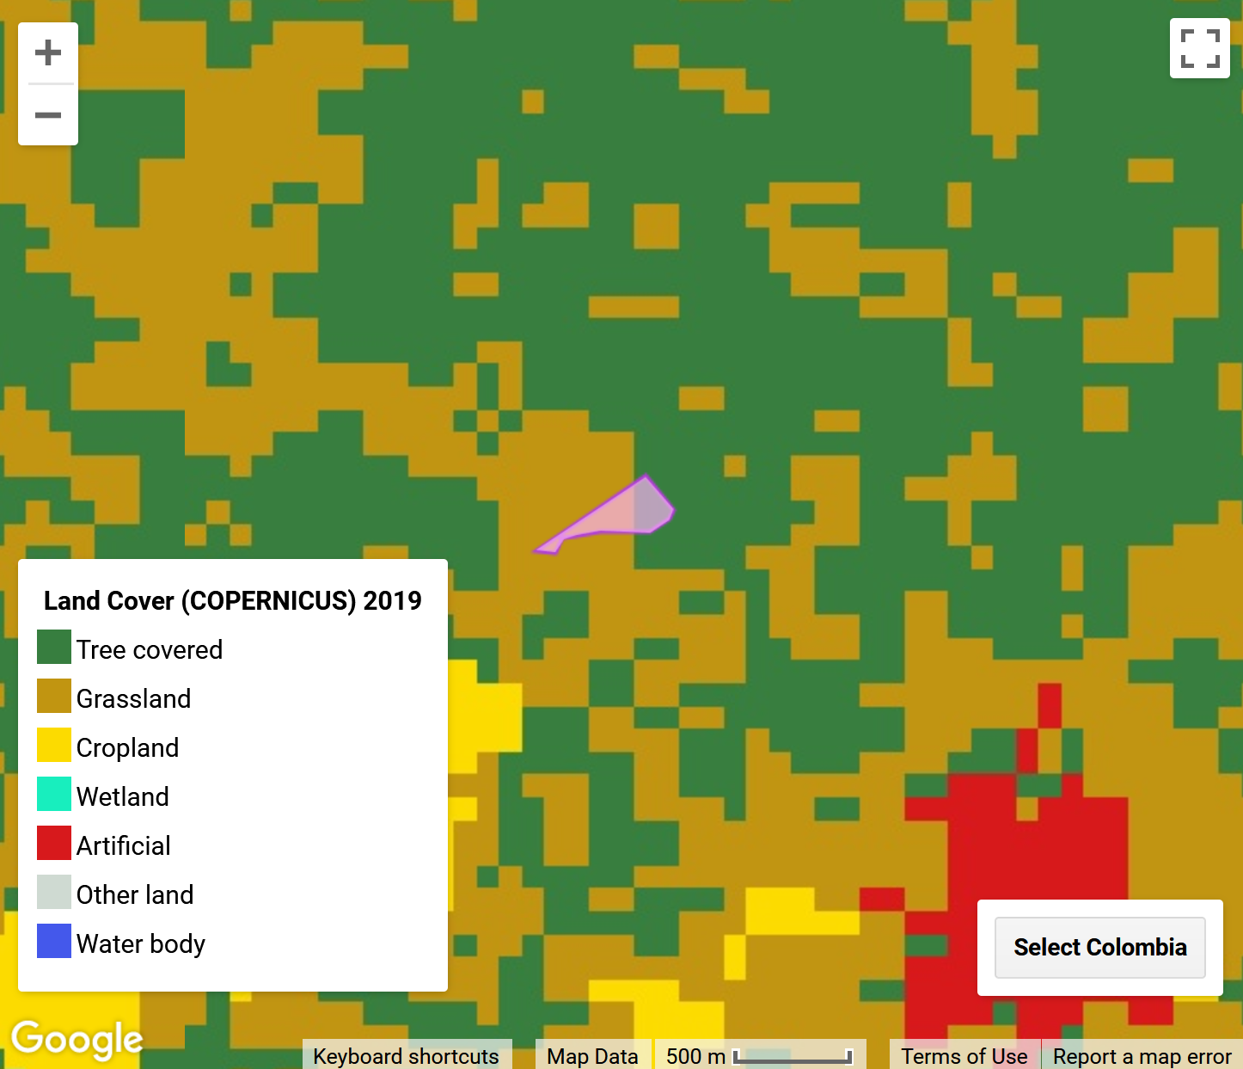
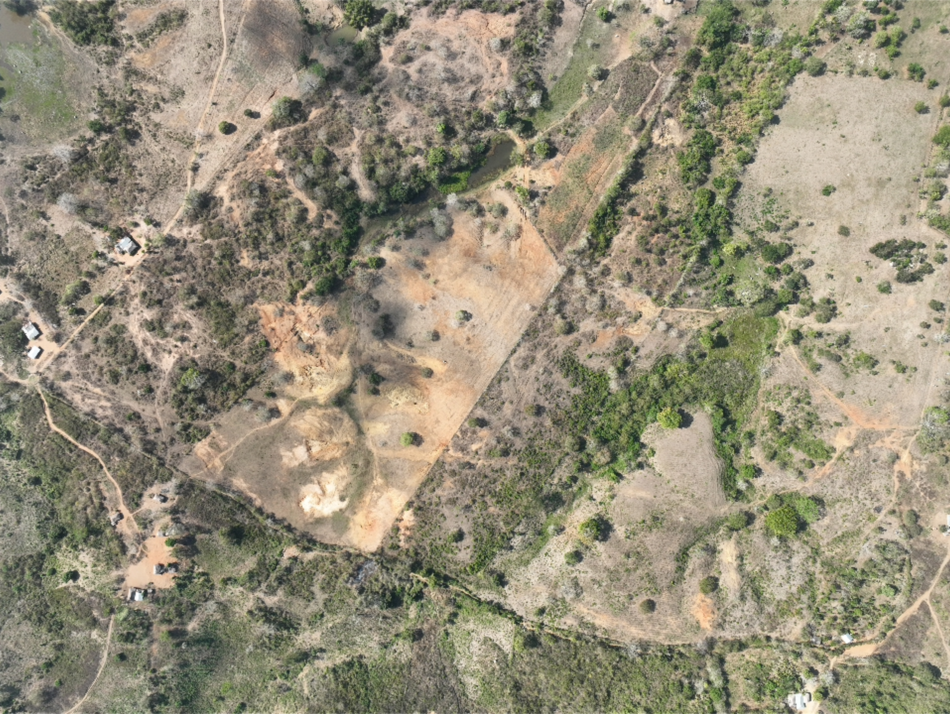
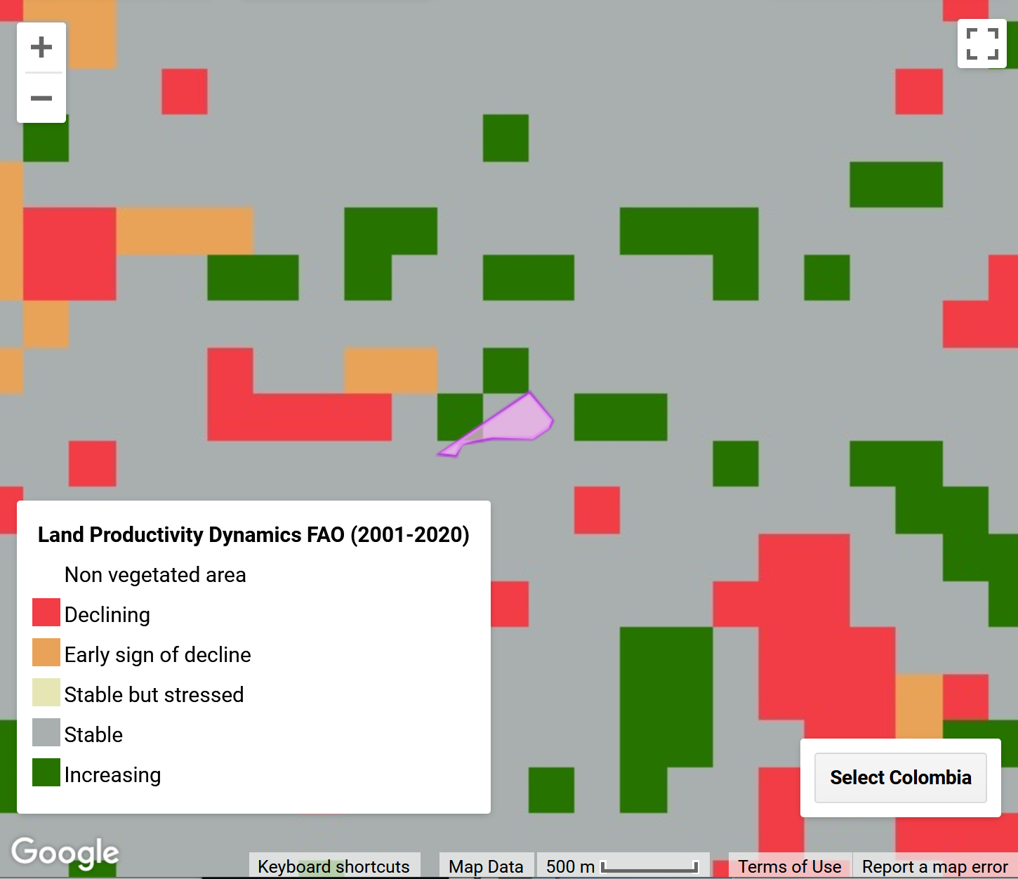
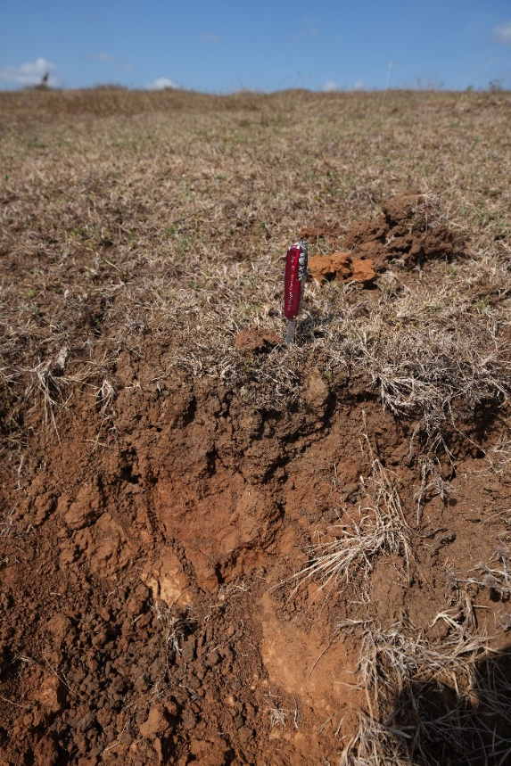
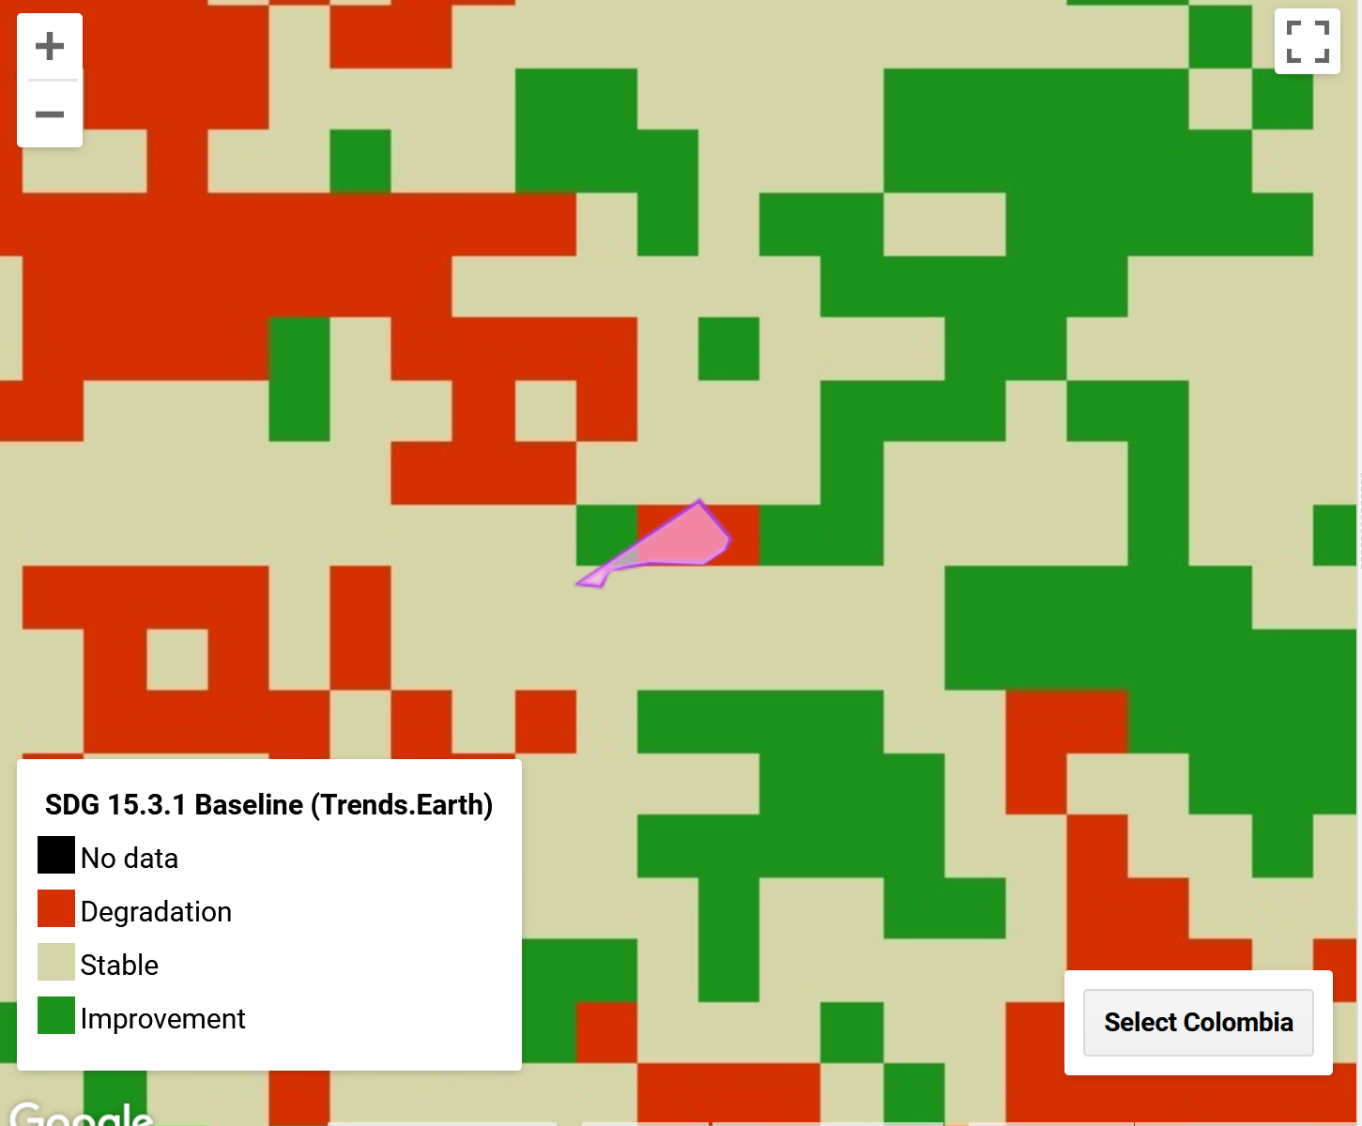
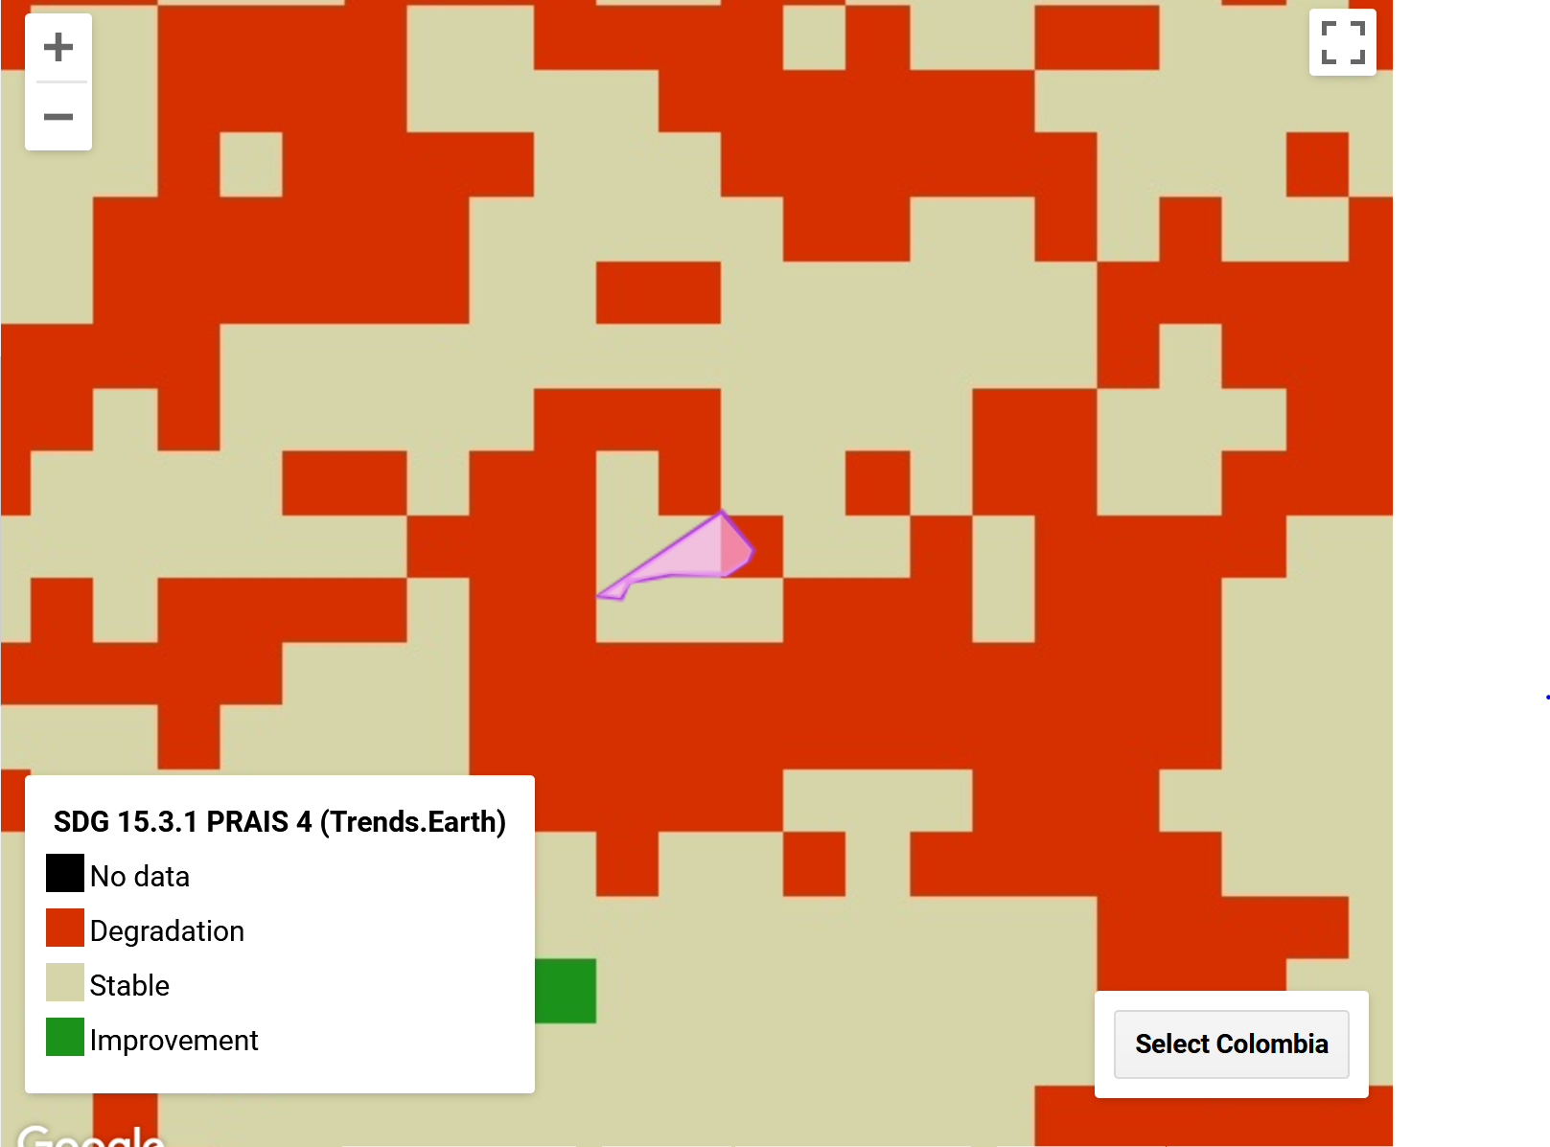
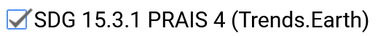
Field testing in Colombia
DRONE IMAGE
SOIL POTENTIAL
2 regions
25 sampling sites

Slide 14
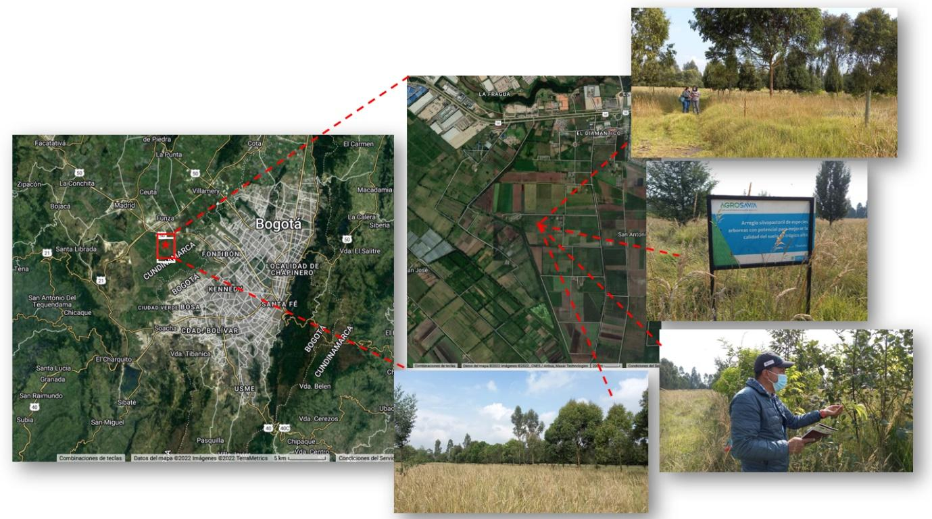
Field verification & land use history
1
In this area Agrosavia implemented a SLM technology in 2014 consisting of an “Silvopastoral arrangement of tree species with potential to improve soil quality in the high tropics”, where 2 native species and 2 exotic species species (Aliso, Cafeto, Eucaliptus and Alamo) are planted in stripes within the grassland. Therefore it is expected to find an improvement in this area, especially in the reporting period.
Coordinates Lat-Lon: 4.684577, -74.21134

Slide 15
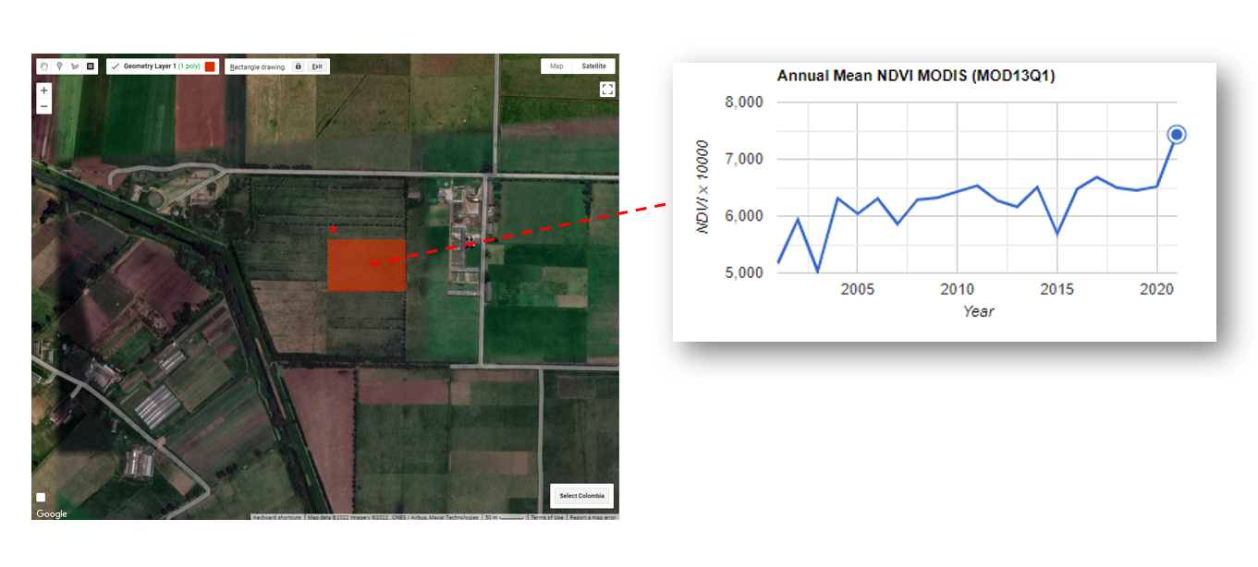
Using the LDN DSS… analysis of NDVI trends
2
According to the Annual mean NDVI time series, the area has shown an increase in productivity from 2000 to 2022, particularly after 2015, as expected by the land use change.

Slide 16
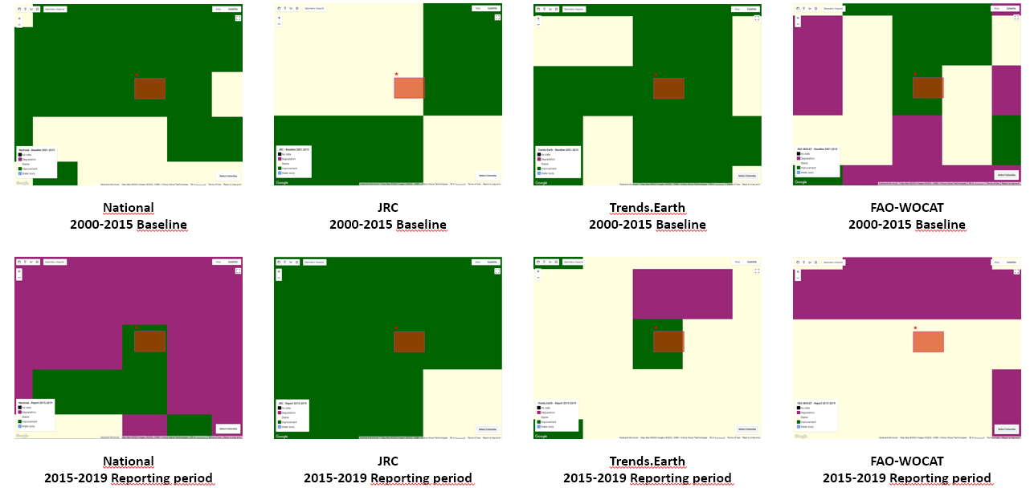
Using the LDN DSS… what do the maps say?
3
Notes:
According to the National and Trends.Earth indicators, land degradation was “Improving” in the two periods considered. However, JRC showed a change from “Stable” to “Improving”, while FAO-WOCAT showed an inverse pattern. In this case there are clear differences among the different assessments, indicating the importance of comparing different sources of data and the validation by field testing and expert knowledge.

Slide 17
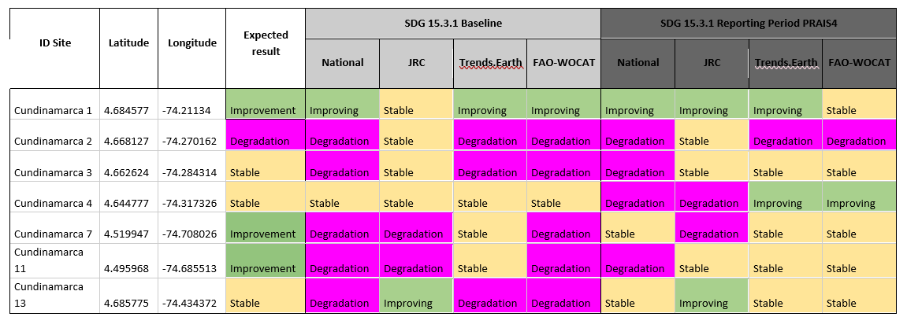
Aggregating information
4
Notes:
Sites used (7 of a total of 13) to verify land degradation trends in the Andean Region. The table shows the expected results and the Land Degradation indicators (National, JRC, Trends.Earth, FAO_WOCAT) between the two periods considered (2000-2015 Baseline and 2005-2019 reporting period PRAIS4)

Slide 18
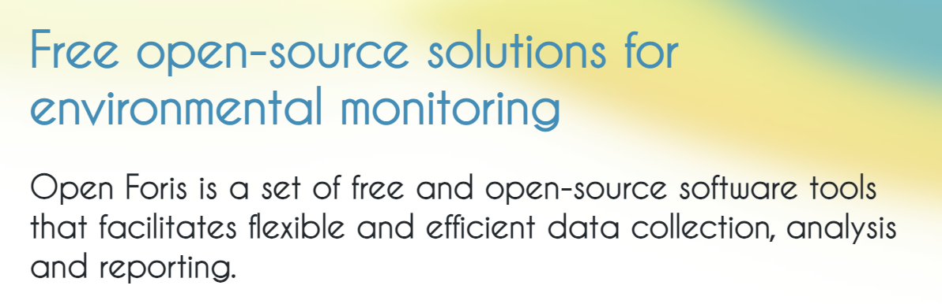

OPEN FORIS TOOLS
https://openforis.org/

Slide 19
OPEN FORIS TOOLS
https://openforis.org/

Slide 20
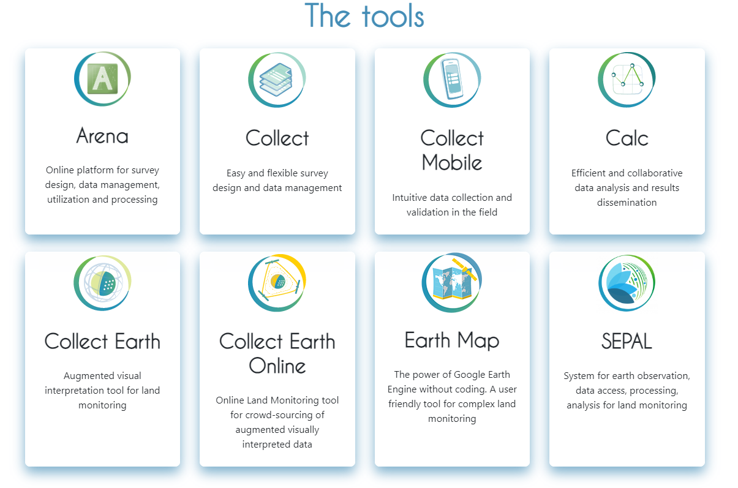
https://openforis.org/

Slide 21


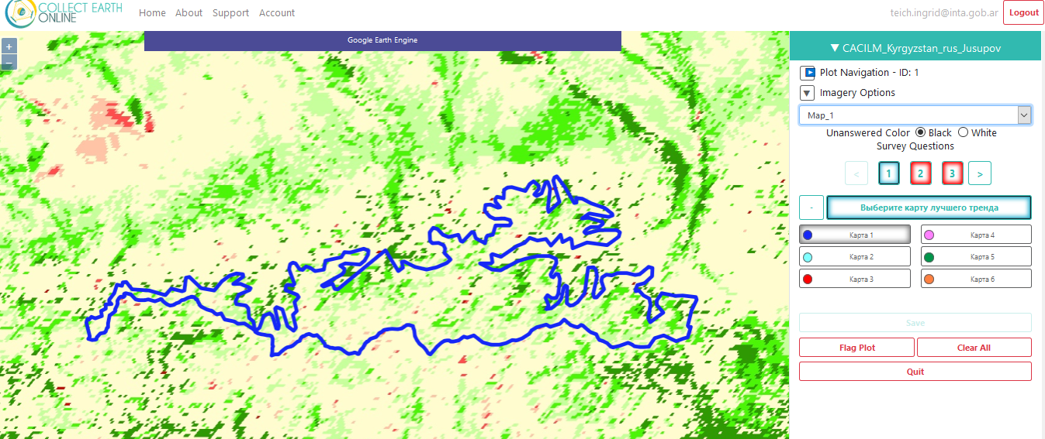
Case study: Validating LPD maps in Central Asia

Slide 22
Categorization of Trends Intensity (TI)
TI | Description | LTT (AM & ESPI) | SWATI (AM & ESPI) | SSWATI (AM & ESPI)
-3 | Strong Negative trend | Decrease of at least 50% | SWATI= -4 or -5 | SSWATI<0, decrease of at least 50%
-2 | Moderate Negative trend | Decrease between 25% and 50% | SWATI = -2 or -3 | SSWATI<0, between 25% and 50%
-1 | Light Negative trend | Decrease of less than 25% | SWATI = -1 | SSWATI<0, between 25% and 10%
0 | No Trend | No Significant slope (p >0.05) | SWATI = 0 | Decrease or increase lower than 10%
1 | Light Positive trend | Increase of up to 25% | SWATI = 1 | SSWATI>0, between 10% and 25%
2 | Moderate Positive trend | Increase between 25% and 50% | SWATI = 2 or 3 | SSWATI>0, increase between 25% and 50%
3 | Strong Positive trend | Increase of at least 50% | SWATI = 4 or 5 | SSWATI>0, increase of at least 50%
Trend Intensity (TI) categorization for the different methods. Changes expressed as percentages, are referred to the initial value (intercept at year 2000 of estimated linear model).
https://cesarnon.users.earthengine.app/view/cacilmlti
Notes:
For the purposes of reporting on SDG indicator 15.3.1, it is not necessary to quantify the magnitude of change in productivity in biomass units of net primary productivity (NPP); rather it is important to determine whether productivity is increasing (greening: positive trend), decreasing (degradation: negative trend), or if remains stable (no change: no significant trend) for the land unit over time. However, some indication of the magnitude of the change (for example identifying if the rate of change represents a strong, medium or light variation) is of much importance in the LDN scheme. The LDN framework is based on hierarchical responses, establishing different actions depending on the level of degradation.
Results were classified in 7 categories of trend intensity (TI) according to the magnitude and type of trend, ranging from -3 (Strong Negative Trend) to 3 (Strong Positive Trend). Negative TIs correspond to negative trends (strong, medium and light) which indicate a decrease in productivity, whereas positive TIs correspond to positive trends that indicate that productivity is increasing. A TI of zero indicates that no changes in productivity were detected with a significant level. In this way, the TI provides seven qualitative classes of land productivity trends for the 2000−2018 period.

Slide 23

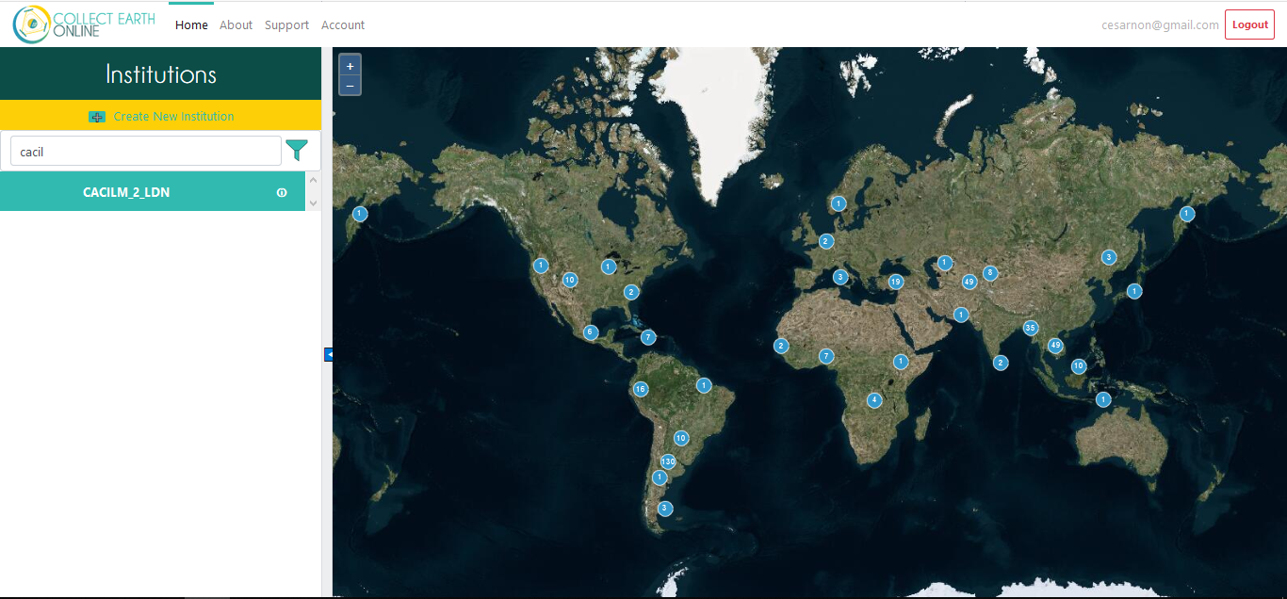
https://collect.earth/home

Slide 24
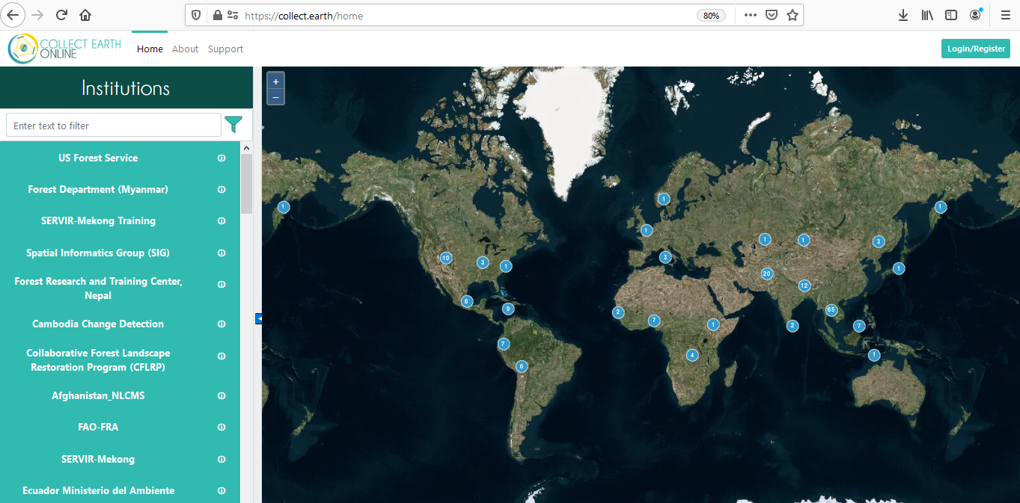
1
LOGIN
https://collect.earth/

Slide 25
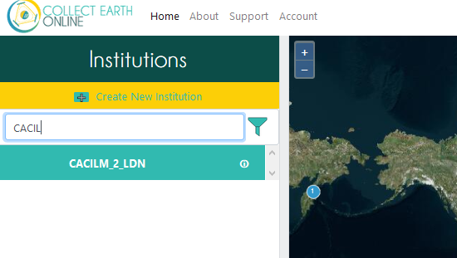
2
SEARCH FOR CACILM_2_LDN

Slide 26
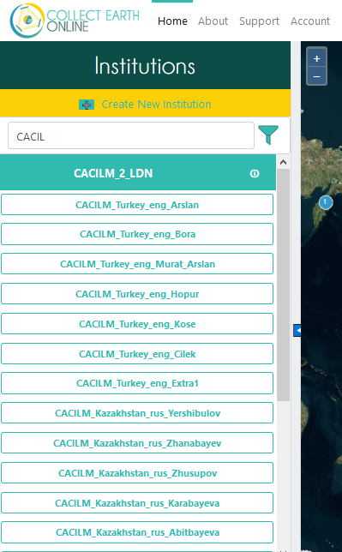
3
SEARCH FOR YOUR NAME

Slide 27
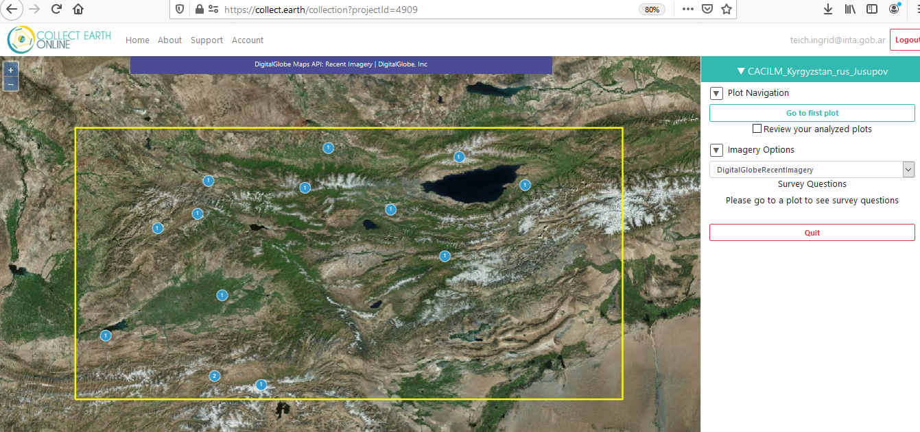
4
GO TO FIRST PLOT

Slide 28
5
GO TO FIRST PLOT

Slide 29
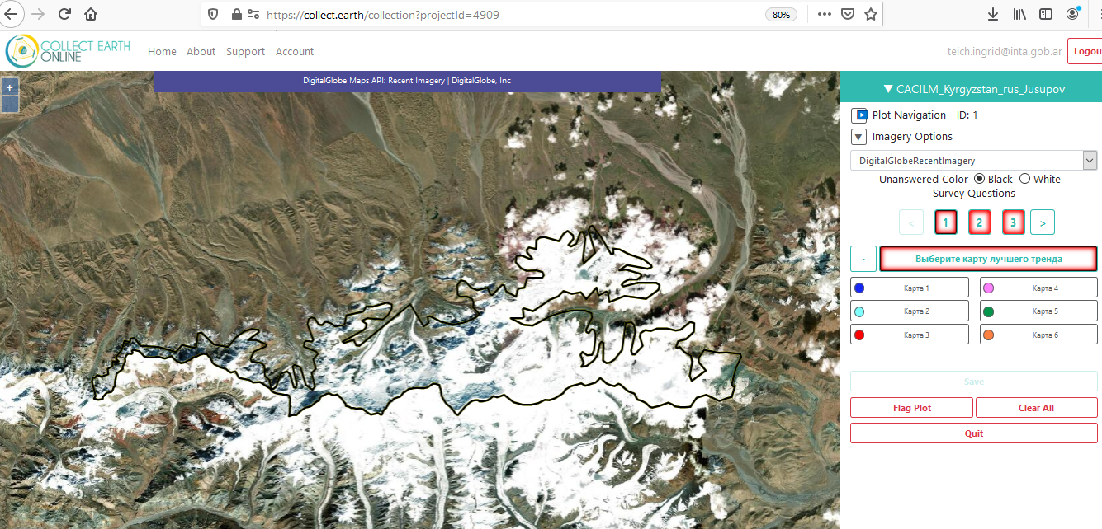
6
LOOK AT THE DIFFERENT Land Productivity Trend MAPS

Slide 30
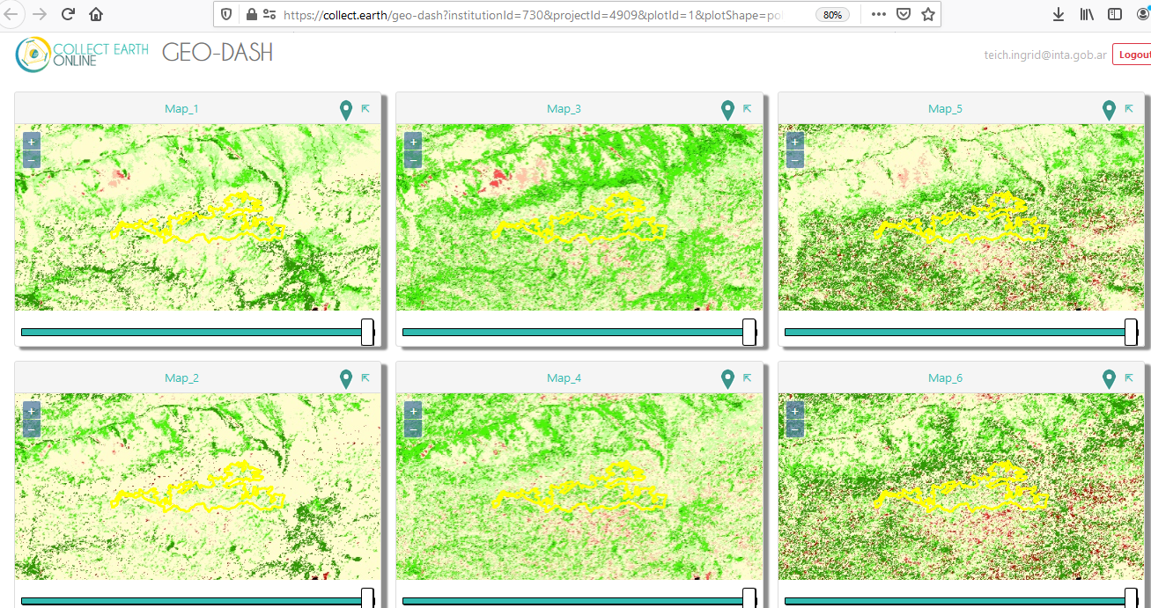
Geo dash also helps to LOOK AT THE DIFFERENT Land Productivity Trend MAPS

Slide 31
7
Choose the best map

Slide 32
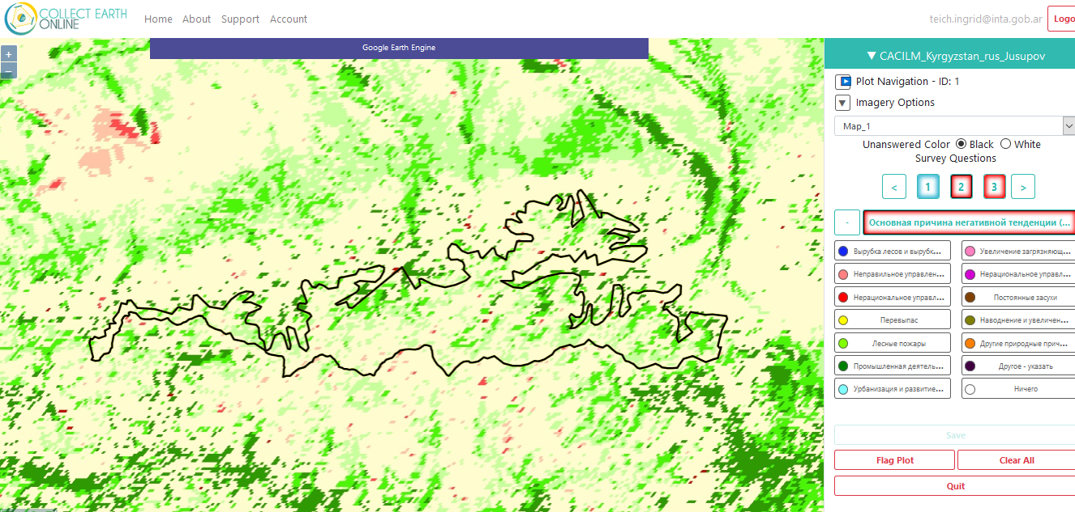
8
Continue completing

Slide 33
9
Continue completing

Slide 34
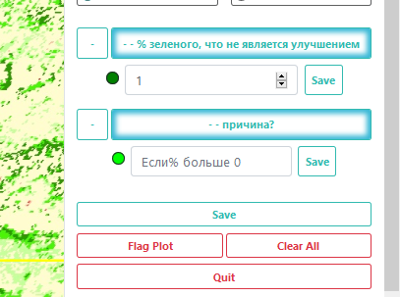
10
Save

Slide 35
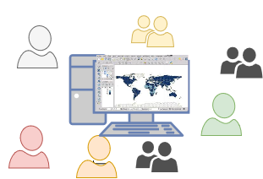
Earth observation data plays an important role to efficiently produce maps and indicators, specially in large countries.
Integration of EO data to participatory processes that include local knowledge is crucial in the process of LDN
Imposition
Vs
Consensus
Hard Data – Ground Data
Validation of Indicators
Soft Data – Expert Knowledge
AIM: use a workflow to validate maps of vegetation trends and other EO derived indicators at national and regional levels.

Slide 36
Thanks!
Do you have any questions?

