Slide 1
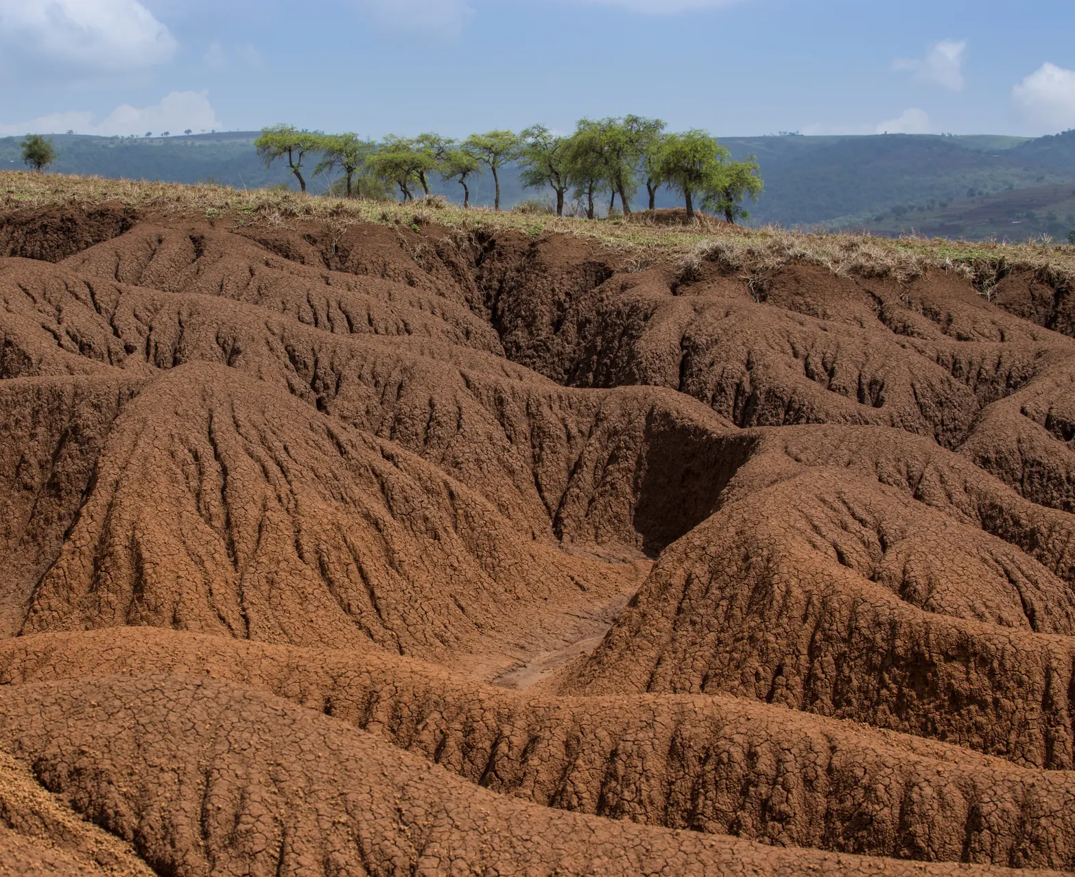
Planning for Neutrality: Land Degradation Neutrality integration in ILUP
Ingrid Teich, Senior Research Scientist, WOCAT-CDE
Ph credits: Carey Marks/Plymouth University

Slide 2
Main Contents
ILUP
LDN & ILUP
KEY CONCEPTS TO INTEGRATE LDN IN PLANNING PROCESSES.
FROM THEORY TO ACTION
CONCLUDING REMARKS

Slide 3
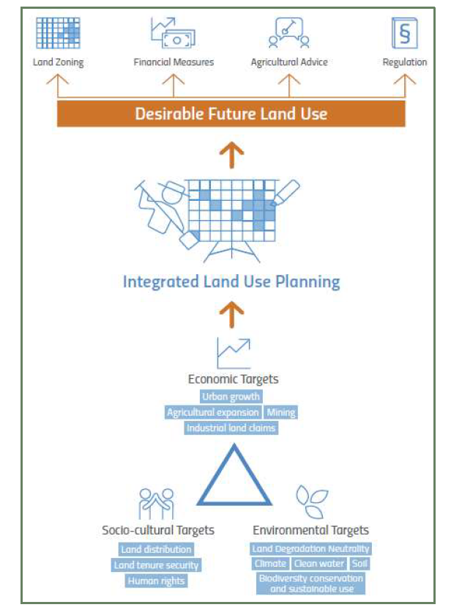
INTEGRATED LAND USE PLANNING
Integrated Land Use Planning (ILUP) goes beyond conventional LUP as it
assesses and assigns the use of resources by taking into account (i.e. integrating) demands from different users.
Looks for a balance between the potentially conflicting needs of different sectors and to harmonize their future interventions.
PARTICIPATORY PROCESS

Slide 4
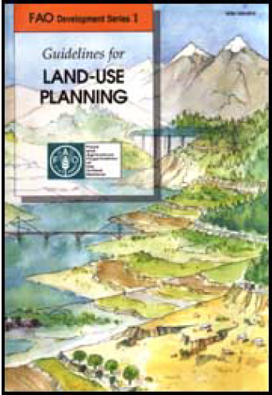
ILUP process
FAO Updated Guidelines on LUP
Source: FAO Updated Guidelines on LUP

Slide 5
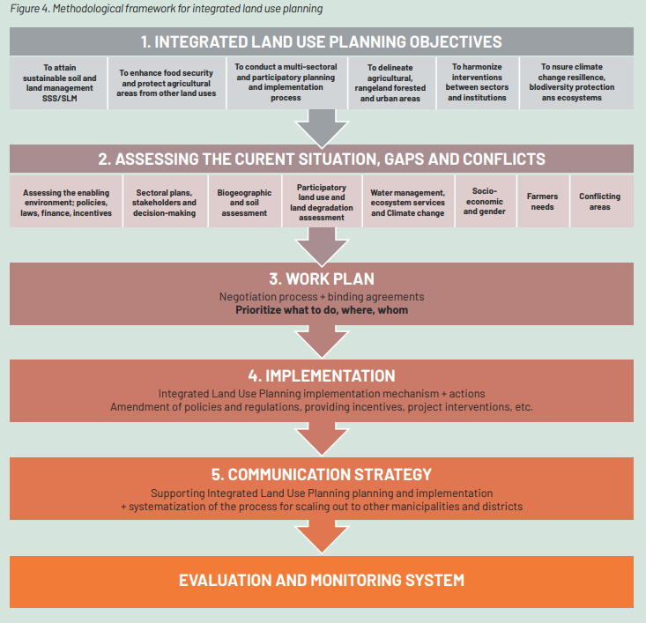
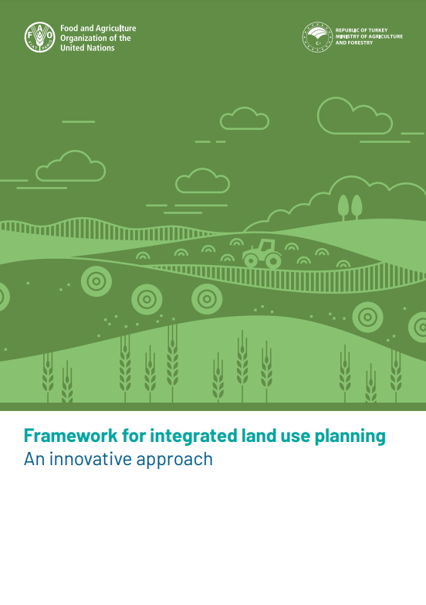
ILUP process
Methodological Framework for ILUP
https://www.fao.org/publications/card/en/c/CB1170EN/

Slide 6
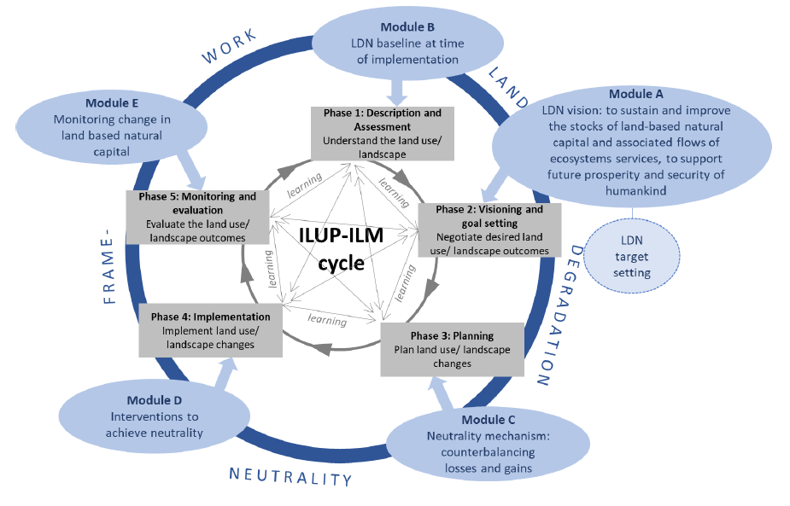
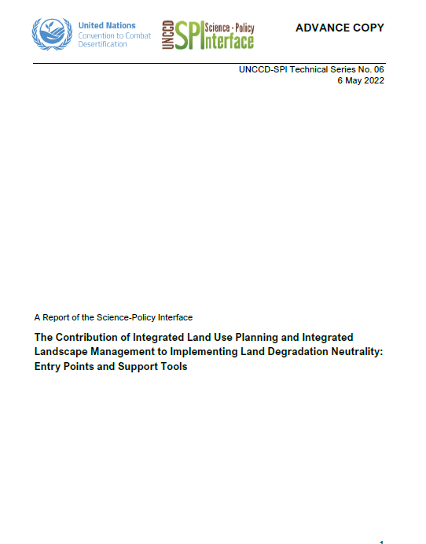
ILUP process
UNCCD SPI Report
Source » https://www.unccd.int/resources/reports/contribution-integrated-land-use-planning-and-integrated-landscape-management

Slide 7
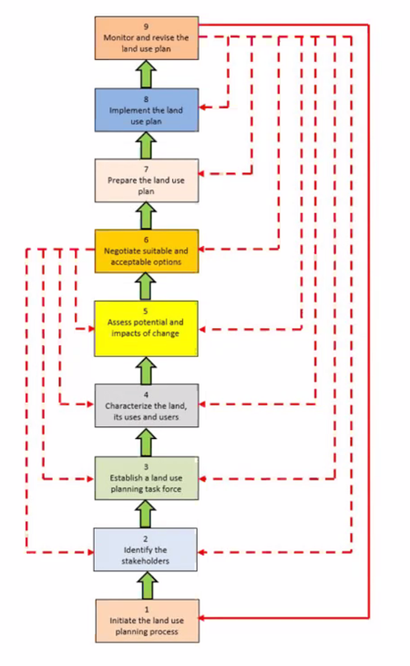

Slide 8
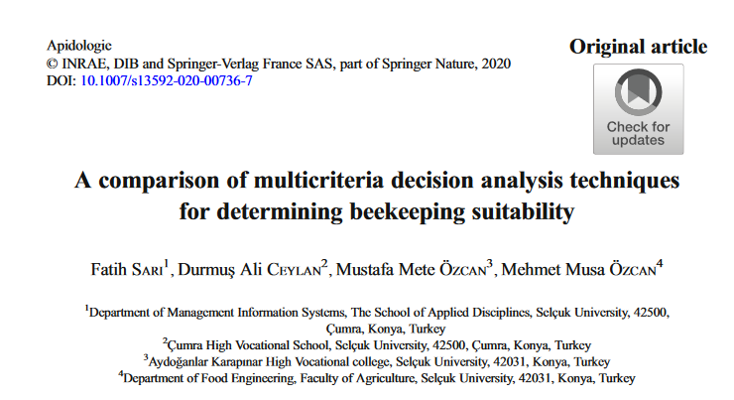
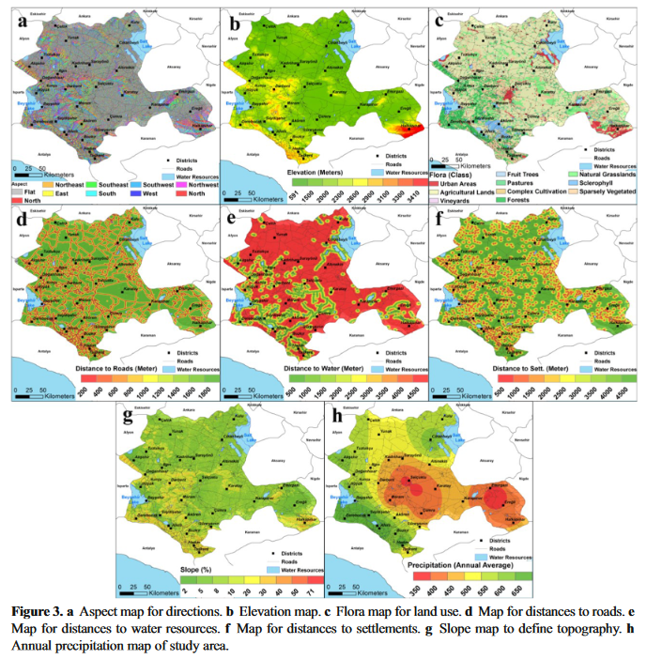
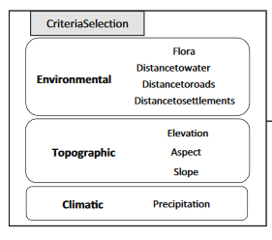
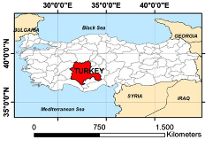
Spatial data is essential for ILUP
Eg: Land Suitability Assessment & Multicriteria Evaluation
“the fitness of a given type of land for a defined use”

Slide 9
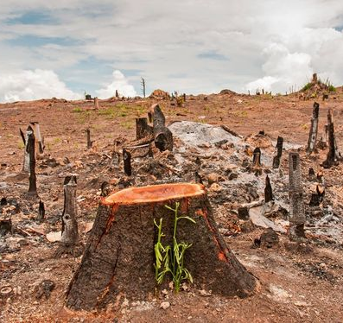
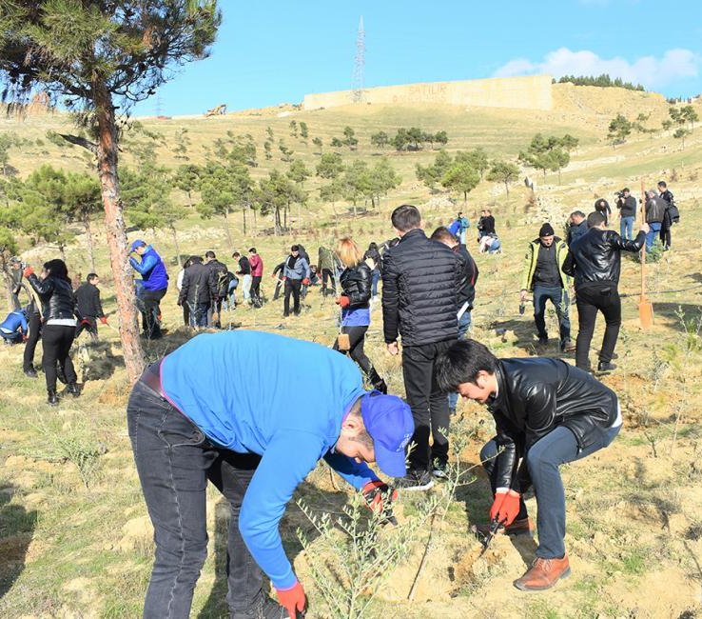
LDN & ILUP
LDN is more than the implementation of sustainable land management practices
SLM TECHNOLOGIES & APPROACHES
LDN provides a framework for a balanced approach, which considers trade-offs and anticipates new degradation.
LANDSCAPE DEVELOPMENT
Planning is needed for achieving no net loss of land-based natural capital
ILUP is at the nexus between national land policies and healthy land
Notes:
The zero net principle—also known as the neutrality principle—requires landscape planning and management that goes beyond a consideration of individual land parcels and sustainable land management practices to embrace national planning. This allows unavoidable losses to be compensated for and allows landscape diversity (e.g., socioeconomic, ecological, and cultural) to optimise the LDN response hierarchy (i.e., avoiding, reducing, and reversing land degradation). The neutrality principle allows for trade-offs among competing interests across a landscape (Orr et al., 2017), and it helps optimise synergies between the mandates of the three Rio Conventions for which land is central

Slide 10
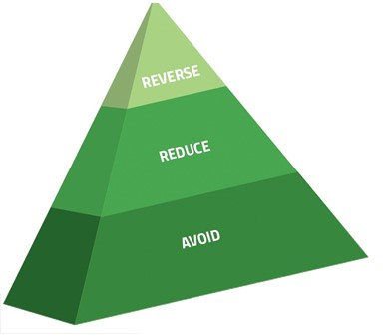
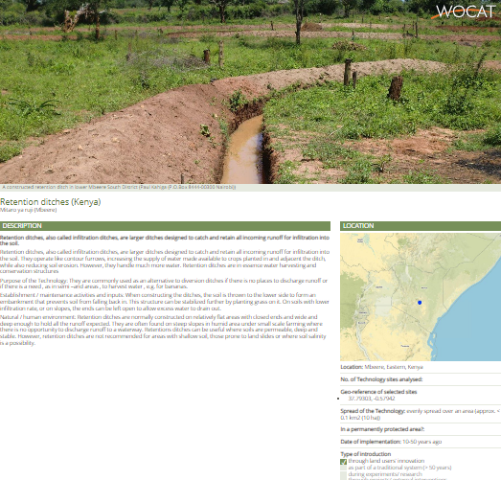
LDN & ILUP
The LDN framework and ILUP-ILM processes share common characteristics
science-based evidence
good governance
participatory processes
Inclusiveness
gender considerations
Land use planning and interventions for achieving LDN are developed by cyclical, iterative processes in which monitoring enables learning for adaptive management
SPI Report
Planning is needed for achieving no net loss of land-based natural capital
Notes:
The five phases of a cyclical ILUP-ILM planning process. While the general ILUP-ILM process is cyclical, feedbacks and learning happen among all phases. The outer circle represents the modules of the LDN scientific framework (Orr et al., 2017) with arrows pointing to entry points into the phases of the ILUP-ILM cycle.
Source: A Report of the Science-Policy Interface “The Contribution of Integrated Land Use Planning and Integrated Landscape Management to Implementing Land Degradation Neutrality: Entry Points and Support Tools“

Slide 11
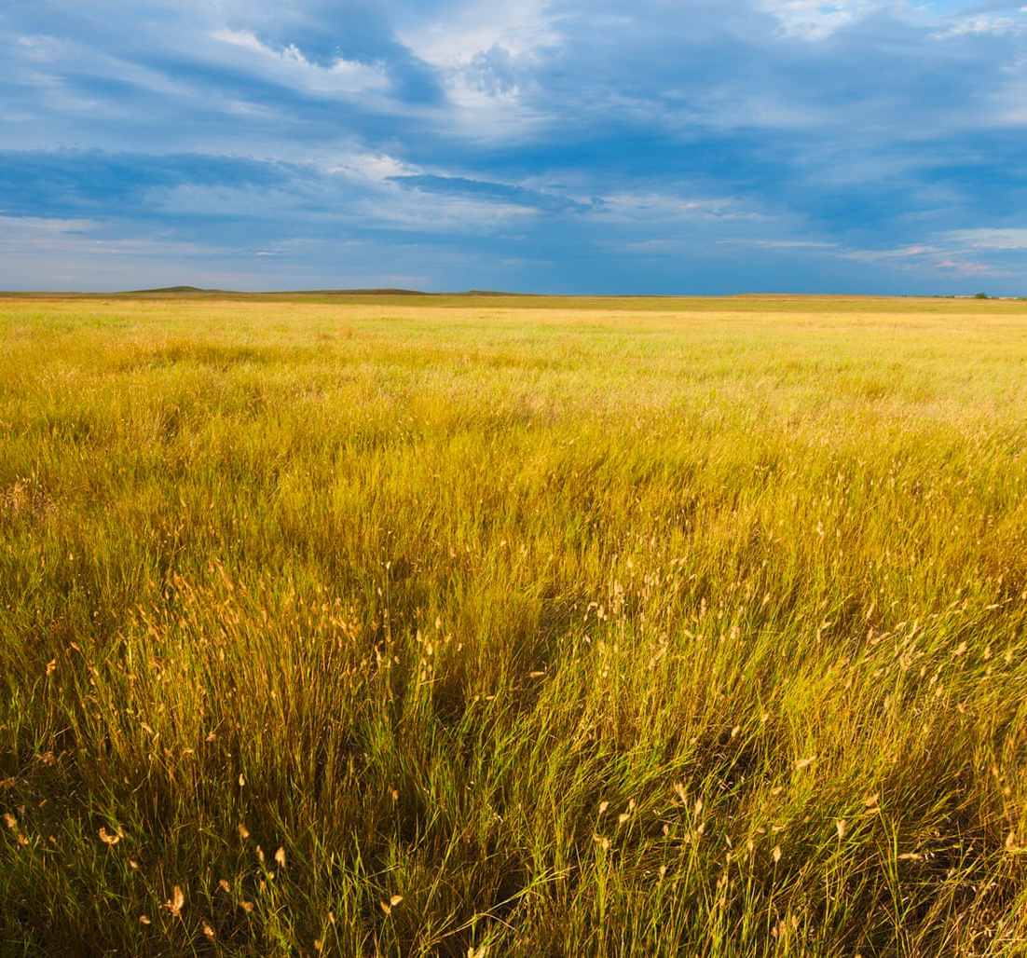
3 Key concepts to integrate LDN in planning processes
COUNTER-BALANCING
LAND TYPE
LAND UNITS
Defined by the combination of edaphic, geomorphological, topographic, hydrological, biological, and climatic features – land potential
A mechanism to implement the principle of neutrality: no net loss of natural capital
Spatial unit used in LDN planning and monitoring; e.g. watershed
Notes:
Counterbalancing A mechanism for satisfying the principle of neutrality by responding to land degradation with land use changes of an equal and opposite effect, over a specified time frame, within a biophysical domain (e.g., catchment) or administrative area (e.g., provincial spatial domain) and generally within the same land type (modified from Orr et al., 2017).
Land type The class of land with respect to land potential, which is distinguished by the combination of edaphic, geomorphological, topographic, hydrological, biological, and climatic features that support the actual or historic vegetation structure and species composition on that land. Used in counterbalancing ‘like for like’ in land degradation neutrality (Orr et al., 2017).
Land unit The finest resolution spatial unit used in LDN planning and monitoring (Orr et al., 2017).

Slide 12
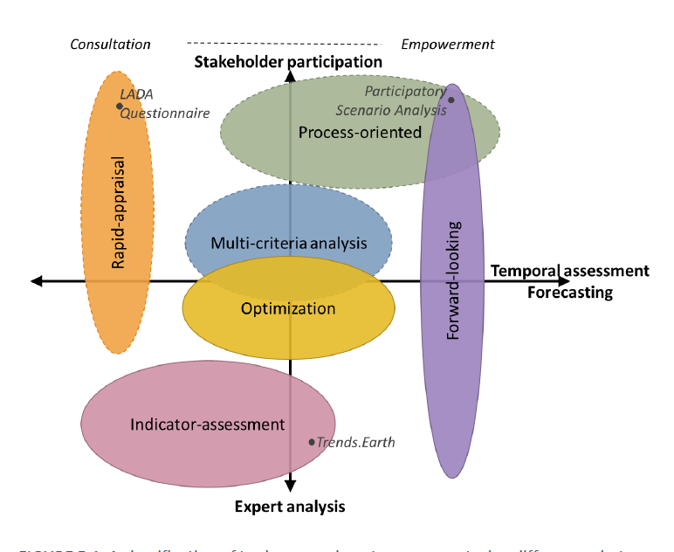
From theory to action
No single perfect tool or approach exists to plan for and integrate LDN interventions
+
Land use planning is conducted in very different ways in different countries
Selection of tools and approaches
LAND GOVERNANCE SYSTEM
DATA AVAILABILITY
FINANCIAL RESOURCES
HUMAN RESOURCES
+ other criteria
Participatory processes foster transparency, inclusiveness, sustainability and ownership
Notes:
The applicability and usefulness of ILUP-ILM tools and approaches depend on the political, cultural, and socio-ecological context (e.g., governance, land tenure, and human capacity). Therefore, the selection of these tools and approaches should be guided by criteria, including the land governance system, data availability, and financial and human resources levels. In many cases, a combination of tools and approaches may be necessary to conform to the guiding principles of the LDN framework.
ILUP-ILM tools that are oriented towards participatory transformation and sustainability management can facilitate participatory stakeholder processes.
participatory processes foster transparency. They also structure decision-making so that both men and women can meaningfully participate, and stakeholders are motivated to take responsibility for actions that address land degradation (i.e., they take ownership of the processes)

Slide 13
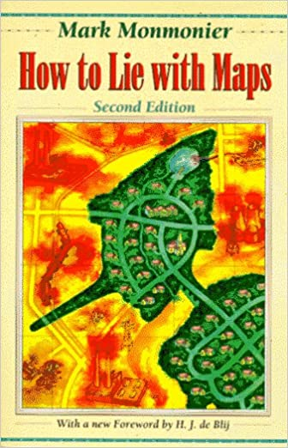
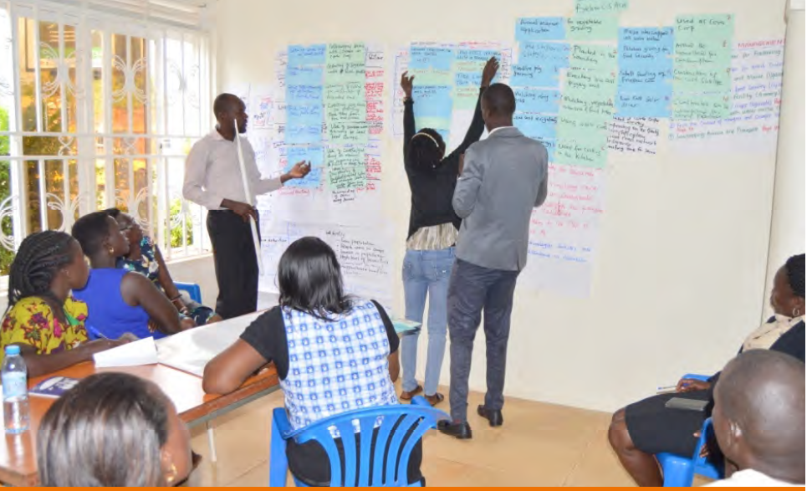
From theory to action
Spatial Data & Analysis is Essential in Land Use Planning
Maps are often the stakeholders’ preferred source of information for spatial decision-making, despite not being easy to understand and use
Mapping temporal and spatial processes is complex, therefore it is necessary to look for convergence of evidence among different perspectives and scales.
Bottom-up & participatory mapping approaches involving local stakeholders is crucial to develop and choose the most appropriate and representative mapping methodologies and datasets
Mapping land degradation is not easy!!!

Slide 14
Final remarks
ILUP is key to achieving LDN
To integrate LDN in ILUP it is key to use the best information available on land degradation status and trends, land potential, socio economical data and gender
Tools and approaches for land use planning are not the solutions per se
Only when land use planning is truly inclusive of all stakeholder interests and integrative across all environmental, economic, social and cultural needs will it contribute to progress towards LDNr

Slide 15
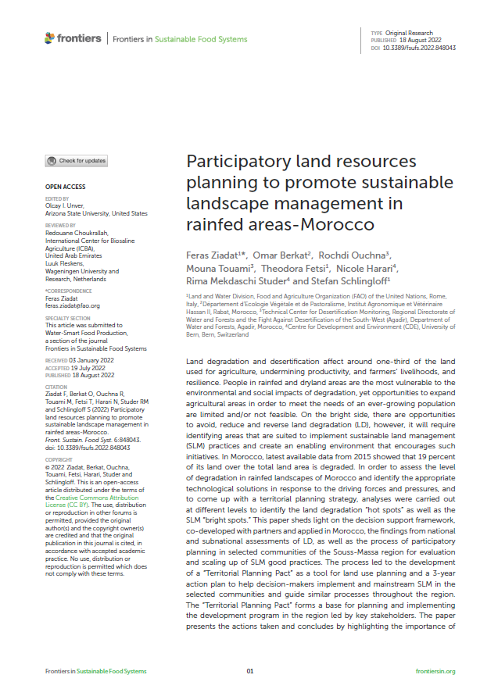
Country experiences: Morocco
An LD and SLM assessment was performed with the QM methodology , which was used as evidence to guide the territorial planning process and enable evidence-based decisions.
The territorial planning included a series of workshops bringing together key stakeholders of three selected communes to negotiate, agree and adopt a programme/ plan for scaling out SLM, taking into account priorities of each commune and facilitating inter-institutional coordination to identify responsibilities for supporting community implementation and securing financial and technical commitment from all stakeholders.

Slide 16
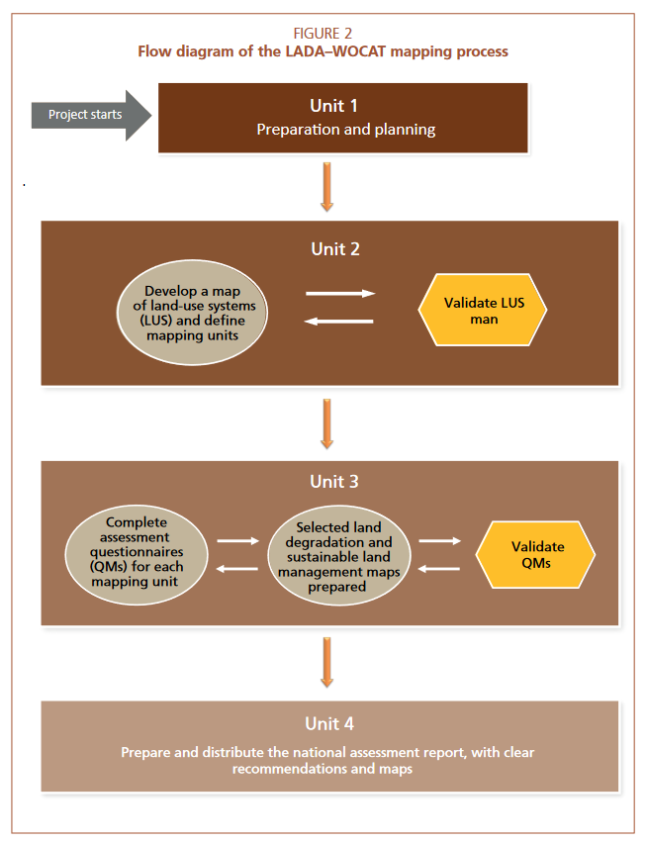
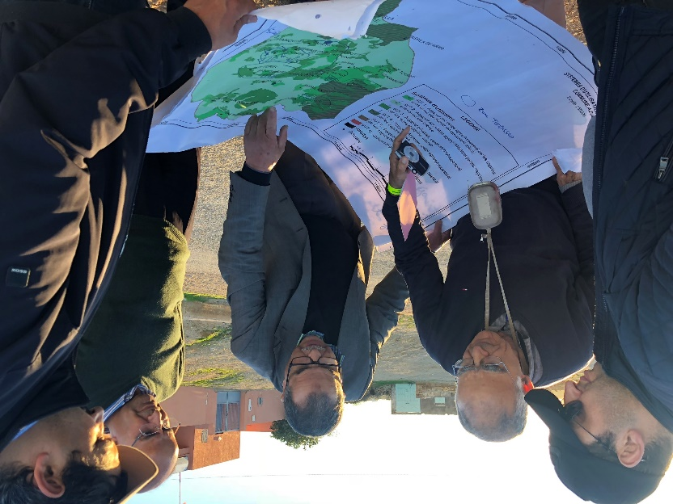
QM – participatory expert assessment (PEA)
PEA brings together experts, scientists and land users in a workshop to assess different mappings units, drawing on their knowledge and experience of the area
Experts/specialists/land users with expertise related to land degradation, land management, different land uses, soil and water conservation, biodiversity… in the country /local context
Discuss, negotiate and fill in the QM tables (supported by documents)
Notes:
Source: FAO Guidelines for national assessment and mapping of land degradation and conservation

Slide 17
QM – 5 Steps
Preparation of the base map
Step 1: Contributing specialists
Step 2: Land Use System (FAO)
Step 3: Land degradation
Step 4: Sustainable Land Management
Step 5: Expert recommendation
Notes:
Nicole

Slide 18
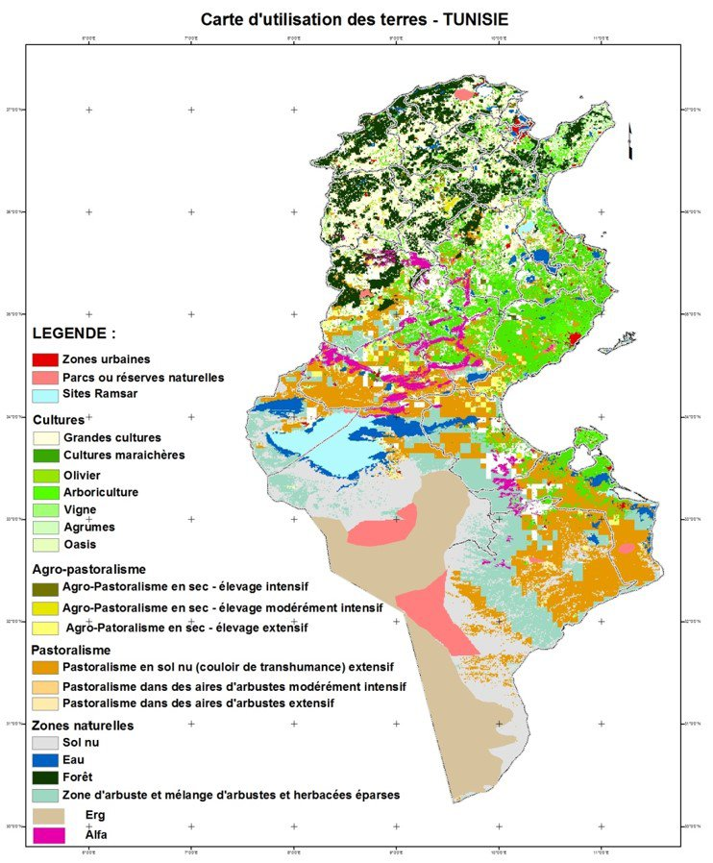
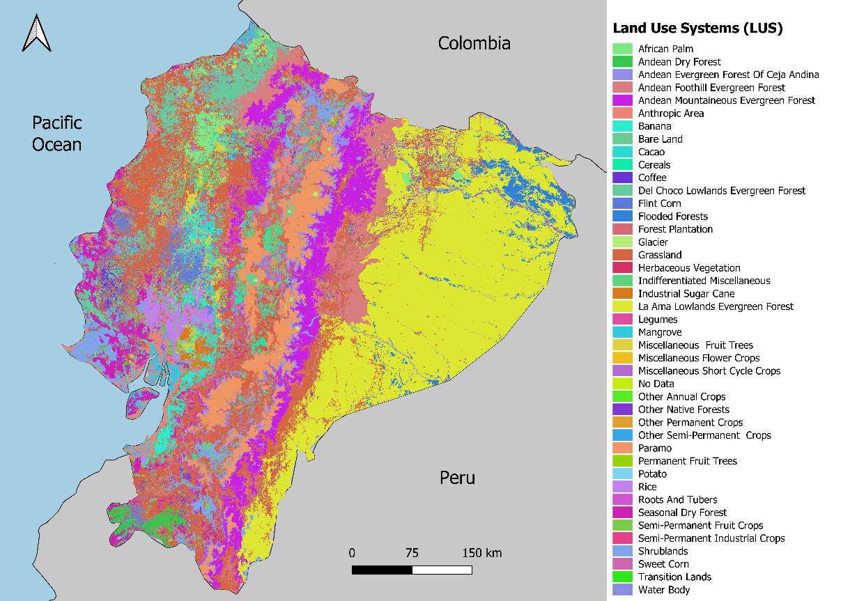
QM – Preparation of the base map
Land use systems as base map
often countries/projects opt to create a new/updated LUS map
If no LUS map is available, any other land use/land cover map can be used
Notes:
Nicole

Slide 19
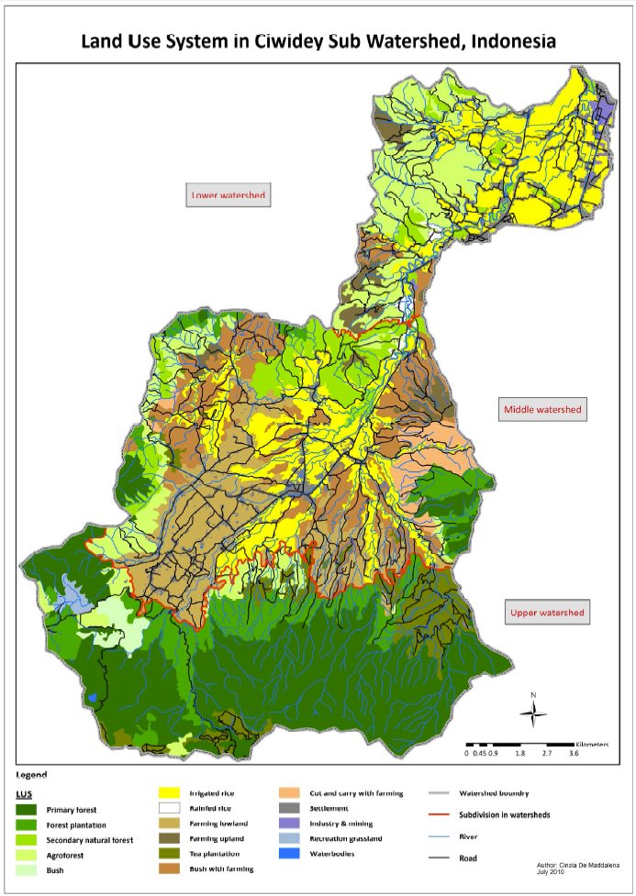
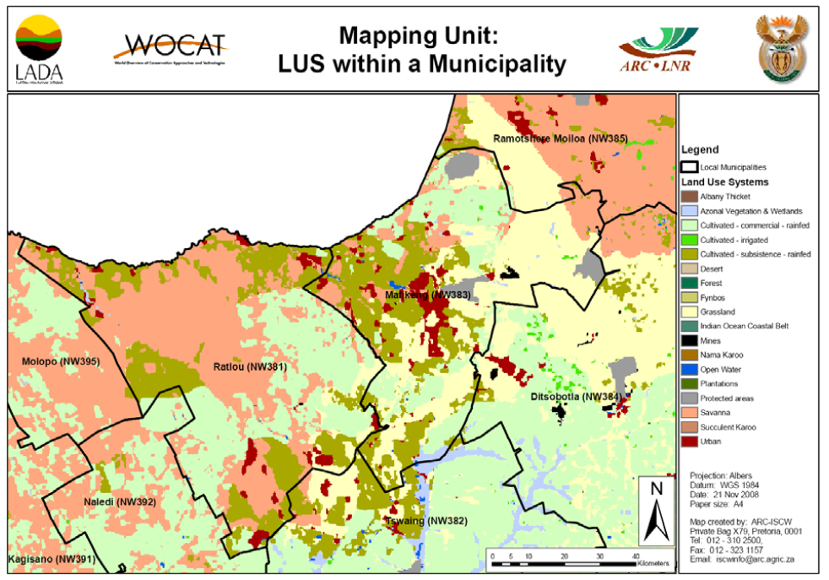
QM – Preparation of the base map
Mapping unit: each land use system within an administrative unit (or e.g. watershed zones)
The smaller is the administrative unit, the more detailed the map will be.
Notes:
Nicole

Slide 20
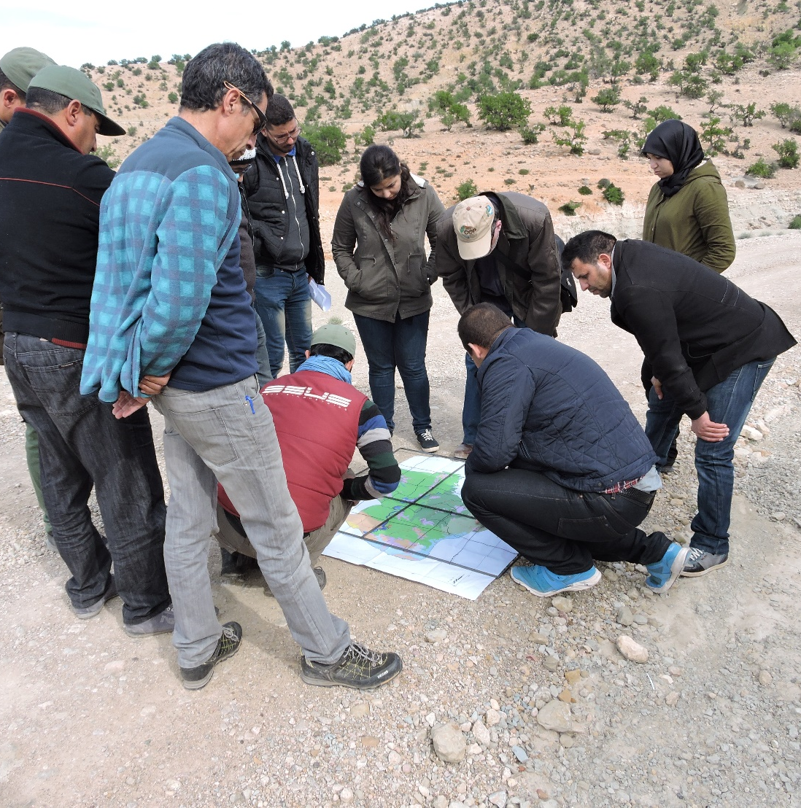
QM – Step 1: Contributing specialists
Identify relevant experts and invite for the participatory workshop
Successful PEA workshops create an environment in which participants are able to judge inputs, express opinions, and discuss and eventually reach consensus on the state of LD and SLM
Where a national assessment is made, governments opt for inviting different Ministries (agriculture, environment, water resources, planning…) to reach a consensus and make the results and maps useful and used by all relevant country stakeholders
Depending on resources, either one PEA workshop or several ones are conducted (e.g. in specific regions or specific communities (Panama – indigenous territories)
Notes:
Nicole

Slide 21
QM – Step 2: Land Use System
Estimation of the increase or decrease in area over the past 10 years
Estimation of the increase or decrease of the intensity of each LUS
Area trend 2 = area coverage is rapidly increasing in size; i.e. > 10% of the LUS area/10 years
Intensity trend 1 = moderate increase
Notes:
Nicole

Slide 22
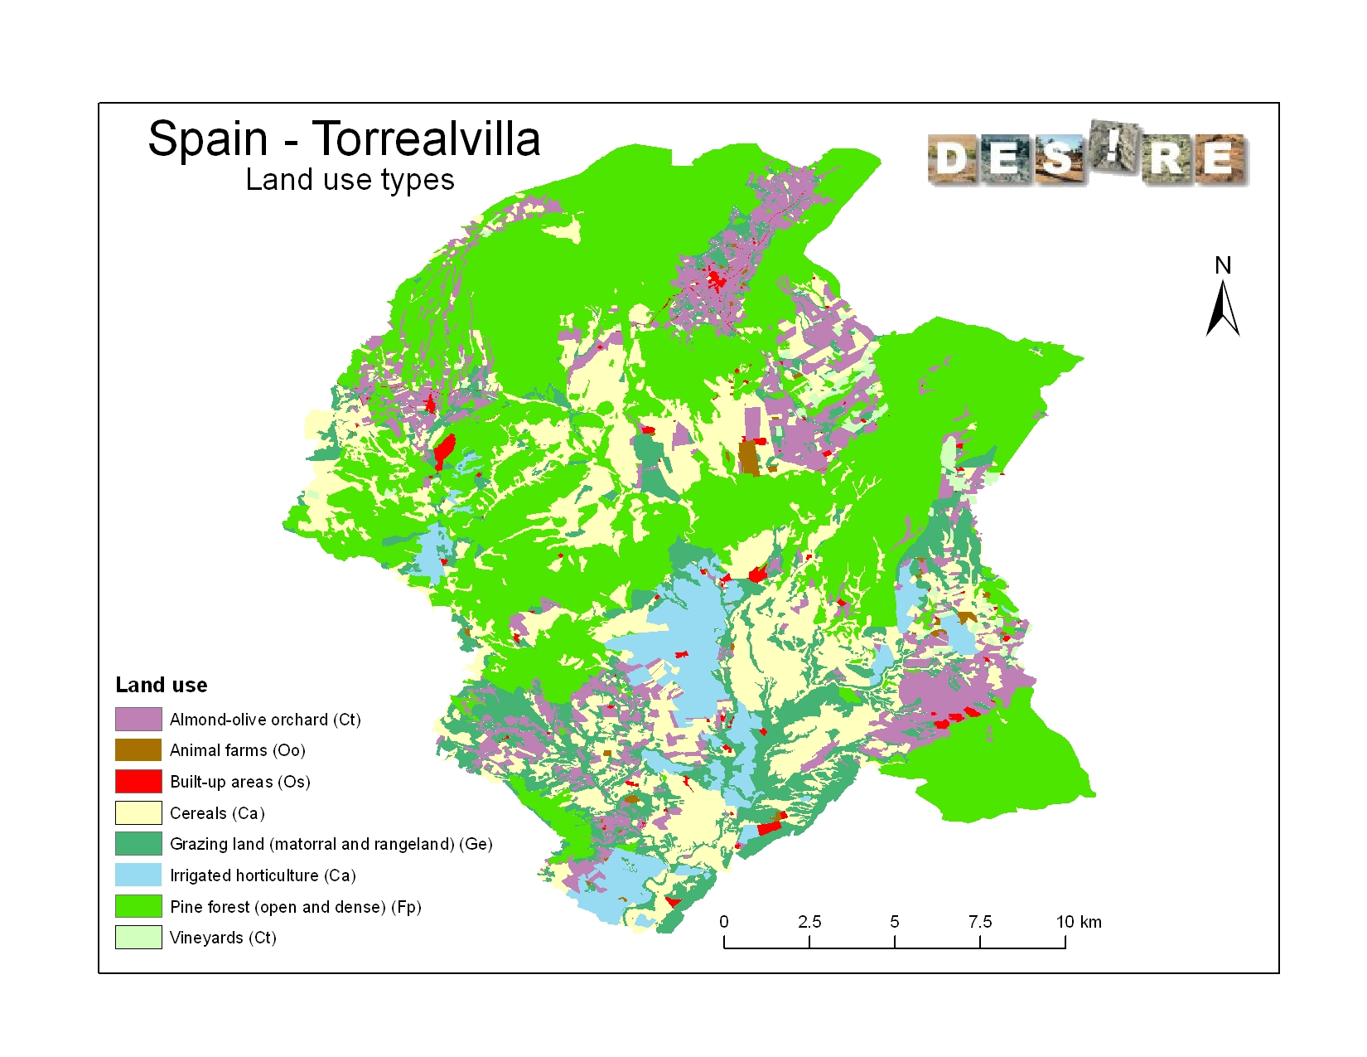
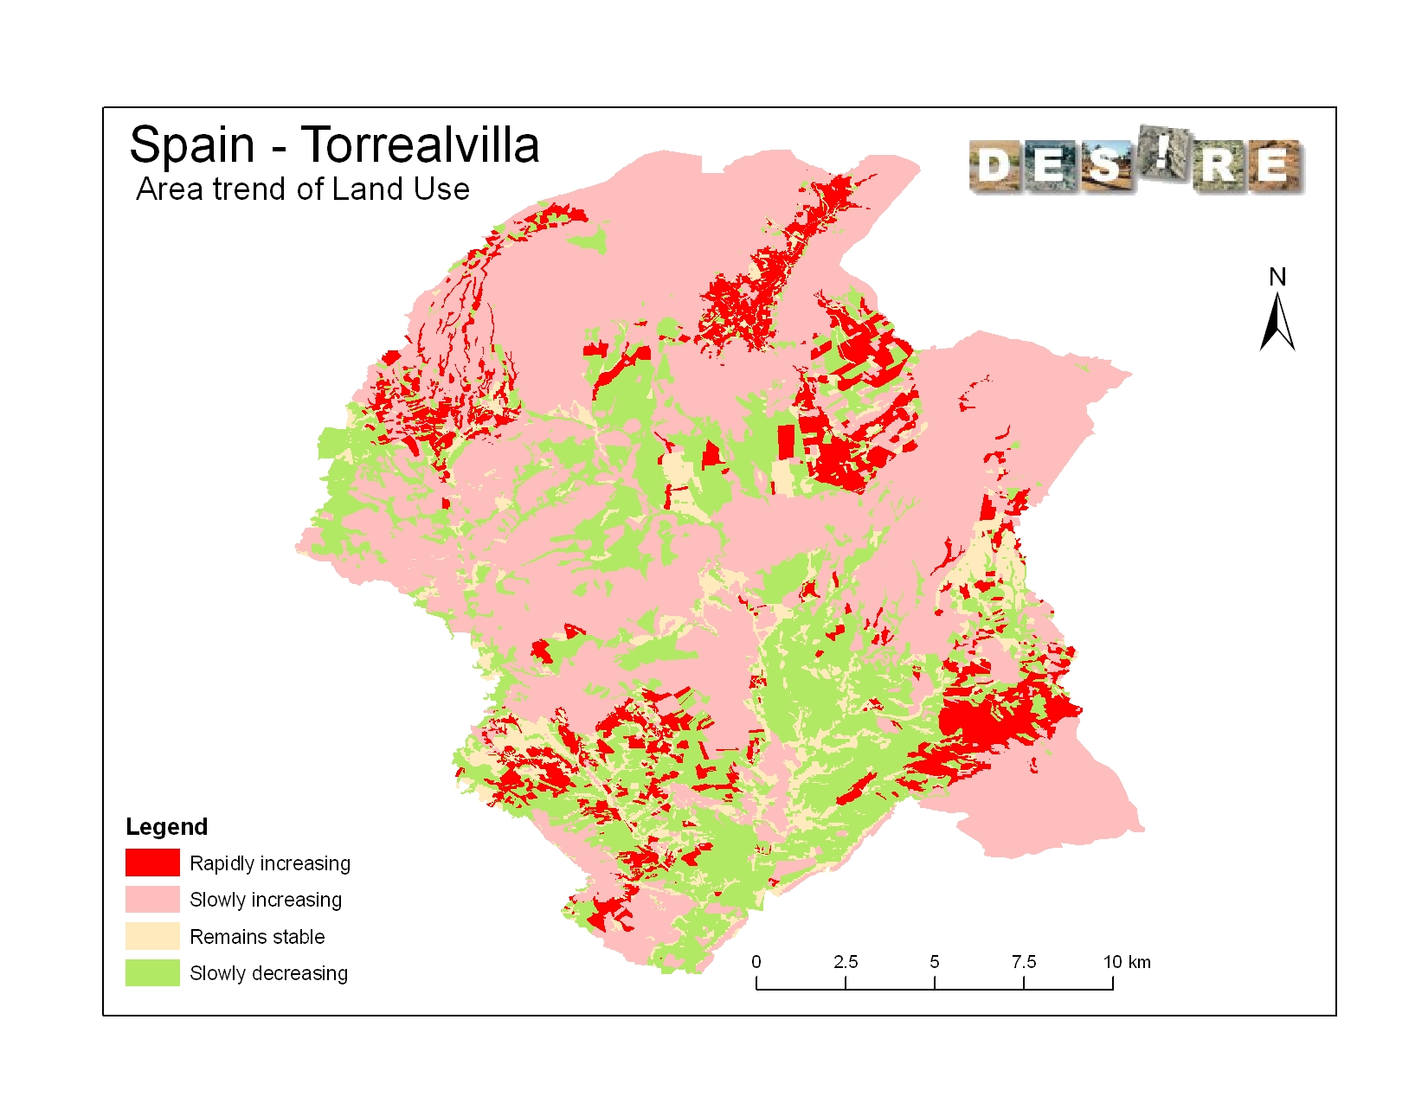
QM – Step 2: Land Use System
Notes:
Nicole

Slide 23
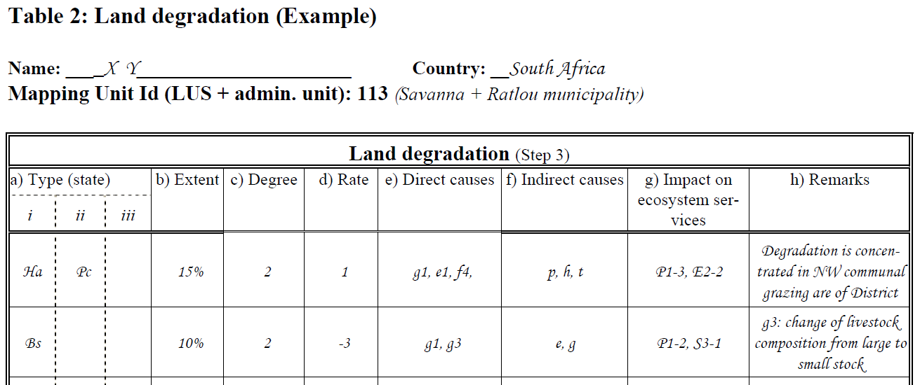
QM – Step 3: Land Degradation
Degradation per LUS
Type
Extent (area)
Degree
Rate
Direct causes
Indirect causes
Impact on ecosystem services (type and level)
Recommendation
Data entry table:
Determine the major types of land degradation presently occurring under each land use system
Notes:
Nicole

Slide 24
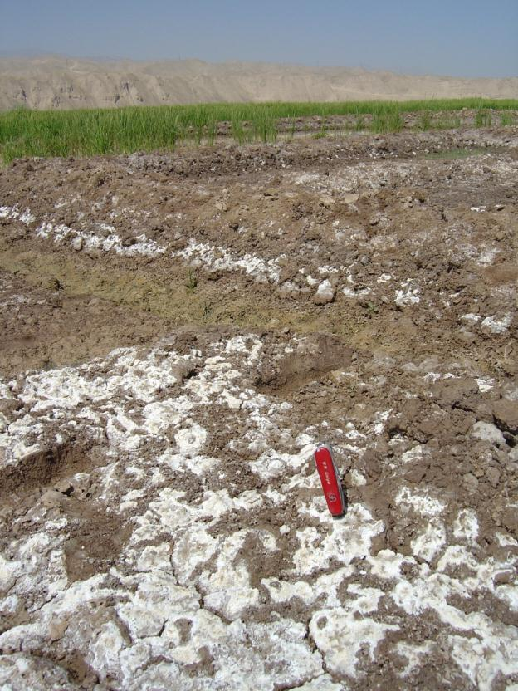
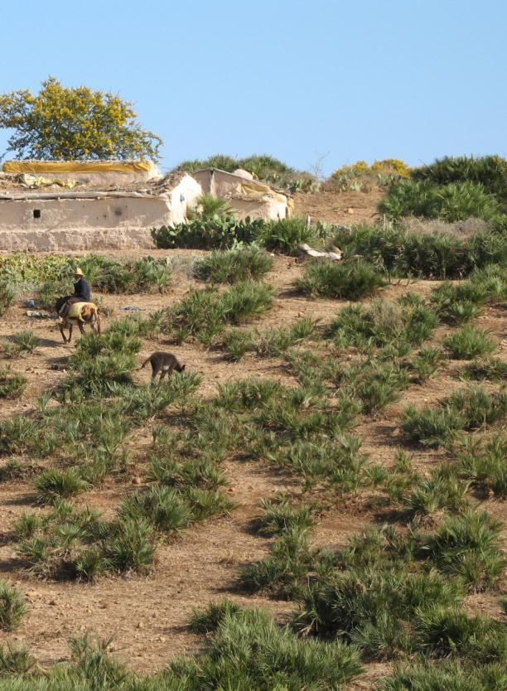
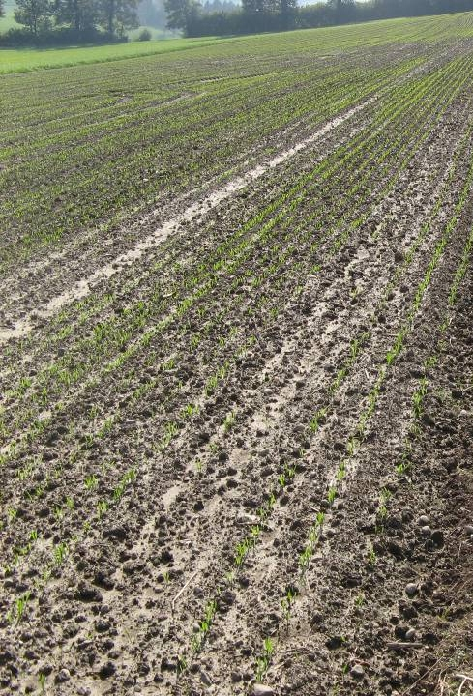
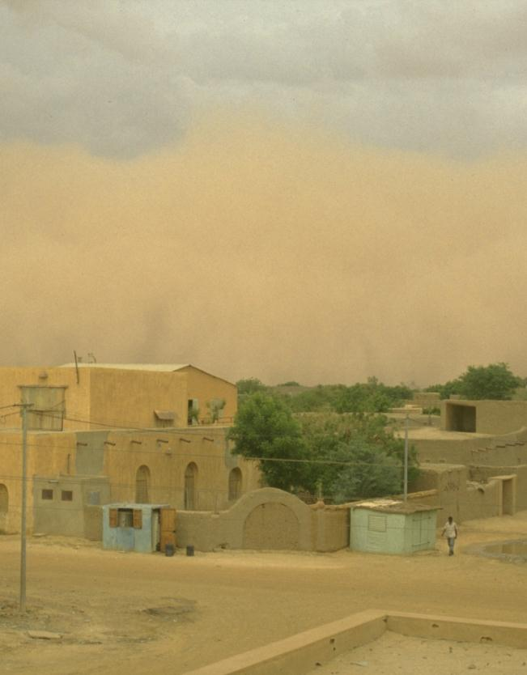
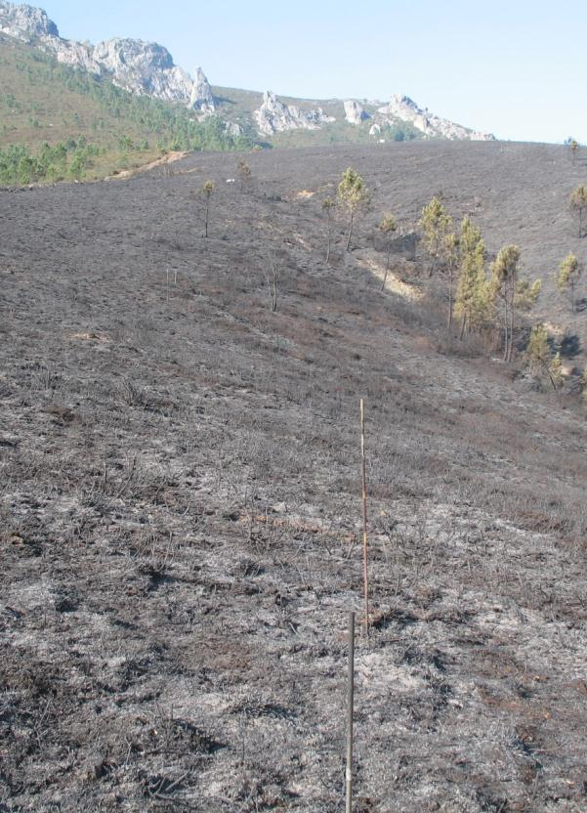
QM – Step 3: Land Degradation
Determine the major types of land degradation (WOCAT 2008) presently occurring under each land use system
Salinization
Soil erosion by wind
Vegetation degradation
Detrimental effects of fires
Soil compaction
HP. Liniger
G. Schwilch
G. Schwilch
G. Schwilch
HP. Liniger
W: Soil erosion by water
Wt loss of topsoil (surface erosion)
Wg gullying (gully erosion)
Wm mass movements
Wr riverbank erosion
Wc coastal erosion
Wo offsite degradation
E: Soil erosion by wind
Et loss of topsoil
Ed deflation and deposition
Eo offsite effects
C: Chemical soil deterioration
Cn fertility decline and reduced organic matter content
Ca acidification
Cp soil pollution
Cs salinisation/alkalinisation
P: Physical soil deterioration
Pc compaction
Pk sealing and crusting
Pw waterlogging
Ps subsidence of organic soils, settling of soil
Pu loss of bio-productive function due to other activities (eg construction, mining)
Notes:
Nicole

Slide 25
QM – Step 3: Land Degradation
W: Soil erosion by water
Wt loss of topsoil (surface erosion)
Wg gullying (gully erosion)
Wm mass movements
Wr riverbank erosion
Wc coastal erosion
Wo offsite degradation
E: Soil erosion by wind
Et loss of topsoil
Ed deflation and deposition
Eo offsite effects
C: Chemical soil deterioration
Cn fertility decline and reduced organic matter content
Ca acidification
Cp soil pollution
Cs salinisation/alkalinisation
P: Physical soil deterioration
Pc compaction
Pk sealing and crusting
Pw waterlogging
Ps subsidence of organic soils, settling of soil
Pu loss of bio-productive function due to other activities (eg construction, mining)
B: Biological degradation
Bc reduction of vegetation cover
Bh loss of habitats
Bq quantity / biomass decline
Bf detrimental effects of fires
Bs quality and species composition / diversity decline
Bl loss of soil life
Bp Increase of pest / diseases, loss of predators
H: Water degradation
Ha aridification / soil moisture problem
Hs change in quantity of surface water
Hg change in groundwater / aquifer level
Hp decline of surface water quality
Hq decline of groundwater quality
Hw reduction of the buffering capacity of wetland areas
Notes:
Besides water erosion we find numerous other types of soil degradation. To name just a few: salinization, wind erosion, degradation of vegetation cover, forest fires, soil compaction, etc.

Slide 26
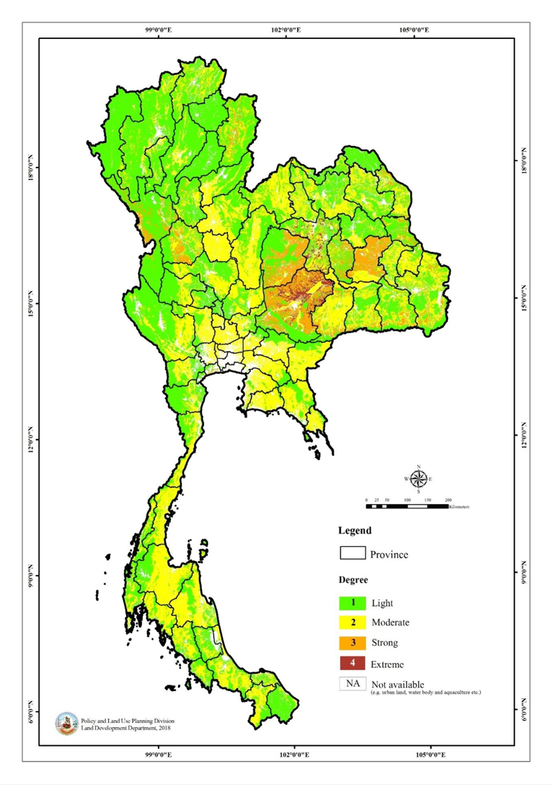
QM – Step 3: Land Degradation
Determine the degree of degradation: intensity of the land degradation process
1 Light: there are some indications of degradation, but the process is still in an initial phase. It can be easily stopped and damage repaired with minor efforts.
Moderate: degradation is apparent, but its control and full rehabilitation of the land is still possible with considerable efforts.
Strong: evident signs of degradation. Changes in land properties are significant and very difficult to restore within reasonable time limits.
Extreme: degradation beyond restoration.

Slide 27
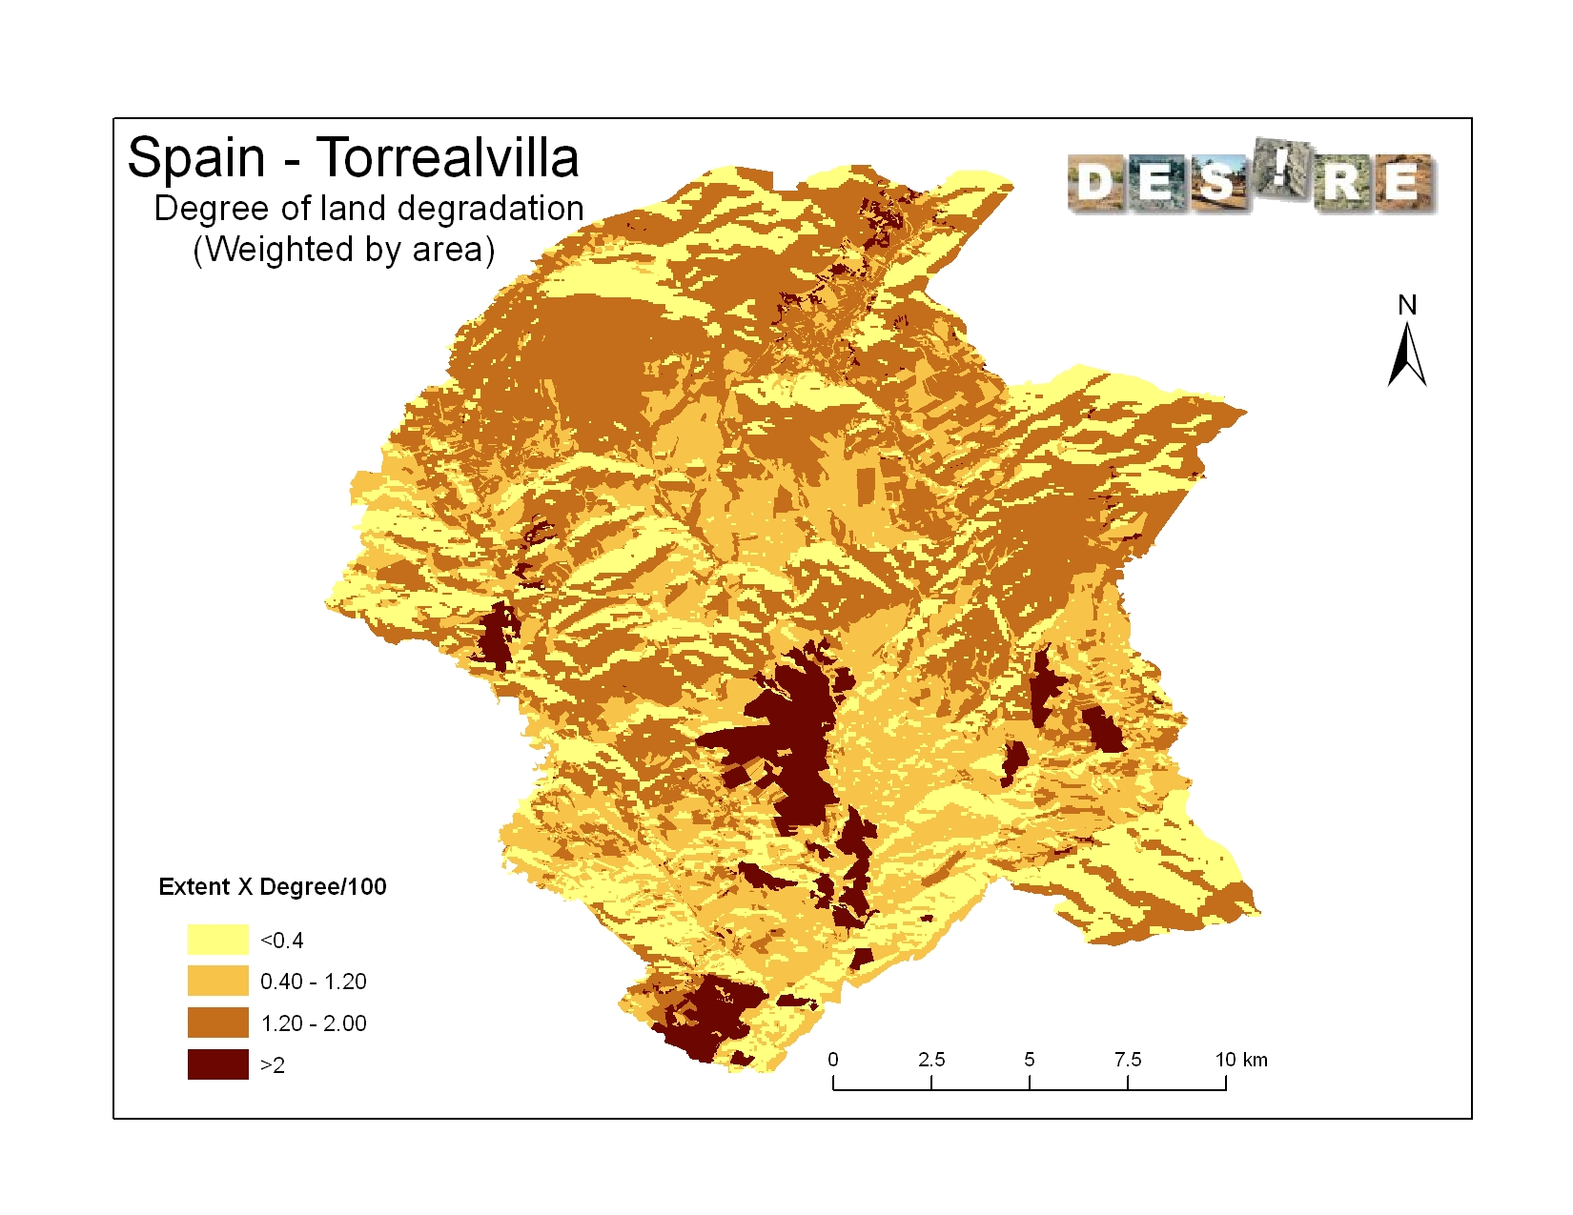

Slide 28
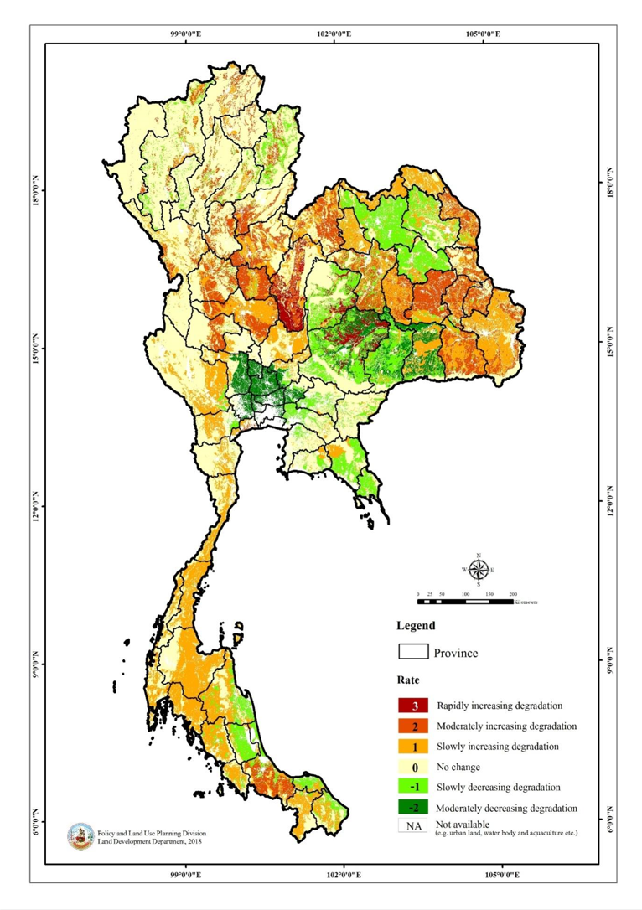
QM – Step 3: Land Degradation
Determine the rate of degradation: the trend of degradation over a recent period of time
3: rapidly increasing degradation
2: moderately increasing degradation
1: slowly increasing degradation
0: no change in degradation
-1: slowly decreasing degradation
-2: moderately decreasing degradation
-3: rapidly decreasing degradation

Slide 29
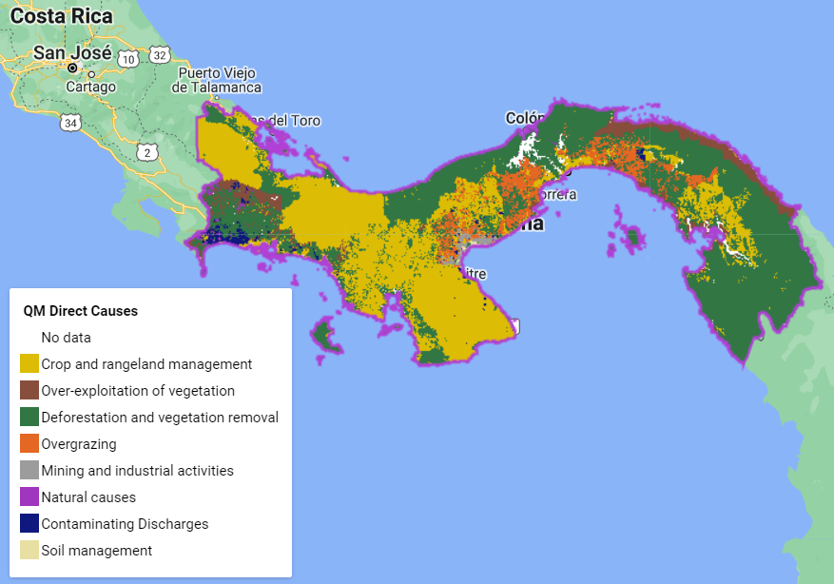
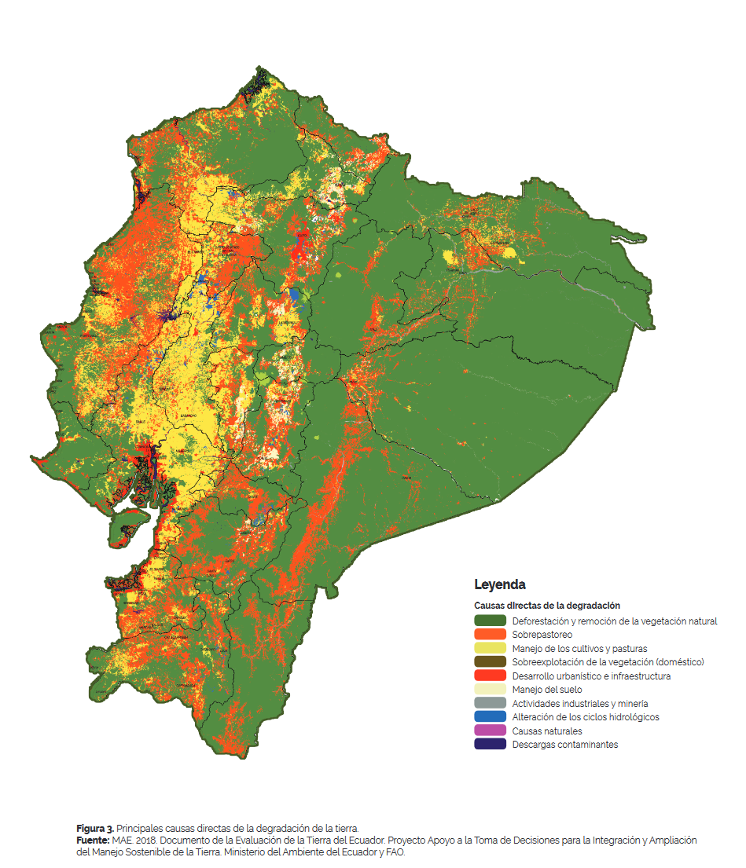
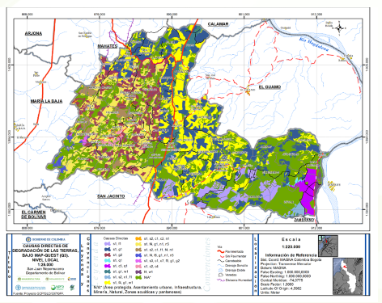
QM – Step 3: Land Degradation
Determine the direct causes of land degradation
s: Soil management: improper / cultivation of unsuitable soils …
a: Crop and rangeland management: improper …
f: Deforestation and removal of natural vegetation
e: Over-exploitation of vegetation for domestic use
g: Overgrazing
i: Industrial activities and mining
u: Urbanisation and infrastructure development
p: Discharges leading to point contamination of surface and ground water resources
q: Causes leading to non-point contamination of surface and ground water resources
w: Disturbance of the water cycle
o: Over abstraction of water
n: Natural causes

Slide 30
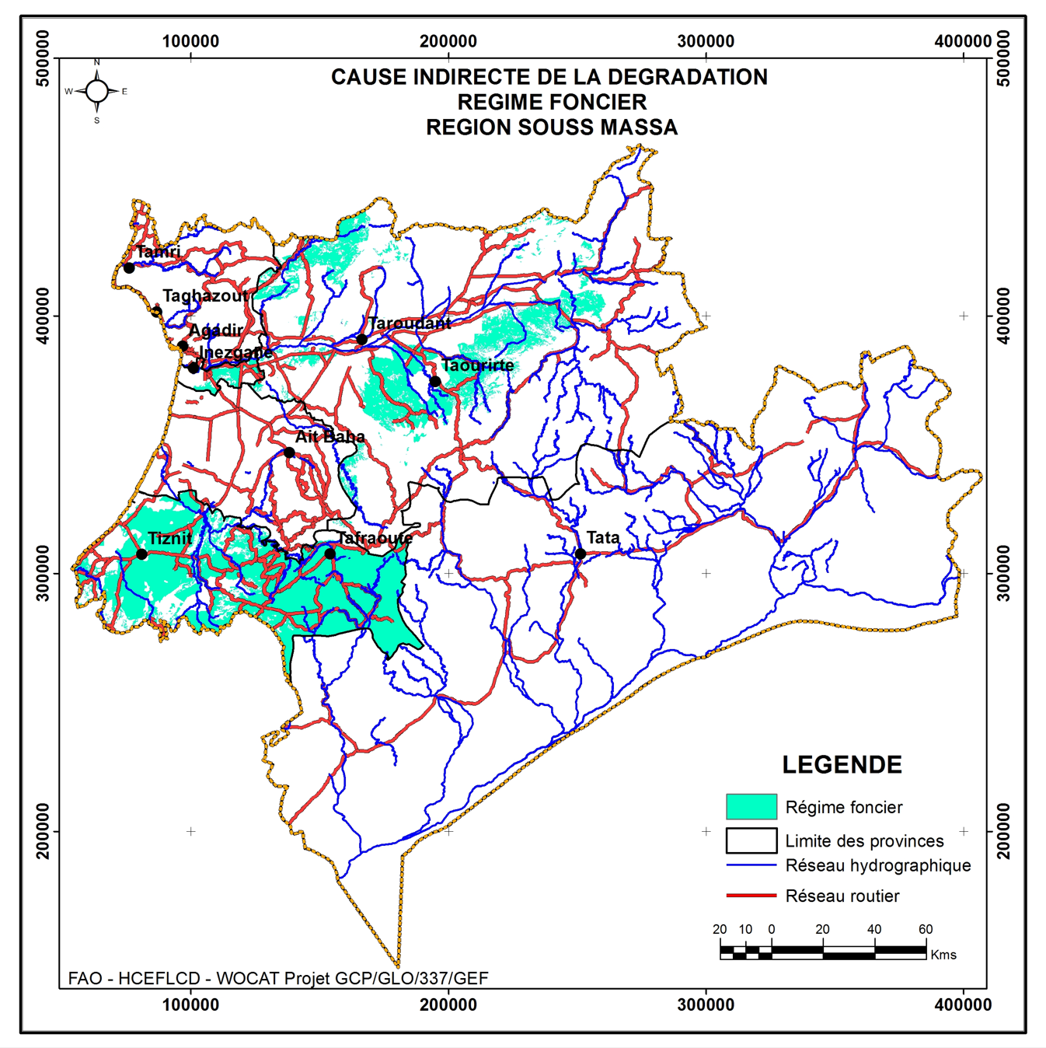
QM – Step 3: Land Degradation
Determine the indirect causes of land degradation
p: Population density
t: Land tenure
h: Poverty / wealth
l: Labour availability
r: Inputs and infrastructure
e: Education, access to knowledge and support services
w: War and conflict
g: Governance / institutional
o: Others (specify)

Slide 31
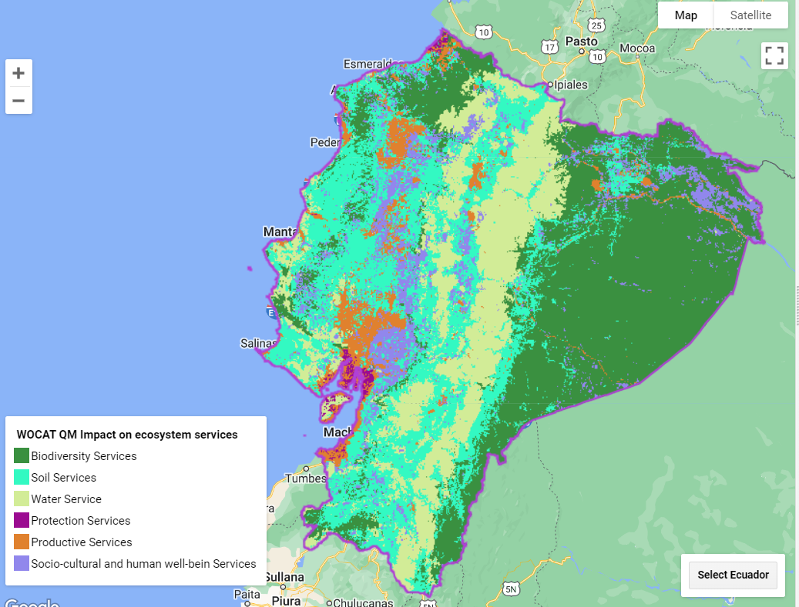
QM – Step 3: Land Degradation
Define the impact on ecosystem services (WOCAT 2008) including level of impact
P Productive Services & indicators
(P1) production (of animal / plant quantity and quality including biomass for energy) and risk
(P2) water (quantity and quality ) for human, animal and plant consumption
(P3) land availability
E Ecological services (regulating / supporting) & indicators
(E1) water cycle: floods, storms, excessive rains
(E2) water cycle: drought, dry season flow, availability of water
(E3) organic matter status
(E4) soil cover (vegetation, mulch, etc.)
(E5) soil structure: surface (eg sealing and crusting) and subsoil affecting infiltration, water and nutrient holding capacity, salinity etc.
(E6) nutrient cycle (N, P, K) and the carbon cycle (C)
(E7) soil formation (including wind-deposited soils)
(E8) biodiversity
(E9) greenhouse gas emission
(E10) (micro)-climate (wind, shade, temperature, humidity)
S Socio-cultural services and human well-being & indicators
(S1) spiritual, aesthetic, cultural landscape and heritage values, recreation and tourism,
(S2) education and knowledge (including indigenous knowledge)
(S3) conflicts
(S4) food security, health and poverty
(S5) net income
(S6) private and public infrastructure (buildings, roads, dams, etc.)
-3 high negative influence: land degradation contributes negatively (more than 50%) to changes in ES
-2 negative influence: land degradation contributes negatively (10-50%) to changes in ES
-1 low negative influence: land degradation contributes negatively (0-10-%) to changes in ES.
0 no impact, i.e. no or negligible change ecosystem service
+1 low positive influence: land degradation contributes positively (0-10%) to the changes in ES
+2 positive influence: land degradation contributes positively (10-50%) to the changes in ES
+3 high positive influence: land degradation contributes positively (more than 50%) to changes in ES.

Slide 32
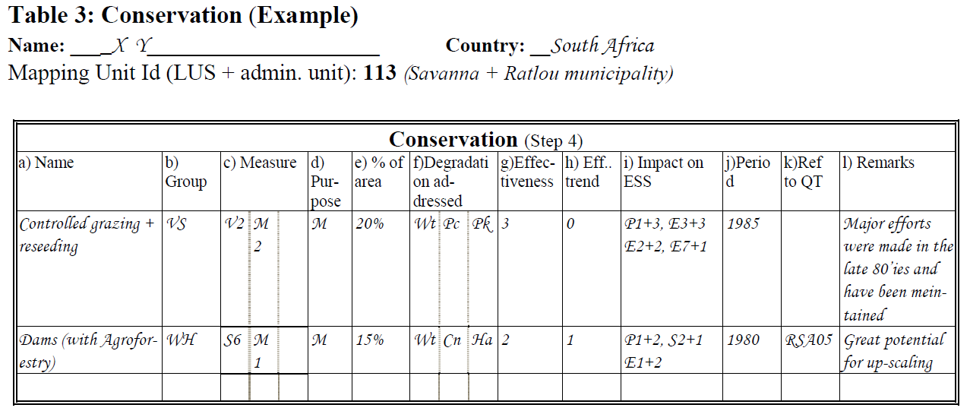
QM – Step 4: Sustainable Land Management
Conservation/SLM per LUS
Name / Group / Measure
Extent (area)
Effectiveness
Effectiveness trend
Impact on ecosystem services (type and level)
Degradation addressed
Data entry table:
Define the impact on ecosystem services (WOCAT 2008) including level of impact

Slide 33
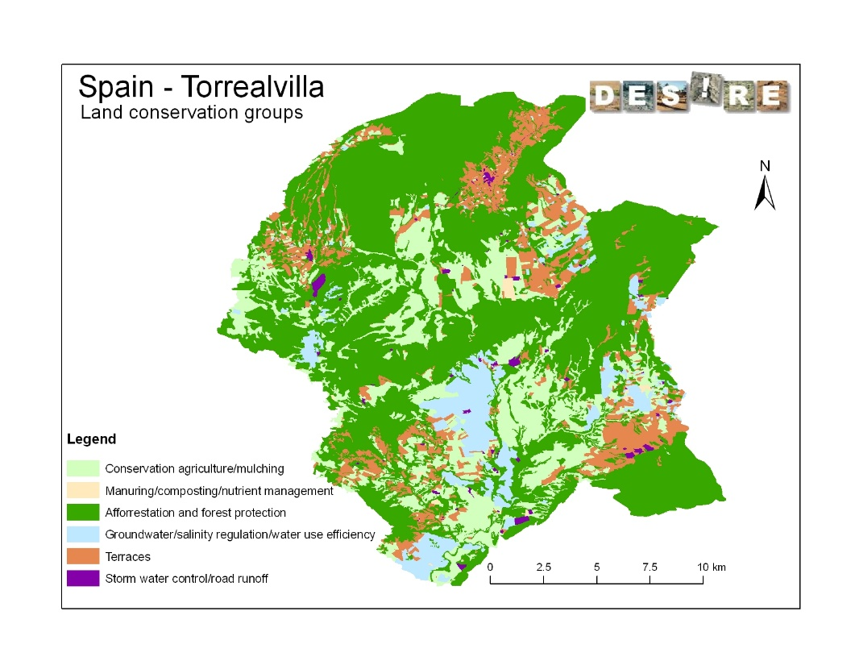
QM – Step 4: Sustainable Land Management
Name the most widespread SLM technologies for each mapping unit
CA: Conservation agriculture / mulching
NM: Manuring / composting / nutrient management
RO: Rotational system / shifting cultivation / fallow /slash and burn
VS: Vegetative strips / cover
AF: Agroforestry
AP: Afforestation and forest protection
RH: Gully control / rehabilitation
TR: Terraces
GR: Grazing land management
WH: Water harvesting
SA: Groundwater / salinity regulation / water use efficiency
WQ: Water quality improvements
SD: Sand dune stabilization
CB: Coastal bank protection
PR: Protection against natural hazards
SC: Storm water control, road runoff
OT: Other: (specify)

Slide 34
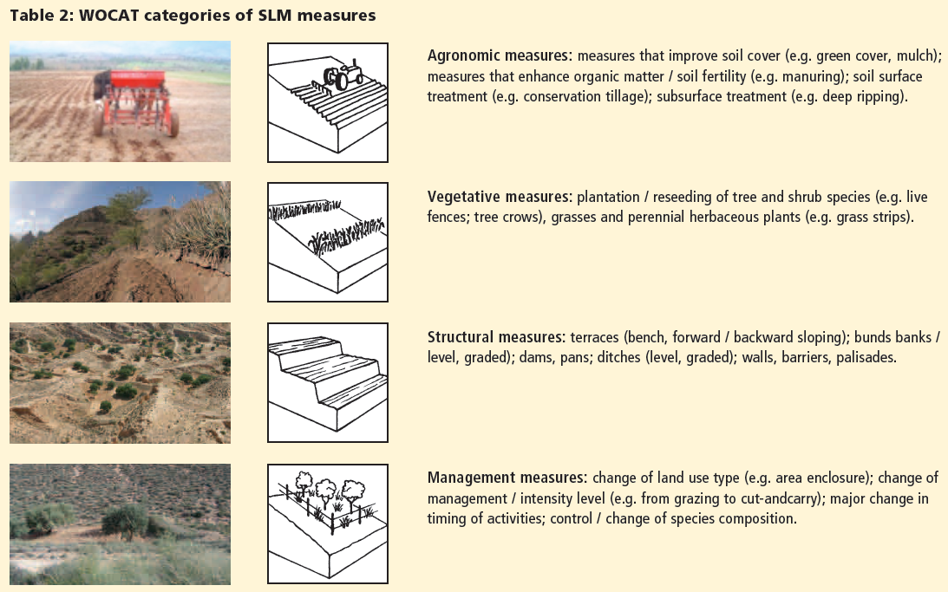
QM – Step 4: Sustainable Land Management
Related SLM measures (WOCAT categories)

Slide 35
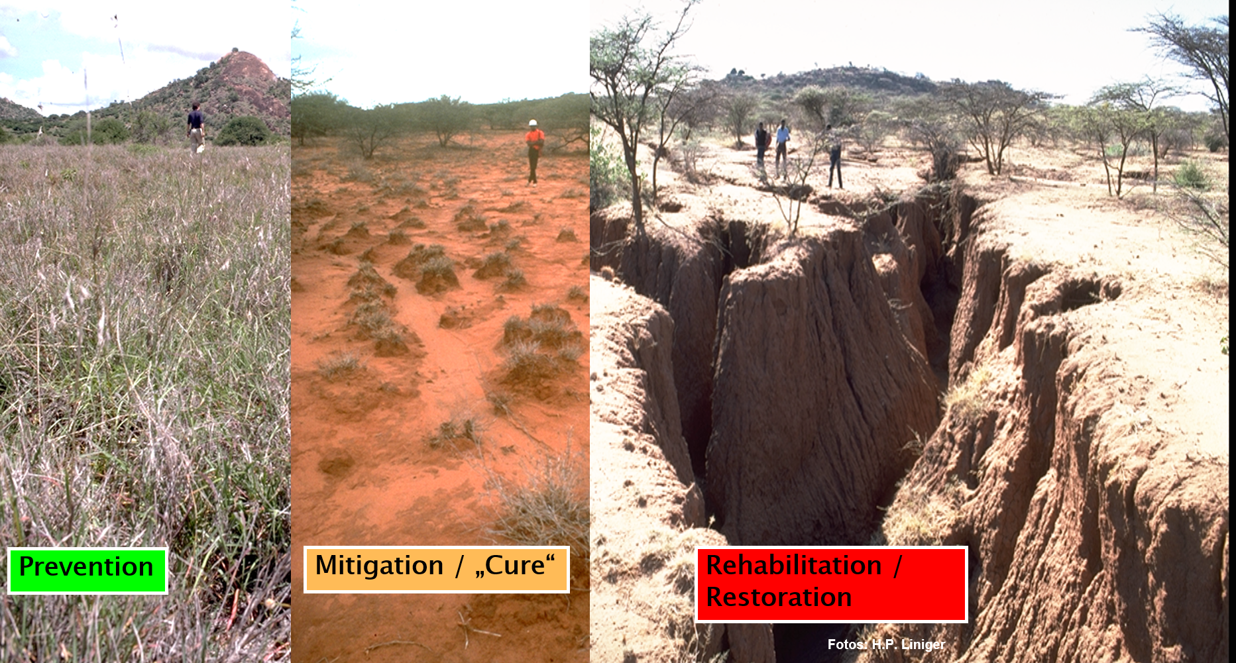
QM – Step 4: Sustainable Land Management
Purpose of the SLM technology

Slide 36
QM – Step 4: Sustainable Land Management
Determine the effectiveness of implemented SLM technologies (how much the technology reduces the degree of degradation or how well it is preventing degradation)
Determine the effectiveness trend (does the technology have a growing positive or negative impact on reducing degradation)
Determine the impact on Ecosystem Services

Slide 37
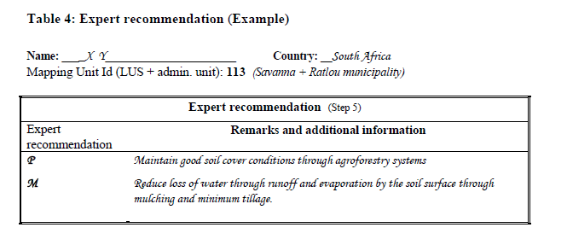
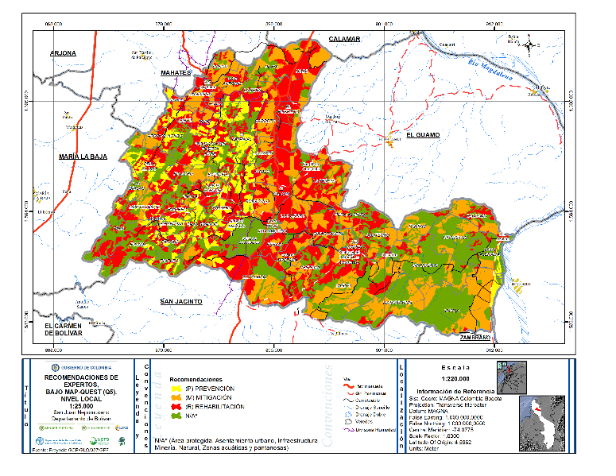
QM – Step 5: Expert recommendation
For each mapping unit, provide an expert recommendation concerning interventions on how to address degradation (maximum 2).
Decide on the best intervention using the following:
A Adaptation to the problem: the degradation is either too serious to deal with and is accepted as a fact of life, or it is not worthwhile the effort to invest in.
P Prevention implies the use of conservation measures that maintain natural resources and their environmental and productive function on land that may be prone to further degradation
M Mitigation: is intervention intended to reduce ongoing degradation.
R Rehabilitation: is intervention when the land is already degraded to such an extent that the original use is only possible with extreme efforts as land has become practically unproductive.
Data entry table:

Slide 38
QM – Available in 5 different languages
English
Spanish
Russian
Arabic
French
https://www.wocat.net/library/media/18/

Slide 39
Spatial assessment in Morocco
The process led to the development of a “Territorial Planning Pact” as a tool for land use planning and a 3-year action plan to help decision-makers implement and mainstream SLM in the selected communities

Slide 40
A list of good practices for potential implementation, which were selected by mutual agreement and with the actual commitment (financial and technical) of stakeholders (State and NGO) and taking into account the priorities of each commune;
Identification of local demonstration areas for testing good practices in each of the communes;
A multi-stakeholder dialogue on relevant approaches and strategies for the implementation and scaling up of SLM.
Identification of simple and measurable indicators for monitoring the impacts of the selected good practices and the degree of adoption of these practices.
The Territorial Planning Pact
A 3-year action plan to integrate SLM at the provincial level
Territorial pact
Presentation and validation of the methodology for designing the Territorial Planning Pact, with participation of the institutional parties, local authorities and local development associations and communities’ representatives.
Evaluation of training needs for implementing SLM: (workshops with all stakeholders, a series of meetings and interviews with project stakeholders)
Organization of a “training of trainers” workshop on the management of land resources and communication tools for the extension of sustainable land management.
Organization of a regional consultation workshop to select good SLM practices and implementation areas covering a broad spectrum of land use systems and practices and to promote territorial approaches for implementation in the three rural communes.

Slide 41
Country experiences: Turkiye LDN Action Plan
LDN Action Plan
https://projectgeffao.users.earthengine.app/view/ldn-turkey

Slide 42
Combination of layers
https://projectgeffao.users.earthengine.app/view/ldn-turkey

Slide 43
LDN ACTION PLAN in the LDN DSS
https://projectgeffao.users.earthengine.app/view/ldn-turkey

Slide 44
LDN ACTION PLAN in the LDN DSS
https://projectgeffao.users.earthengine.app/view/ldn-turkey

Slide 45
Thank you
Ingrid Teich, Senior Research Scientist, WOCAT-CDE
Ph credits: Carey Marks/Plymouth University

