Slide 1
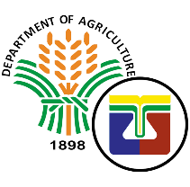
3rd Global Meeting: DS-SLM Project for Mainstreaming and Scaling up of Sustainable Land Management Crowne Plaza Hotel, Ankara, Turkey April 24-27, 2019 MS. FILIPINA Z. VENTIGAN Department of Agriculture-Bureau of Soils and Water Management
THE PHILIPPINES: NATIONAL ACHIEVEMENTS

Slide 2
DS-SLM FRAMEWORK

Slide 3
OPERATIONAL STRATEGY AND ACTION PLAN FOR MAINSTREAMING AND SCALING OUT SLM
MODULE 1

Slide 4
Implementation of Sustainable Land Management (SLM) Practices to Address Land Degradation and Mitigate Effects of Drought
Objective:
Strengthening SLM frameworks to address land degradation processes and mitigate the effects of drought to contribute in enhancing integrated natural resource management in the country.

Slide 5
Outputs:
1.Finalized the Integrated Land Management framework Plan and Guidelines for Mainstreaming Integrated Land Management Framework/Sustainable land Management (ILMF/SLM) into the Comprehensive Land Use Plans of LGUs.
2. Pilot the mainstreaming of SLM into the Strategic Plans of Department of Agriculture (DA) and Department of Environment and Natural Resources (DENR).

Slide 6
These are in consonance with the Thematic Programs of the:
Philippine Aligned National Action Plan to Combat Desertification Land Degradation (DLDD).
Mainstreaming SLM in Local Agricultural Landscapes.
Notes:
Thematic Programs (1) Agro-ecosystem Management (2) SLM Climate smart Agriculture (3) Watershed landscape management and rehabilitation (4) Scaling up best practices as SLM (5) Mainstreaming SLM is to agricultural landscape

Slide 7
National/Subnational Level Assessment
MODULE 2

Slide 8
National Level Assessment
Assessment of land degradation hotspots used the Land Use System (LUS) Map.
The state of Land Degradation adopts the Land Degradation Neutrality Target Setting Program (LDNTSP) using three (3) indicators and are now being used as baseline data for spatial planning:
Trends land cover change (LCC)- National Datasets
Land productivity dynamics (LPD)- UNCCD Dataset/Global Datasets
Soil Organic Carbon (SOC)
National datasets
Data Sources: Land Cover Map 2003, Land Cover Map 2010, Soil Survey Reports for Organic Carbon
Notes:
Notes: Currently, the LD 2015 assessment is on-going. We are conducting consultation workshops with partner agencies. In addition, we do ground validation to verify the correctness of national datasets available..
National Mapping Resources and Information Authority (NAMRIA) – National Mapping arm of the Philippines. provides national datasets

Slide 9
National Level Assessment
The National Level Assessment for the period was anchored on the Land Degradation Neutrality (LDN) Target Setting Program that mapped LDN baselines and priority targets for SLM adoption and implementation. The following activities were undertaken: Submission of UNCCD National Report in August 2018 (LD 2010 Assessment). Conducted two (2) consultation meetings for the on-going assessment LD 2015: UNCCD National Report Consultation Meeting in August 2018; Luzon-Wide Consultation Workshop: UNCCD Reporting Process in November 2018. Conducted Workshop on Gender Mainstreaming in LDN Programming in October 2018; National Drought Plan Workshop in October 2018; (SO3. Mitigating, adapting to, and managing the effects of drought in order to enhance resilience of vulnerable populations and ecosystems); Update: Three consultation workshops (Visayas: March 2019 ; Mindanao Island: June 2019; National Consultation: August 2019 ) in collaboration with National Agencies and Private sectors. Ground validation on the Assessment of Land Degradation (LD) is on-going through the use of Unmanned Aerial Vehicle (UAV)
Notes:
Notes: Land cover 2010 and 2015 assessment is available through the LDNTSP-UNCCD. The trends.earth extension of QGIS is being used to assess the LD.

Slide 10
Subnational Level Assessment
Assessment of priority river basin and delineation of provinces within the river basin under LDN TSP;
Partnership with policy institutions and financing mechanisms.
Notes:
Cagayan River Basin, Pampanga River Basin, Mindanao River Basin, Cagayan De Oro River Basin.

Slide 11
Selection of Priority Landscapes
MODULE 3

Slide 12
Land Use Management Options and Soil Conservation Measures recommended in different landscapes/ topography.
Prime agricultural land (0 – 3% slope) Cropland (3 – 8% slope) Modified cropland (8 – 18%slope) Diversified cropland (18 -30% slope) Plantation/orchard and pasture (30 – 50% slope)

Slide 13
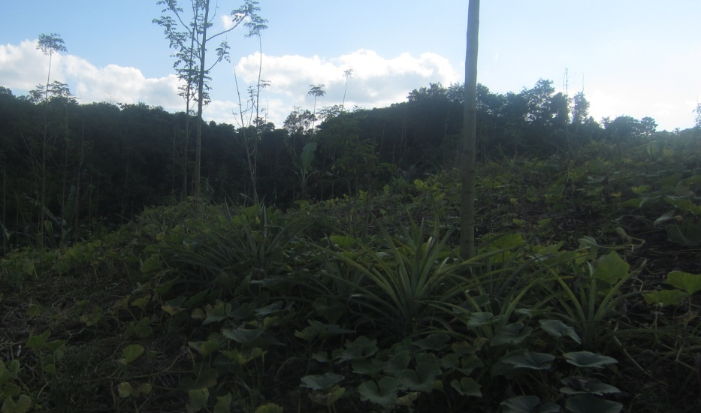
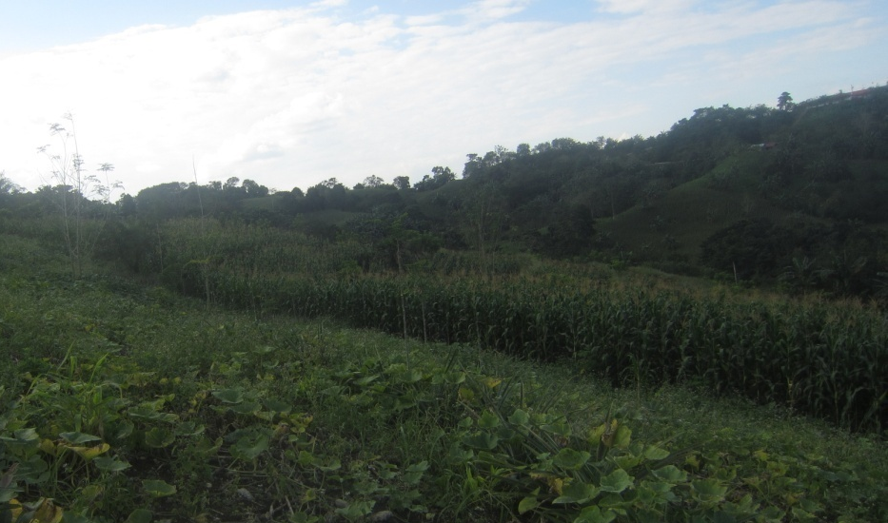
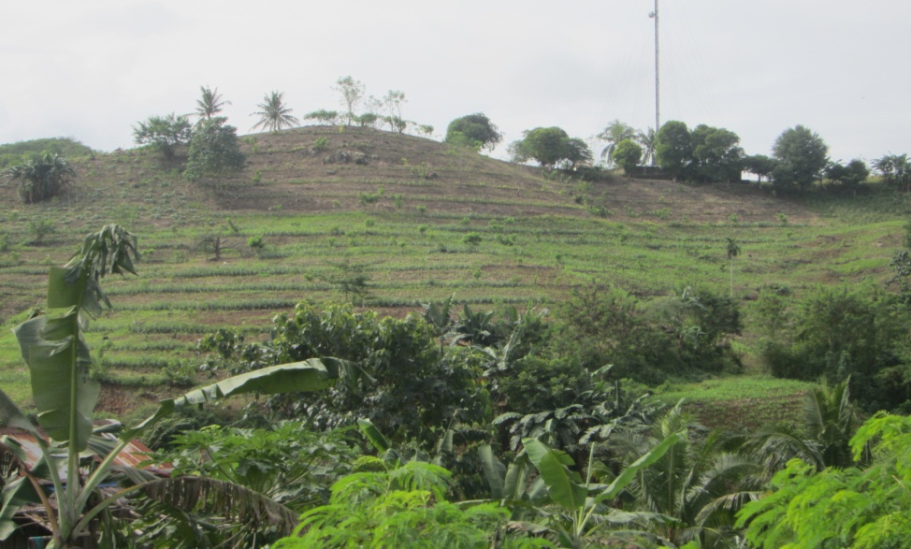
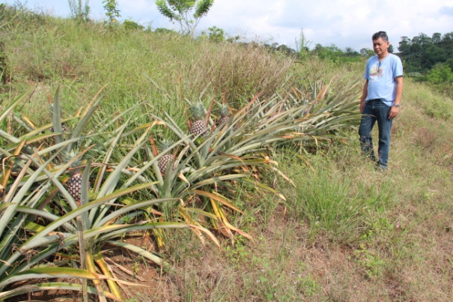
A total of sixteen (16) techno-demo farms were established last 2017 in different regions.

Slide 14
Landscape level assessment
MODULE 4

Slide 15
Selecting of appropriate technologies to upland development considers the biophysical characteristics and other land limitations
Baseline data and information will be generated/collected:
Topographic map
Soils and land use data (including maps)
Agro-meteorological information
Agro-economic information
Hydro-meteorological data
In addition, appropriate technologies will be selected based from the agro-socio-economic characteristics of the site.

Slide 16
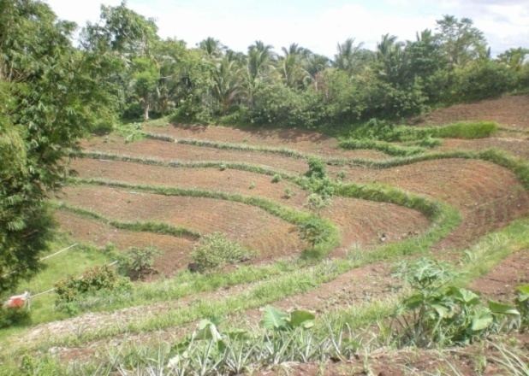
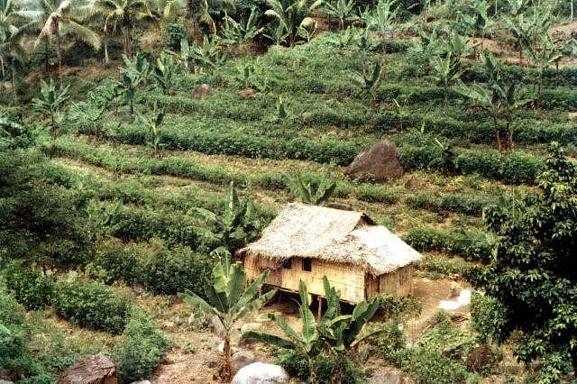
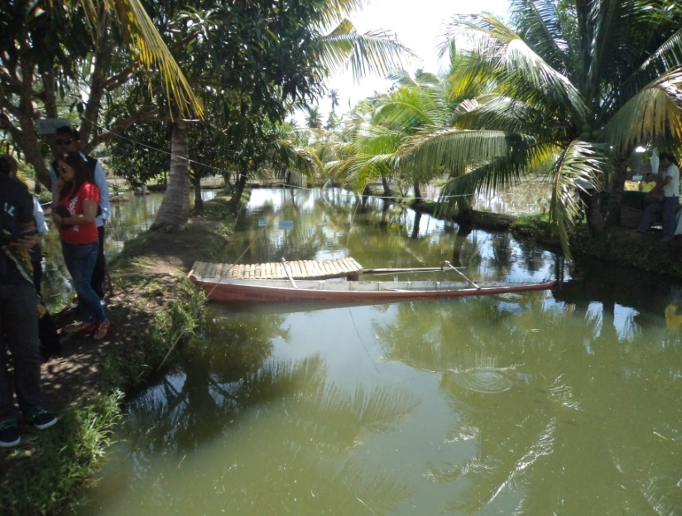
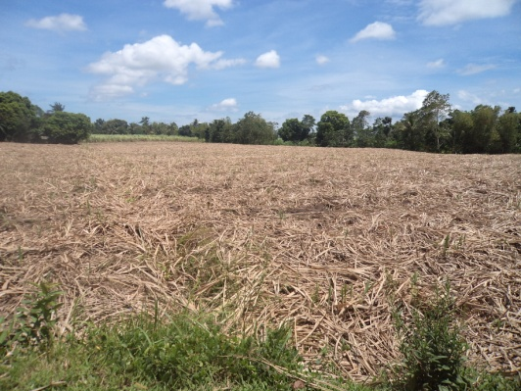
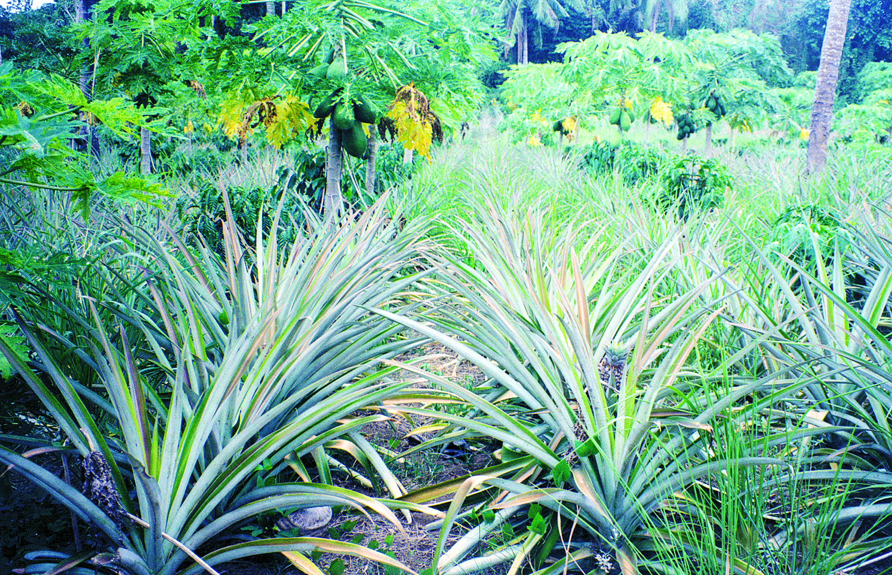
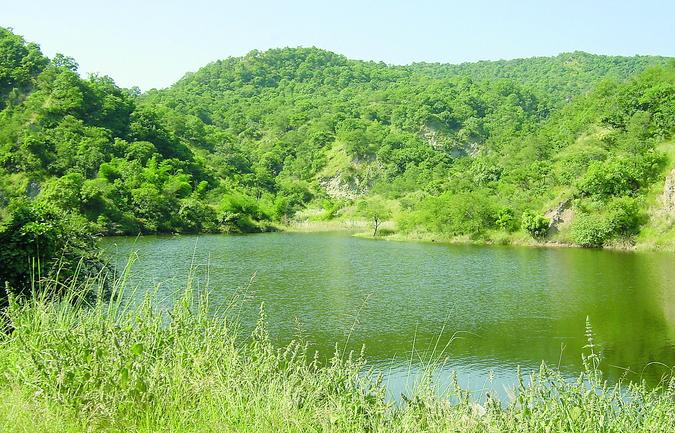
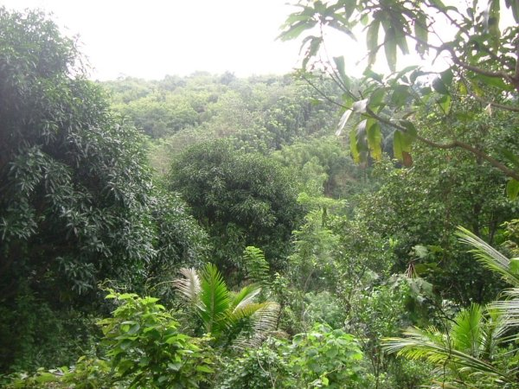
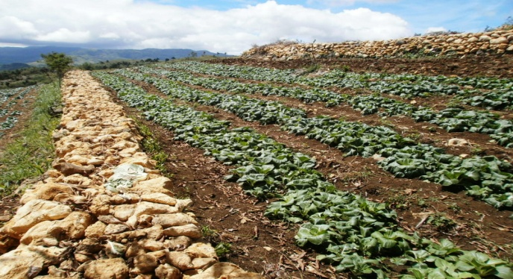
Some identified best SLM practices
Some identified best SLM practices
Sloping Agricultural Land Technology
Vegetative strips
ResiduesManagement
Rainwater harvesting
Stone Wall Terraces
Watershed Forest Protection
Multi-storey cropping a
Agro-forestry

Slide 17
SLM Territorial Planning
MODULE 5
Vegetative strips

Slide 18
Establishment of community-based and farmer-managed techno-demo farms cum learning centers on soil and water conservation;
Promote and disseminate effective soil and water conservation approaches and technologies for broader adoption;
Capacitate the LGUs in the promotion and implementation of soil and water conservation measures at the local level; and
Develop a strong linkage and partnership among national agencies, local stakeholders and farmers in the implementation of the program.
Vegetative strips

Slide 19
SLM Implementation and Scaling out
Module 6
Vegetative strips

Slide 20
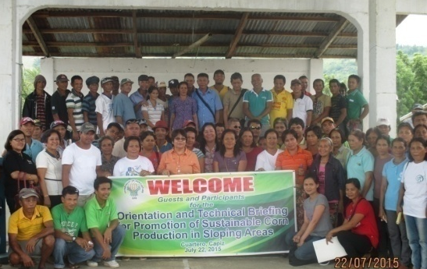
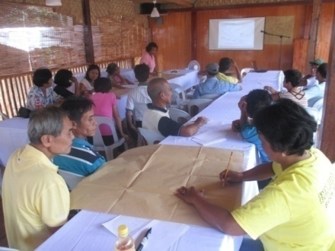
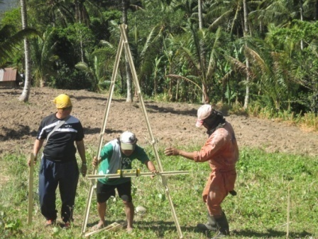
Mainstreaming and scaling out of technology demonstration farm on soil erosion control and soil fertility management in the agricultural program of the LGUs.
Vegetative strips
Corn cluster areas in the country, particularly sloping areas with established Sustainable Corn Production in Sloping Areas (SCoPSA) were selected for establishment of techno-demo farms (TDF).
Components of the program include information and advocacy campaign; training, education and extension; establishment of a Community-Based SCoPSA Model Farms; and regular monitoring

Slide 21
The implementation of SLM was initiated in sloping areas being cultivated to herbicide-resistant corn varieties to prevent and control soil erosion. The following activities were undertaken to facilitate scaling out of SLM: Conducted awareness-raising and advocacy campaign through technology briefing to 850 farmers and agricultural technicians as participants; Conducted 11 specialized capacity building activities on soil conservation and management.
Vegetative strips

Slide 22
Knowledge management platform for informed decision making
Module 7
Vegetative strips

Slide 23
“Development of Decision Support Tools on Sustainable Land Management (SLM) as a Key to Address Abiotic Stresses in Areas Vulnerable to Climate Change”
Objective:
To document SLM approaches and technologies by adopting the documentation tools and methodologies of World Conservation Approaches and Technologies (WOCAT).
Vegetative strips

Slide 24
Project Outputs
Documented 22 technologies and 6 approaches covering five (5) ecosystems.
Vegetative strips
Notes:
This wealth of knowledge can be found in the landscape where there is a plethora of sustainable land management practices that provide solution to specific LD problem from the highland down to coastal zone. Documented SLM practices consist of 34 SLM technologies and 9 approaches representing specific functions in the landscape; namely soil fertility management, water management, runoff management and erosion control (structural measures and vegetative measures), enrichment planting and protection of vegetative cover, fire and wind breaks, and biological pest control.

Slide 25
Project Outputs
Conducted trainings and workshops on WOCAT SLM documentation tools, processes and methodologies Development of decision support tool in Java script. A spreadsheet on Financial Analysis as another decision. support tool in the selection of appropriate SLM practices. A compilation of SLM practices consists of summarized case studies (WOCAT format) was produced with 600 printed copies. IEC materials in form of leaflets/flyers in English and translated to three local dialects were also generated. Processed documentation (multi-media documentation- can be accessed through Youtube). Established on-line database on SLM knowledge management: http://www.bswm.da.gov.ph/philcat-slm/
Vegetative strips

Slide 26
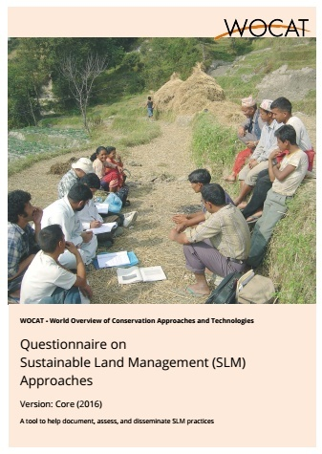
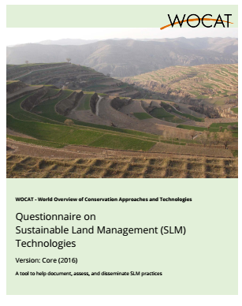
Vegetative strips
The WOCAT questionnaires on approaches and technologies used as basis for documentation of sustainable land management practices.

Slide 27
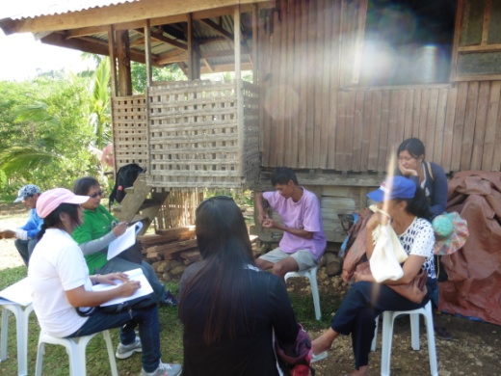
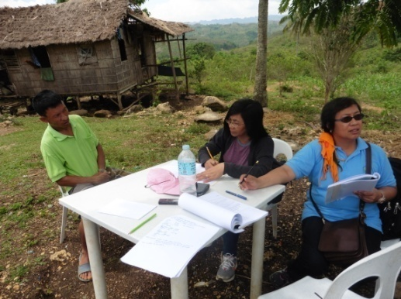
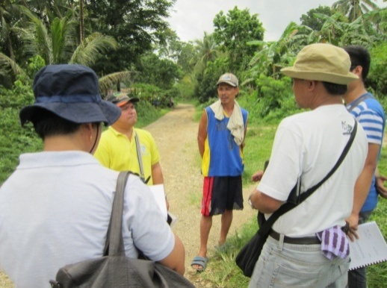
Farmers/Practitioners Interviewed

Slide 28
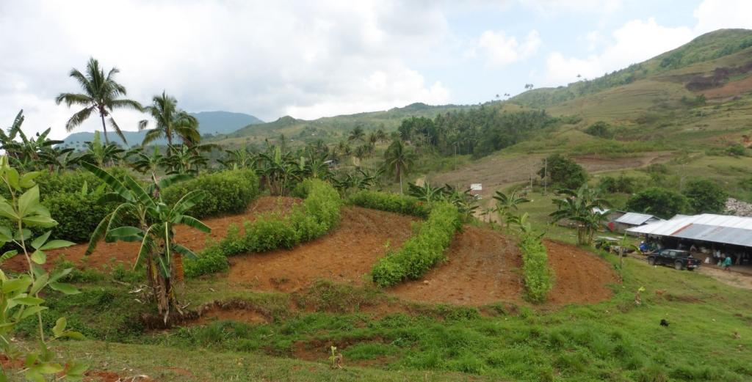
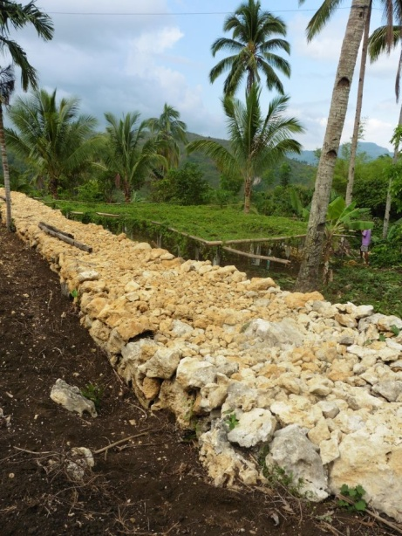
Some SLM Best Practices Documented
Conservation Farming Village that implements hedgerow planting
Rockwall Terracing

Slide 29
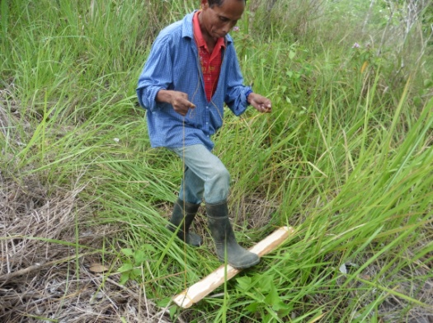
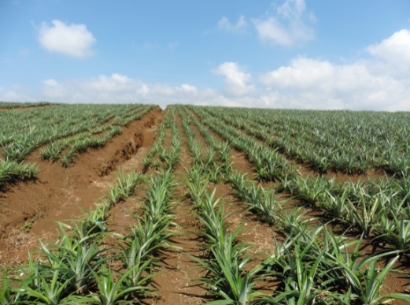
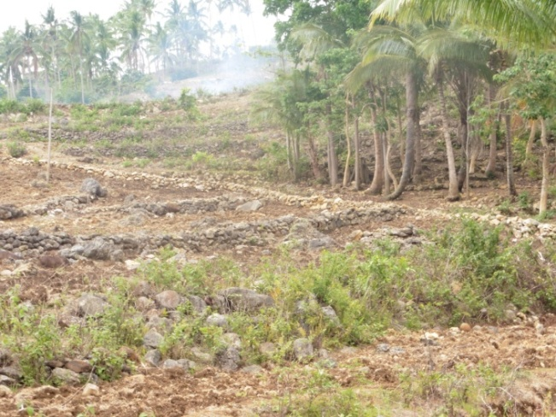
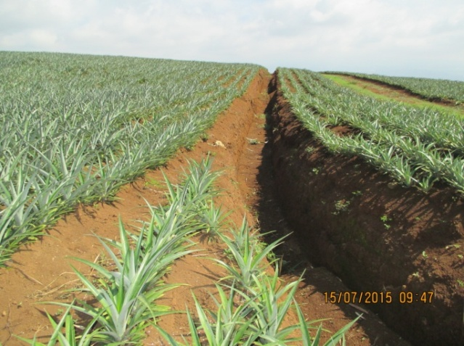
Pressing of cogon
Contour Block Lay out
Trees as windbreakers and buffer
Silt traps, cascading catchment canal and catch basins as sediment traps

Slide 30
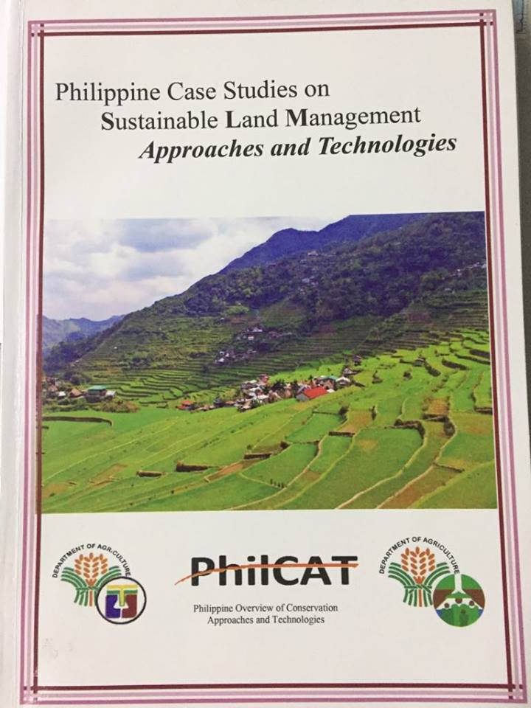
A compilation of SLM practices consists of summarized case studies (WOCAT format)
Notes:
We also published a book titled “Philippine Case Studies on Sustainable Land Management Approaches and Technologies” which compiles the summary profiles 34 SLM Technologies and 9 Approaches generated from the WOCAT database. We distributed copies to national government agencies, local government units, CSOs.

Slide 31
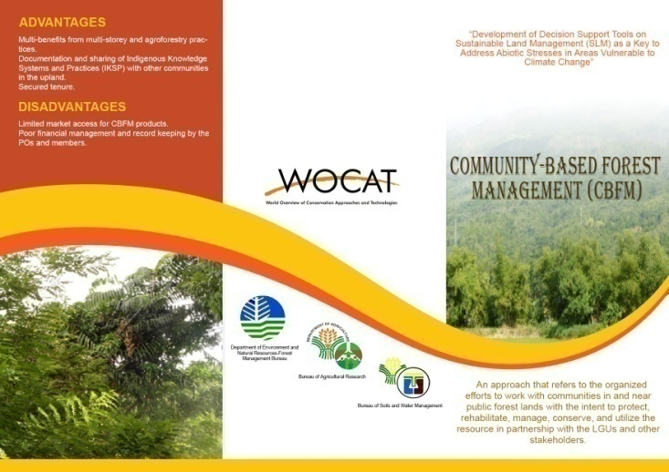
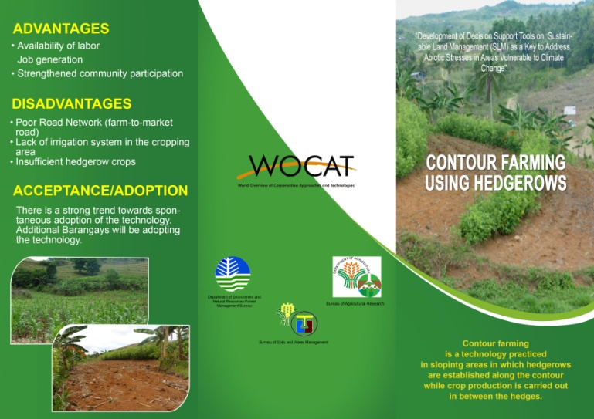
Sample cover of the IEC materials on SLM technologies and approaches
Notes:
Meanwhile, we also produced simplified and laymanized IEC materials for each technology and approach. Written in English and 3 major Philippine dialects, we are distributing these materials to land users and farmers during farmers trainings and other related events.

Slide 32
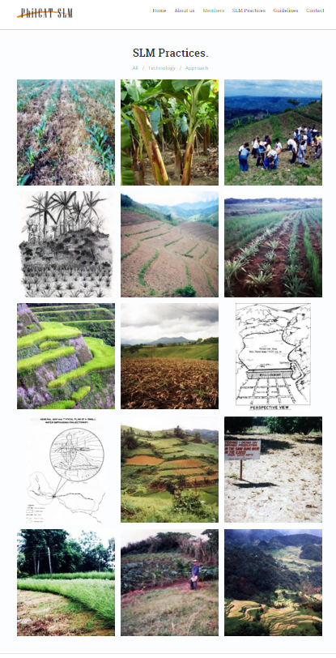
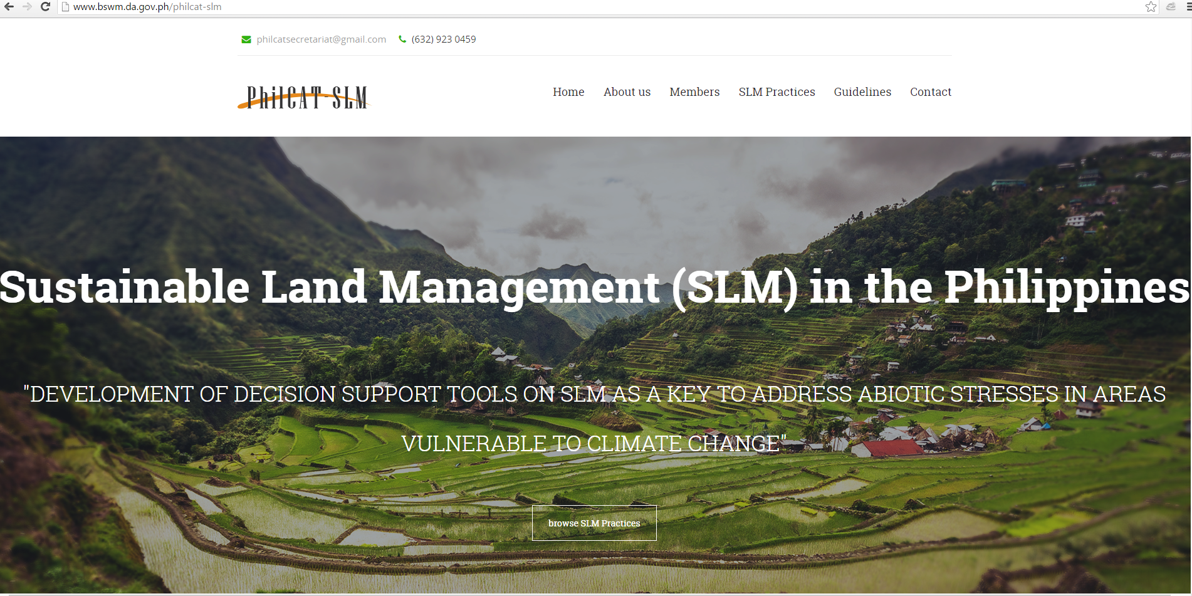
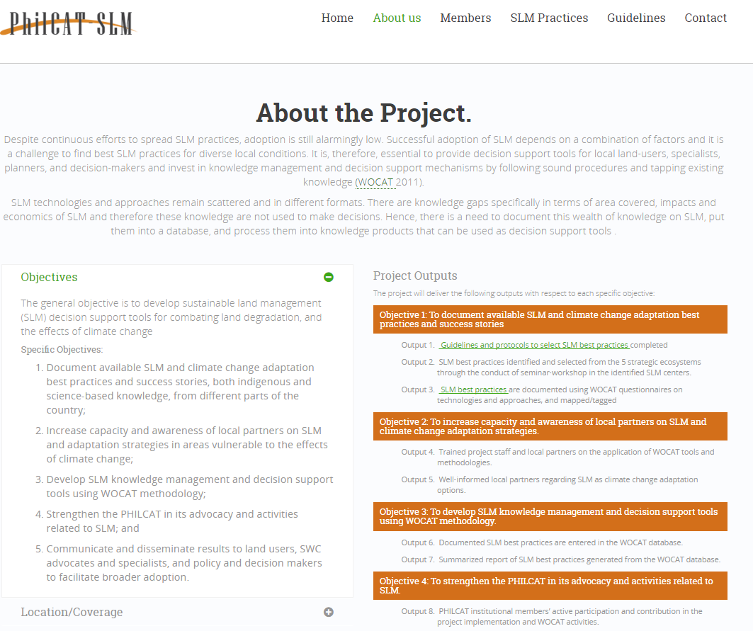
Documentation of SLM PRACTICES
SLM PhilCAT Web site
G. Schwilch
32
Notes:
Profile summaries in WOCAT format of documented 34 SLM technologies and approaches can be accessed from the PhilCAT website. It also contains videos of some selected SLM practices with landusers providing testimonies about the technology. The decision support tool considers the selection of appropriate practice with respect to specific ecosystem, type of conservation measures, main function of the practice, and type or form of LD. Each technology and approach was rated accordingly with respect to production and socio-economic benefits, socio-cultural benefits, ecological benefits, and offsite benefits as bases in making decision.

Slide 33
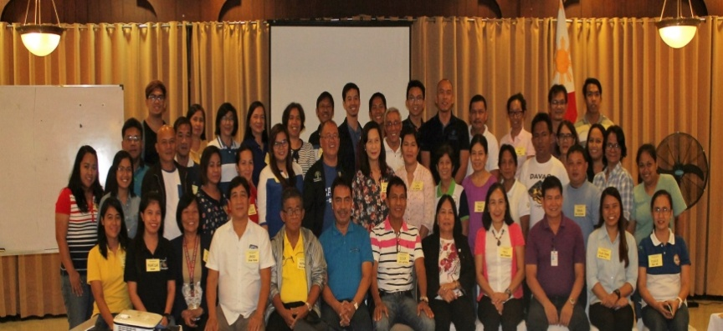
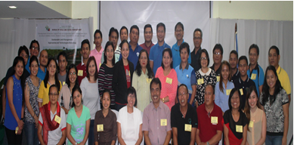
Participants during the National Consultation Workshop
Workshops in North and South Luzon, Visayas and Mindanao

Slide 34
Work Plan from April 2018-April 2019
Training on local degradation assessment.
2. Training on the use of new QT & QA with PhilCAT members and selected LGUs and DA-RFOs as participants.
Documentation of additional approaches technologies using new QT & QA.
Presentation of output cum workshop.
Project meetings.
6. Final output presentation.

Slide 35
Training Workshop on the Use of New WOCAT Questionnaires on Technologies and Approaches
February 20-22, 2019
Training on Improved Decision Making Through GIS Platforms
February 26-March 1, 2019

Slide 36
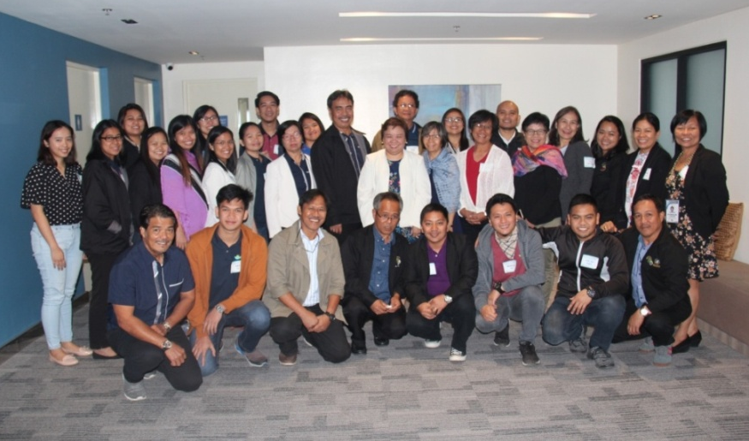
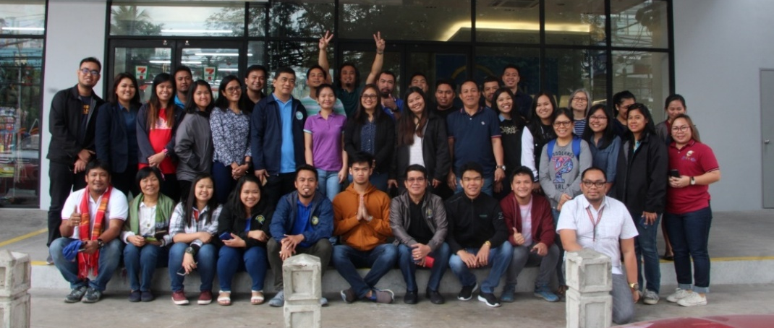

Slide 37
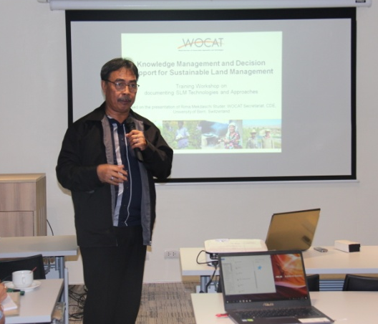
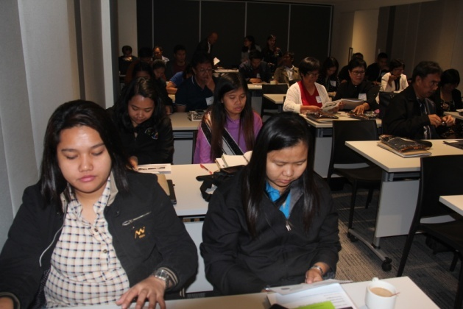
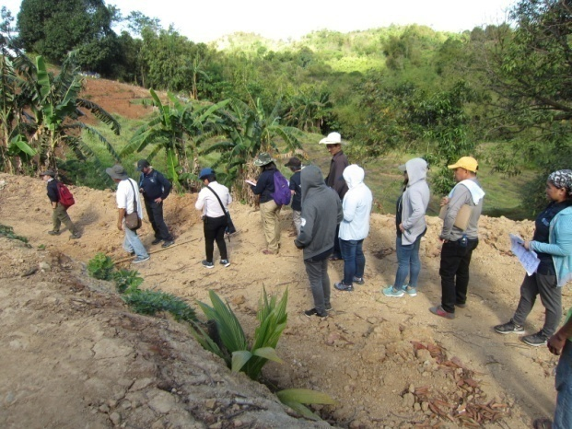
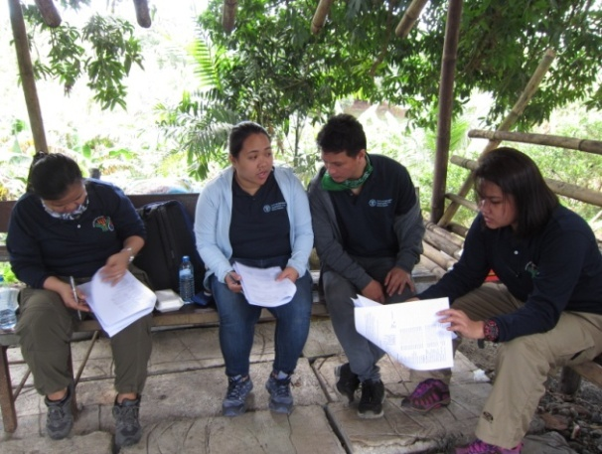
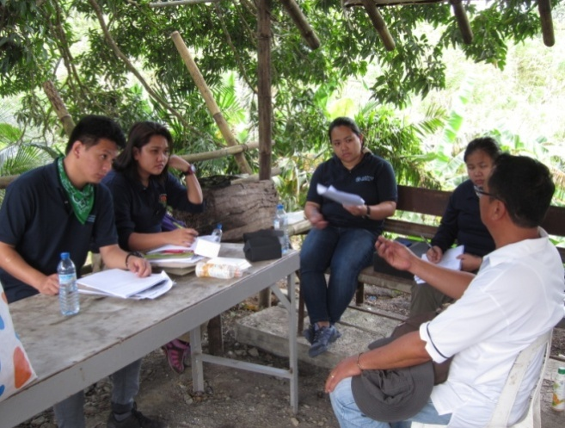
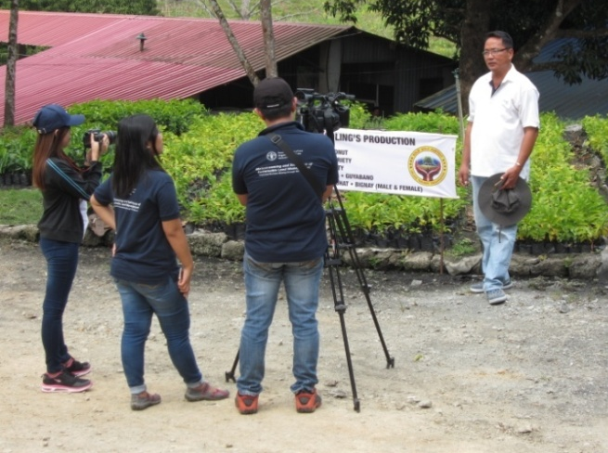
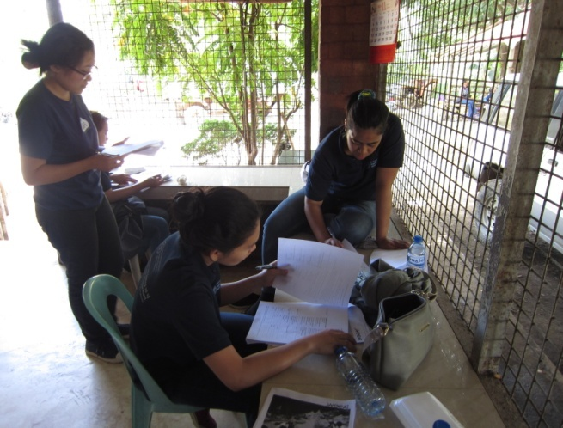
Field practicum

Slide 38
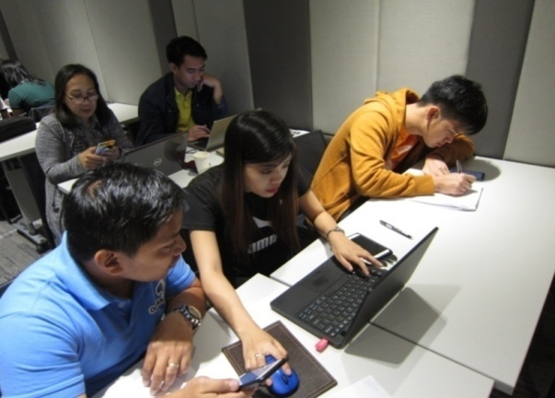
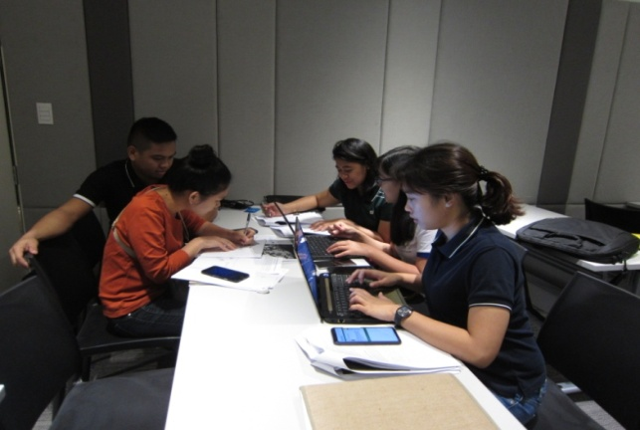
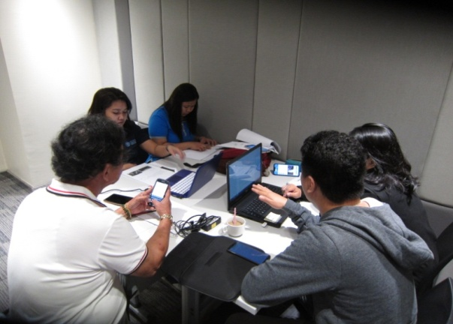
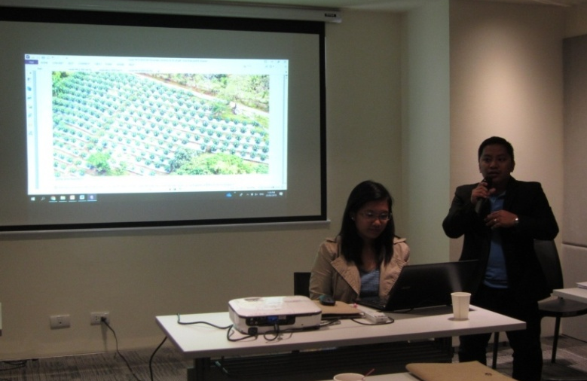
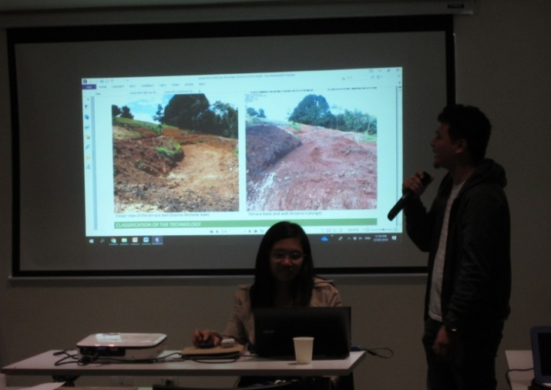
Data entry and output presentations

Slide 39
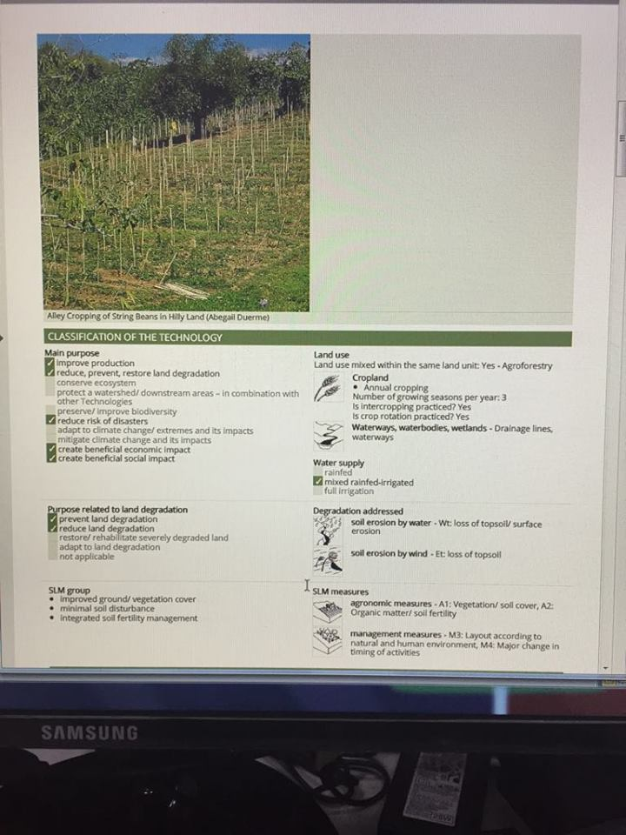
Workshop outputs

Slide 40
For review: Documented SLM

Slide 41
For review: Documented SLM

Slide 42
Training on Improved Decision Making Through GIS Platforms

Slide 43
WAY FORWARD
Crafting of proposal focusing on the SLM Mainstreaming;
Continued activity to capacitate technical staff: GIS platform as a tool for LD;
Continued activity on the promotion of SLM through consultations.

Slide 44
Thank you

